Slide 1

Holding Government Accountable

Slide 2
Local Government

Slide 3
Learning Objectives
By the completion of this learning unit, you will be able to:
  Define local government
  Identify at least 1 type of local government
  Identify at least 1 opportunity to get involved in local government

Slide 4
What is Local Government?
Local government are the entities that consist of elected officials, appointed officials, and bureaucracies that discuss and adopt local laws and regulations that effect the day-to-day lives of residents within a specific geographic region
Local governments have some autonomy, but are governed by state and federal laws and regulations

Slide 5
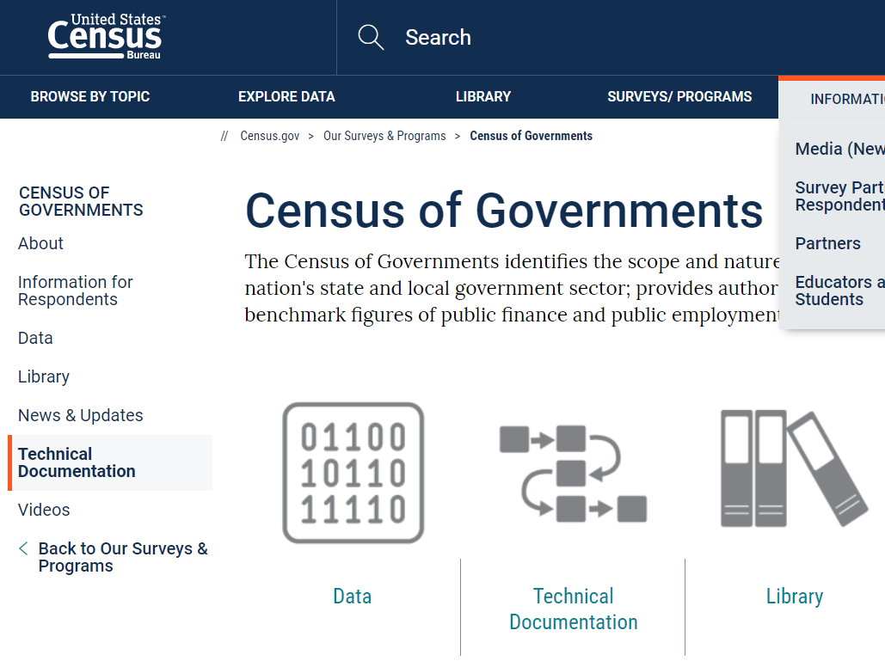
Census of Governments
“The Census of Governments identifies the scope and nature of the nation's state and local government sector; provides authoritative benchmark figures of public finance and public employment.”

Slide 6
Types of Local Government
County
Municipal (aka Cities or Townships)
School district
  Elementary
  High School
  Unified
  Community College
Special district
  24 - Local Fire Protection
  02 - Cemeteries
  88 - Soil and Water Conservation
  32 - Health
  98 - Sewerage and Water Supply
  91 - Water Supply Utility
  99 - Other Multi-function Districts
  40 - Hospitals
  64 - Irrigation
  01 - Air Transportation
  59 - Other Natural Resources
  80 - Sewerage
  89 - Other Single Function Districts
  09 - Education
  61 - Parks and Recreation
  81 - Solid Waste Management
  03 - Miscellaneous Commercial Activities
  94 - Public Mass Transit Utility
  52 - Libraries
  62 - Police Protection
  44 – Highways
  …And there are other types

Slide 7
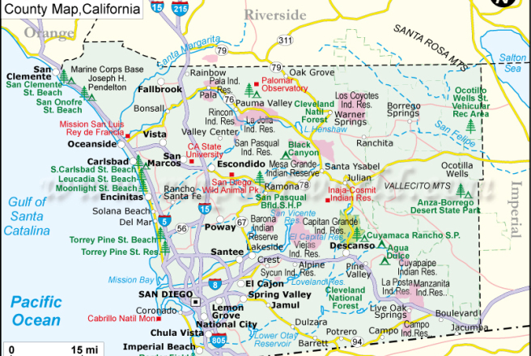
Map of County Where Your Campus is Located

Slide 8
Examples of Local Governments in Region
County
Hyperlink to County Here
Municipal
Hyperlink to City Here
School district
Hyperlink to School District Here
Special district
Hyperlink to Special District here

Slide 9
How can I get involved?
Find a local government you are interested in
1
Visit their website
2
Attend a public meeting
3
Give a public comment
4

Slide 10

Discussion

Slide 11

State Boards and Commissions

Slide 12
Learning Objectives
By the completion of this learning unit, you will be able to:
  Explain what State Boards and Commissions are
  Describe the Appointments process
  Identify at least one State Board or Commission you would be interested in attending, speaking at, or serving on

Slide 13
What are State Boards and Commissions?
Every U.S. state, like the U.S. Federal Government, has three branches of government: legislative, executive, and judicial.
The Executive Branch consists of State Boards and Commissions.
State Boards and Commissions are legally established entities that have convening, oversight, and/or regulatory power of specific policy areas, professions, and/or geographic areas.

Slide 14
Is there a List of State Boards and Commissions?
Hyperlink to Your State’s Boards and Commissions Here

Slide 15
What is the Appointments Process?
Gubernatorial
Legislative
Other

Slide 16
Gubernatorial Appointments
How to Apply for a Governor-Appointed Position?

Slide 17
Legislative Appointments
How to Apply for a Legislature-appointed Position?
Notes:
Source: https://a25.asmdc.org/article/how-get-appointed-boards-and-commissions

Slide 18
Other Appointments
How to apply for Other appointments on State Boards and Commissions?
  Individual directly applies to the board or commission
  Individual indirectly applies through a statewide association or organization

Slide 19
How do I choose a Board or Commission to Attend?
What are you interested in?
What is your declared major?
What is your intended career?
What are you concerned/worried about?
What do you want to develop an expertise in?

Slide 20
How can I speak at a Board or Commission?
What are you concerned/worried about?
What do you want to develop an expertise in?
What are you being effected by?
What is a concern in your community?

Slide 21
Discussion

Slide 22
Questions for Discussion
Do you want to serve in an appointed position? Why or why not?
Which Board or Commission did you choose to attend? Why?
Would you deliver a public comment at a Board or Commission? Why or why not?
What questions do you have about delivering a public comment at a Board or Commission?
What are the pros and cons of being appointed to a Board or Commission versus directly lobbying a Board or Commission?

