Slide 1
Student Power

Slide 2
Learning Objectives
By the completion of this learning unit, you will be able to:
  Define student power
  Identify at least 1 opportunity to exercise your student power on-campus
  Identify at least 1 opportunity to exercise your student power off-campus

Slide 3
What is Student Power?
Student power is the social and political power inherently held by students
Students are individuals enrolled K-16+ educational institutions, like elementary school, high school, community college, 4-year universities, and graduate schools
Students represent the future, therefore they are a social force
Students represent the future voters, therefore they are a political force

Slide 4
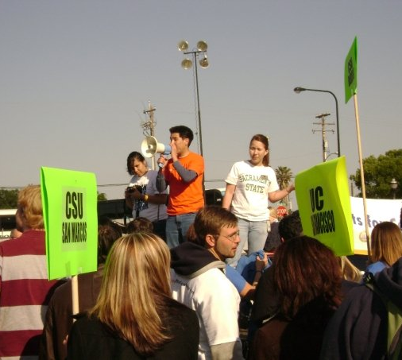
Why is Student Power Important?
Student power is important because it is understudied, undervalued, and underestimated
However, students become self-aware, they can unlock their power and help others unlock their power

Slide 5
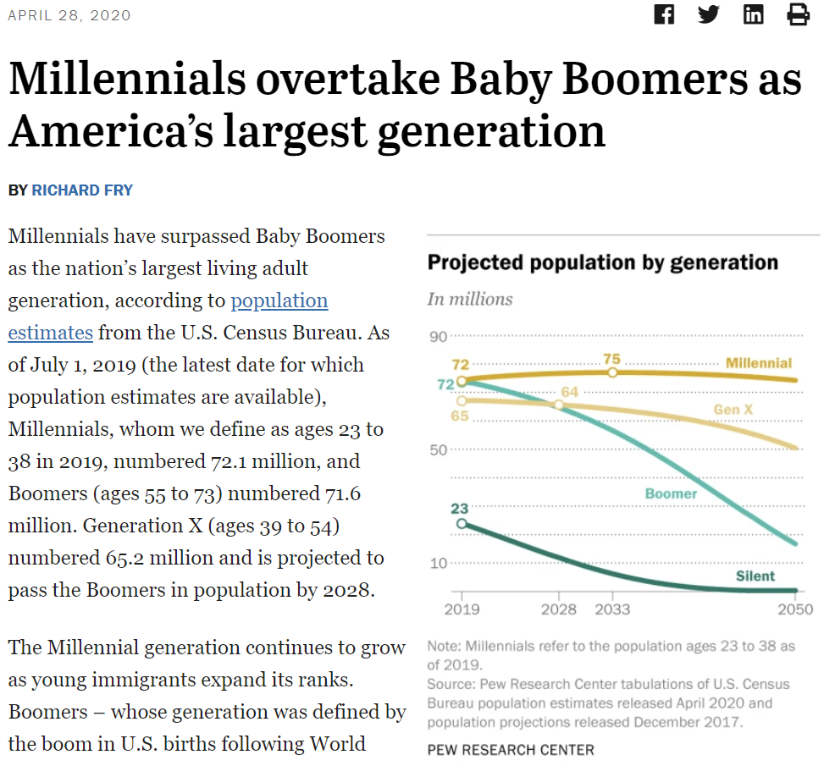
The Next Generation

Slide 6
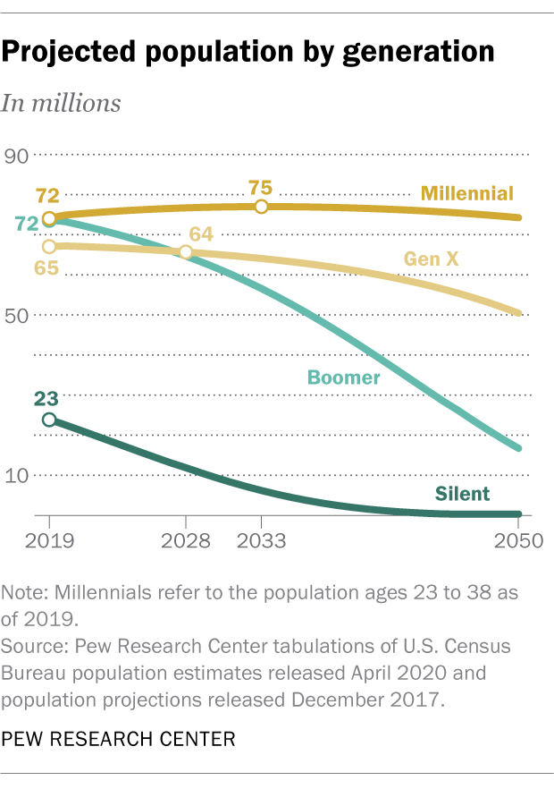
Notes:
Source: Millennials outnumbered Boomers in 2019 | Pew Research Center

Slide 7
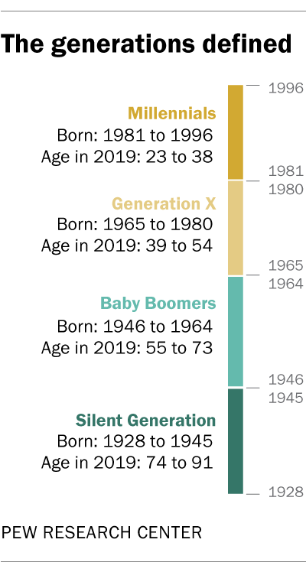
Notes:
Source: Millennials outnumbered Boomers in 2019 | Pew Research Center

Slide 8
What can I do On-Campus?
Student Government
Student Clubs and Organizations
College/University Governance Councils and Committees
Community College District Governing Board

Slide 9
Student Government

Slide 10
Student Clubs and Organizations

Slide 11
College/University Governance Councils and Committees

Slide 12
What can I do Off-Campus?
City Commissions
County Commissions
State Boards and Commissions

Slide 13
City Commissions

Slide 14
County Commissions

Slide 15
State Boards and Commissions

Slide 16

Discussion

Slide 17
Question for Discussion
What are the pros and cons of exercising power on-campus versus off-campus?
What are at least three reasons why students engage in politics?
What are at least three reasons why students disengage from politics?
What are at least three tools that students need to effect policy change?
Is voting the only power that students have? Why or why not?

Slide 18

Further Reading
Margolin, Jamie, and Greta Thunberg. 2020. Youth to Power: Your Voice and How to Use It. Hachette Go. https://www.amazon.com/Youth-Power-Your-Voice-How/dp/0738246662.

Slide 19
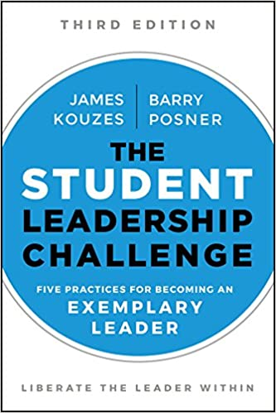
Further Reading
Kouzes, James M., and Barry Z. Posner. 2018. The Student Leadership Challenge: Five Practices for Becoming an Exemplary Leader (J-B Leadership Challenge: Kouzes/Posner). 3rd ed. Jossey-Bass. https://www.amazon.com/Student-Leadership-Challenge-Practices-Exemplary/dp/1119421918/

Slide 20
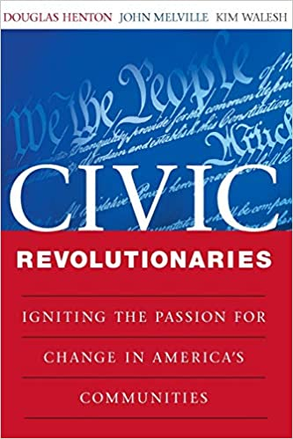
Further Reading
Henton, Douglas, John G. Melville, and Kimberly Walesh. 2003. Civic Revolutionaries: Igniting the Passion for Change in America’s Communities. 1st ed. Jossey-Bass. https://www.amazon.com/Civic-Revolutionaries-Henton/dp/0470447648/

