Slide 1
TLC Workshop Playing Games to Teach Comparative Politics 2020
Victor Asal vasal@albany.edu
Joseph W. Roberts jroberts@rwu.edu

Slide 2
Before We Start
Thanks for attending
We have never done this online before and apologize for any glitches
  We hope it goes well
  We are also looking forward to suggestions from others for ideas as well
Want More? Slides, Articles, Chat?
  Feel free to email us and we would be happy to send you material or talk.

Slide 3
Introduction
Welcome everyone
For some games we will do them all as a group and for some we will go into breakout rooms
The goal is to provide you with games and exercises you can use to teach comparative politics focusing on the meta-theories of Structure, Culture and Rational Actor
We have 90 minutes — we will keep going till we run out of time

Slide 4
Why Use Simulations?
Engage students in ways that lectures cannot
Encourage students to exercise judgment
Allow students to create reservoir of experience
Give added motivation and urgency
Offer “three-dimensional learning”

Slide 5
Disadvantages of Simulations
Take time away from required curriculum, from other educational choices
Involve considerable set-up time and effort by educator
Require cooperation by students

Slide 6
How Do Simulations Teach?
Simulation-related preparation
Participating in the simulation
Stopping the action to reflect at points in the simulation
Oral debriefing
Written debriefing
Cases to be referenced in exams

Slide 7
Simulation Outcomes
Increased understanding of issues and their complexity
Greater appreciation for connections among issues
More realistic view of the workings of the system
Improved comprehension of the negotiation process
Greater sensitivity to cultural differences

Slide 8
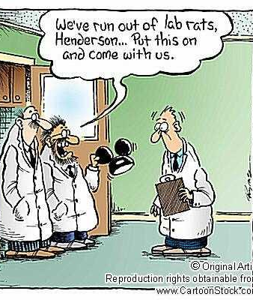
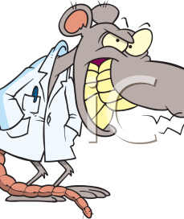
The bottom line: students get to be lab rats in their own experiments.
Let’s Play

Slide 9

Two Volunteers

Slide 10
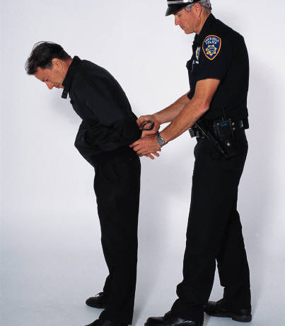
Prisoner’s Dilemma I
You and your partner in crime have been picked up for a bank robbery.
You have been placed in separate rooms and are being interrogated.
Do you remain silent or squeal to the police?

Slide 11
Prisoner’s Dilemma II
If both of you remain silent, you split the proceeds and both get $50,000 but …

Slide 12
Prisoner’s Dilemma III
If one of you remains silent and the other squeals, then the one who remains silent has the book thrown at her and goes to jail for 10 years.
The squealer on the other hand …

Slide 13
Prisoner’s Dilemma IV
Goes free with the thanks of the court and keeps your past ill-gotten gains of $100,000 and lives happily ever after.

Slide 14
Prisoner’s Dilemma V
If you both decide to talk, then you both go to jail. Since both cooperated with the police you both get put away, but only for two years.

Slide 15
Prisoner’s Dilemma VI
If we translate this into points, then:
  If both squeal, each gets -2
  If both remain silent, each gets +5
  If one squeals, that person gets +10 and the other gets -5

Slide 16
The two volunteers can message us what they wrote
Why?

Slide 17
Break Out Rooms
We will put you into a room with one other person
Play one iteration and then come back

Slide 18
Poll — What did you choose?
Discussion
  Why did you pick the choice you picked?
If you were doing multiple times, would it make a difference?

Slide 19
Now we are sending you back to a room
Please play prisoner’s dilemma 3 times and then come back

Slide 20
How did it go?
Did multiple iterations make a difference?

Slide 21
Now we are sending you back to a room
Please play Prisoner’s Dilemma as many times as you can until we call you back – could be two minutes or 20

Slide 22
How did it go?
Did endless make a difference?

Slide 23
Prisoner’s Dilemma in a Group
If all remain silent, everybody gets +5
If all talk, everyone gets -2
If one person talks and everyone else remains silent, the talker gets +10 and everybody else gets -5
If more than one person talks but someone remains silent, the talkers get -2 and the silent ones get -5

Slide 24
Please do the poll now
Do you expect the results to be different this time?
Once everyone has done the poll
  Anyone surprised?
  Why did people choose what they chose?

Slide 25
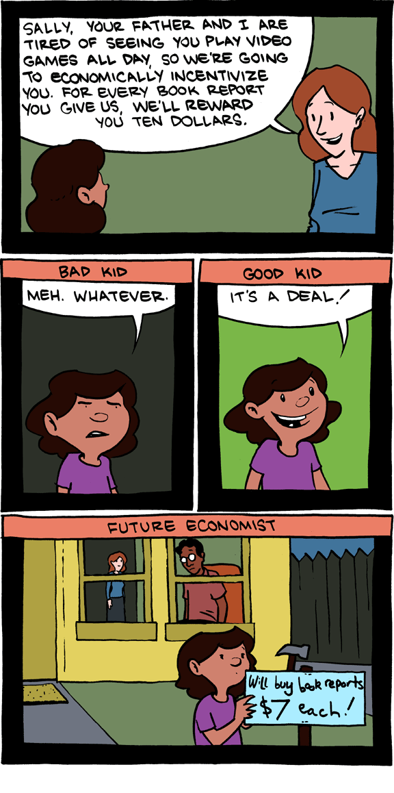
Lessons from Strategic Interaction
Do you see who this strongly connects to the Rational actor approach?
Rationality and Best Outcome
Shadow of the Future
Impact of Changing Payoffs
Impact of the Number of Players
Possibility of Regime Building
Structure
  Do you see how structure can actually be applied here as well in terms of the rules and how the game is structured?

Slide 26
The Box
I need volunteers who see themselves as
  Rational actor thinkers
  Cost-benefit calculators

Slide 27
For One Million Dollars, guaranteed anonymity and free of punishment …
Would you kill someone you do not know?
Write down what you would do
Everyone else take a poll

Slide 28
So what did you choose?
What does the poll say?

Slide 29
For One Million Dollars, guaranteed anonymity and free of punishment …
Would you kill someone you do know?
Write down what you would do
Everyone else take a poll

Slide 30
So what did you choose?
What does the poll say?

Slide 31
For One Million Dollars, guaranteed anonymity and free of punishment …
Would you kill someone who is a close friend?
Write down what you would do
Everyone else take a poll

Slide 32
So what did you choose?
What does the poll say?

Slide 33
For One Million Dollars, guaranteed anonymity and free of punishment …
Would you kill a baby?
Write down what you would do
Everyone else take a poll

Slide 34
So what did you choose?
What does the poll say?

Slide 35
What if you got a 100 million dollars, would you kill the baby?
Everyone else take the poll
Notes:
(up the ante—offer them more money, and then, change the person from someone they don’t know, to someone they do know but don’t like, to someone they like, to a family member)

Slide 36
So what did you choose?
What does the poll say?

Slide 37
What theory explains these results?

Slide 38
Do you see how culture can be strongly applied here?

Slide 39

Identity Exercise
I am going to ask you write down the top five groups or communities you identify with
You do NOT need to share what you write down so please be honest with yourself
I will ask for people to volunteer information but
  If you do not raise your hand, I will NOT ask you to share
  and you do NOT need to share anything you are not comfortable sharing

Slide 40
Identity Exercise
Write down five key identifiers for yourself that you share with others
Cross one off
Cross another one off
Cross another one off
Cross another one off — yes I know but cross it off anyway
Why did you choose this last identity to save?

Slide 41
If you are comfortable please tell us what category of identities you chose

Slide 42


Why these identities?
This Photo by Unknown Author is licensed under CC BY-SA-NC

Slide 43
Fundamental Identities
Now we are going to go back to the list and if no one says that one of the identities was their top we will erase it
We will then discuss why the ones left were chosen as the top identities — feel free to share stories about why if you are comfortable doing so

Slide 44
The identity exercise has been used in
Comparative, IR and American Politics classes to start discussions in different directions.
I often use it when discussing where ethnic discrimination can lead
  It can also be tied to other areas

Slide 45
Incentives for Ethnic Mobilization
From Iraqi officer orders –June 1987
  “The Corps Commander shall carry out sporadic bombardments … In order to kill the largest number of people … all persons captured … shall be detained and interrogated … and those between the ages of 15 and 70 shall be executed after any useful information has been obtained … (Cited in Gurr 127)”
Other Factors?

Slide 46
My Father’s House — Gabriel Aresti (Basque)
I shall defend
The house of my father
Against wolves,
Against draught,
Against usury,
Against the law,
I shall lose
cattle,
Orchards,
Pine groves;…
They will take my weapons,
And with my hands I shall defend the house of my father:
they will cut off my hands,
And with my arms I will defend the house of my father …,
and with my soul I shall defend
The house of my father.
I shall die,
My soul will be lost, my descendants will be lost;
But the house of my father
Will endure
On it feet.

Slide 47
The Ultimatum Game
Two of you will be put into break out rooms and you will have 20 bonus points for the next quiz.
The student whose first letter of their name is closest to A gets to decide how many points to keep and how many to offer to the other player.
  (If both your names start with the same letter go to the second letter of your name and so on)
The second player has the option to simply accept the offer, or refuse, in which case neither will gain any points.
Go into your rooms and play and then come back to the main room.

Slide 48
What happened?
Why do you think these were the results?
What theory do you think explains this?

Slide 49
The Ultimatum Game II
The student whose first letter of their name is farthest from A gets to decide how to divide the points. The other player has no say at all.
  (If both your names start with the same letter go to the second letter of your name and so on)
Go into your rooms and play and then come back to the main room.

Slide 50
What happened?
Were the results different?
How different?
Why do you think these were the results?
What theory do you think explains this?
Do you see the strong power of structure here?

Slide 51

Appendix
Exercises and games that we have not figure out how to do online

Slide 52
Game 1: Bowling for Extra Credit
12 volunteers in three groups
Lining up
One person from each group go stand in the area I ask you to

Slide 53
10 extra credit points
If you can get the ball into the cardboard box, you will get 10 extra credit points
You will pitch from where you are standing now
  Team 1 pitch
  Team 2 pitch
  Team 3 pitch

Slide 54
Discussion
What are the results?
Is this fair?
Which theories of politics could this be used to discuss or explain?
Why?

Slide 55
Football Addendum: Where would you put your money?
Football game
  Six seconds left
  Team with the ball is losing and on the 48-yard line
Who would you bet on?
  At what odds?

Slide 56
Caveat to the power of structure
November 23, 1984: Doug Flutie's "Hail Mary" finds Gerard Phelan to give BC a huge 47-45 win over Miami.
http://www.youtube.com/watch?v=q3ykWbu2Gl0

