Slide 1
Election Forecasting

Slide 2
What is Election Forecasting?
The attempt to write models predicting the outcome of the election as early as possible
Relatively new as a field in political science
Recently, gaining more and more media attention
Both bad and good

Slide 3
Types of Forecasting Models
Structural
National level analysis
Focus on large, nationwide factors
Predict nationwide outcomes
Public Opinion
Combined (aggregate) citizen preferences
Public Opinion + Structure
National level plus public opinion
Ensemble Forecasting
Just average everybody!
Notes:
Structuralist
National level analysis
Focus on large, nationwide factors
Predict nationwide outcomes
Aggregators
Public opinion aggregation
Synthesizers
National level plus public opinion

Slide 4
What are the forecasts predicting?
Local v National
Big issue in American politics
Generally, most polls predict OVERALL outcome
(% votes for a party)
Challenge: Elections in the US very localized
Challenge: Malapportionment
Challenge: Non-competitive districts
Predicting local elections
Challenge: Limited data availability at local level

Slide 5
How to Evaluate Forecasts
Accuracy
How well do they do?
What does this mean?
Lead
How far ahead do they work?
Simplicity
How much data do we have to include?
Replication
Do they work on more than one election?
Flexibility
Can they be updated effectively?

Slide 6
The Accuracy Challenge
Example:
Election Outcome: Candidate A wins with 51% of the vote, Candidate B loses with 49% of the vote
Which is more accurate: Forecast 1: Candidate B wins with 51% of the vote Forecast 2: Candidate A wins with 95% of the vote
Forecast 1: Vote share very close to actual outcome (only 2% off) but correct candidate not identified
Forecast 2: Correct candidate identified, but vote share extremely off
Notes:
Good place for discussion
Bringing up presidential elections and flipped elections really great to help spur discussion

Slide 7
Another word on accuracy
We tend to look at this very bluntly in US
Who wins?
BUT:
All models have error
Was result in possible prediction?
If model predicts a close election
Actual winner often not predicted
So really a coin flip
America also has experience with flipped elections
Party with largest share of the vote doesn’t always win the most seats/control of the presidency

Slide 8
Forecasts not just useful for predicting elections
The model’s quality tells us something about elections
All forecasts are built on an assumption of what matters to voters
Forecasts are an immediate test of our understanding of voter behavior

Slide 9
Election Analysis
To understand this, we turn to a very challenging election to forecast – the 2020 US Presidential Election
Notes:
Note to instructors: This section is best to update with whatever the most recent election was. I will post an update for the 2022 midterm elections

Slide 10
Uncertainty about 2020 Elections
Midterm elections indicate a shift left
Democrats outperform expectations… but do not win control of Senate
Midterms often see decline in support for president’s party
Economic performance story is mixed
Prior to Covid, robust economic performance
But major declines and slow (but marked) recovery
Approval ratings unclear
President’s approval was lower than many incumbent presidents
But approval rating remains strong and robust among Republicans
https://www.youtube.com/watch?v=TambSayfCOE&feature=youtu.be

Slide 11
Things we know about presidential elections
Incumbent President has an advantage
Only 9 presidents have failed to win re-election when running
(But Johnson declines to run again or would have lost)
Presidential approval matters
Presidents above 50% generally safe
But some presidents have won with less
But increasingly partisan
Trump approval fairly low, but exceptionally divided by partisanship
Economy matters… but unclearly
Retrospective, and based on perceptions
US economy has strong growth: 4.15
But not being reflected in presidential approval
Unclear how covid will play into calculations
Presidential approval is a pretty big predictor…
Notes:
The bad news for Republicans is the parties of each of the last three presidents with approval ratings around 40% (i.e., Carter, Clinton, and Obama) suffered double-digit House seat losses in their midterms and the most recent two each lost more than 50 seats (i.e., Clinton in 1994 and Obama in 2010).

Slide 12
What we knew about 2020 Congressional Races
Usually presidential success is a good (but not perfect) predictor of control of the House of Representatives
Senate elections depend on open seats
12 Democratic seats up for election
1 likely switch (Alabama)
1 competitive/lean dem (Michigan)
23 Republican seats up for election
5 too close to call (AZ, CO, ME, MT, NC)
4 competitive (lean Rep): (GA, GA, IA, KS)

Slide 14
Three Forecasting Models we will consider
Structural: Presidential Approval + Economy
Public Opinion
Level of support for candidates, parties
Campaign Resources
Most effective campaign wins

Slide 15
Structural
Economy plus presidential approval
Forecast assumes that high performing economy and high presidential approval benefit co-partisans
So, Republicans should benefit and do well if
1) Economy is doing well
2) Presidential approval is high
Different models place different weight (consideration) on these two factors

Slide 16
Problems with Structural Model
Doesn’t account for local variation very well
Perception of the economy matters almost as much as the economy itself

Slide 17
Economy Under Trump: Unemployment Rats
Great Decline in Unemployment: The US unemployment rate hit 3.7% in September, its lowest rate since 1969. The US has now added jobs for 96 consecutive months, the longest streak of jobs growth since records began.
Trump
Source: https://www.theguardian.com/us-news/2018/nov/04/trump-economy-performance-reality-midterm-election-vote-2018

Slide 18
Long Term Trends in Unemployment
Obama
Trump
Source: https://www.theguardian.com/us-news/2018/nov/04/trump-economy-performance-reality-midterm-election-vote-2018
Notes:
The problem with economic data is claiming credit. Who gets rewarded for trends, and when do people reward?

Slide 20
Recent Declines

Slide 21
Economic Perceptions

Slide 22
Presidential Approval Is Relatively Low

Slide 23
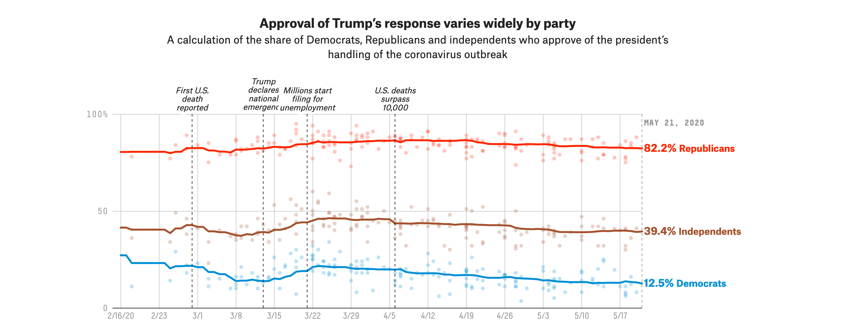
But heavily partisan

Slide 24
Public Opinion
Asking citizens how they will vote as a measure of partisan support
Several ways to do this
Generic ballot
Vote for Democrat or Republican
Aggregate from local races
Public support of specific candidates

Slide 25
Public Opinion
Good way of directly evaluating voter preferences
Generic ballot: Most consistent way of measuring partisan support
Will you vote for a Republican or Democrat for Congress
Specific races: good way of measuring local support

Slide 26
https://projects.fivethirtyeight.com/congress-generic-ballot-polls/

Slide 27
Problems with Generic Ballots
Ignores local level variation
And important structural differences for parties
For example, in Kansas
Not just a Republican v Democrat generic race
Local state issues, and attitudes towards Brownback, also mattered
In Gubernatorial race, Brownback more mentioned by Democrats than Trump!

Slide 28
Problem with local level polls
Expensive! So not very common
Often not representative
E.g. NY Times based on real time updating… but how do we evaluate earlier response?
Small sample sizes
Compare the number of polls about Missouri’s Governor race with the presidential race:
https://projects.fivethirtyeight.com/polls/governor/missouri/

Slide 29
2018 Polling Predictions
Very close race in certain states; means results were often in error terms
Nate Silver: “If polls underestimate Republican by 2-3 points – which is a normal size polling error- the House is a district by district nail biter. If polls underestimate Dems by 2-3 points, there path to victory in the Senate is much more viable; toss ups go their way, TN/TX close etc.”

Slide 30
2020 Polling Issues
Overestimation of Democratic presidential vote share
Why?
Adjustments to models did not fully account for voter shifts
Challenges of understanding the impact of Covid-19 for forecasts
Very different views of the economy
Under-sampling of certain key Republican constituencies
Key Reason:
Election was really close!

Slide 32
Campaigns
Lots of debates about how much campaigns matter
Heavy campaigning in 2020; record breaking spending
Important for undecided and independent voters
Often we use fundraising as a proxy for candidate campaign success
BUT
The highest spending candidate does not always win

Slide 34
Fundraising Numbers
https://www.npr.org/2020/05/20/858347477/money-tracker-how-much-trump-and-biden-have-raised-in-the-2020-election
https://www.followthemoney.org/show-me?y=2019,2020&c-r-ot=G&s=MO&gro=c-t-id

Slide 35
Fundraising may not be a good proxy
You can spend a lot and still not reach voters
Your ads might be bad
Hard to reach people in the same way
PAC spending harder to evaluate

Slide 36
How well did the forecasts do in 2020 do?
Lots of inconsistency in poll forecasts – predicted a close election in many states
Tendency to overstate Biden’s victory chance by about 4%
Especially in Ohio and Florida
Vote by mail helped to reduce polling errors near election
Proposed explanations
Partisan nonresponse
Shy voters
“Likely Voter” estimates off
Pandemic Effect estimates off
Very close elections are nearly impossible to forecast
20,000 voter difference in Wisconsin, for example
https://www.washingtonpost.com/politics/2020/11/25/which-2020-election-polls-were-most-least-accurate/

