Slide 1
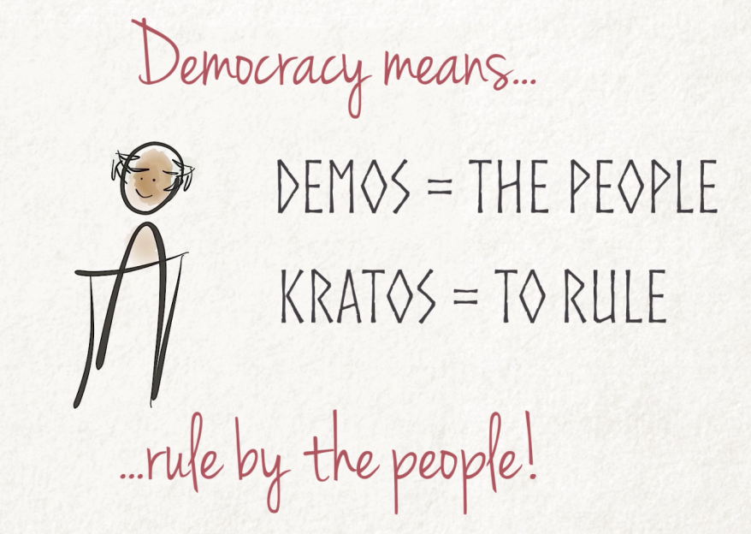
Notes:
Class session #1: I use this slide to introduce the module and keep it up while students fill out the “Identifying Essential Elements in a Democracy” worksheet. The module introduction is brief: I just reiterate the etymology presented in the slide’s image; point out that “rule by the people” doesn’t give much concrete guidance for how democracy should work in practice; and state that unpacking the idea of “rule by the people” is the purposes of this module.

Slide 2
As you read/watch the news story, jot down:
Which part(s) seem most democratic to you, and why?
Which part(s) seem least democratic to you, and why?
Notes:
Class session #1: After completing and submitting their worksheets, students either read or watch a news story that I select for its illumination of several different democratic principles or concerns. A recent news story is ideal, and state/local stories that aren’t already high on students’ radar tend to work especially well. These two articles (adapted for length) have served well in my course in recent semesters:
Casey Smith, “After Second Draft Released, Questions Linger over Indiana’s Proposed Diploma Changes,” Indiana Capital Chronicle, August 21, 2024
Jim Zarolli, “Why It’s So Hard to Tear Down a Crumbling Highway Nearly Everyone Hates,” New York Times, June 3, 2023.

Slide 3
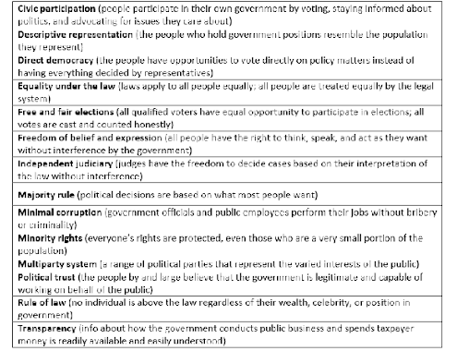
Do any of the listed elements help you “name” aspects of the news story that you thought were either most or least democratic?
Are there any most/least democratic parts of the news story that don’t appear on this list?
Does anything in the list push you to reconsider parts of the news story that you didn’t identify as being especially democratic or undemocratic when you first read it?
If the news story was all you had to go on, would you say the US is a mostly democratic or mostly undemocratic country?
  Is there any information missing from the story that could help you answer?
Notes:
Class session #1: I collect the handouts right after students complete them and put this screen-shot list of elements up on the projection screen for them to refer to during discussion. The rest of the session is devoted to discussion of the news story. Discussion starts in small groups – I ask students in each group to compare their homework answers and discuss the questions in the black box together – and then shifts to full-class discussion.
Class session #2: I remove the discussion questions but otherwise start with the same slide and begin class by clarifying the meaning of concepts students had identified on their handouts as being hard to understand. (I also return the students’ completed handouts, so they have a hard copy they can see up close and make clarifying notes on.)

Slide 4
Notes:
Class session #2: Using the completed handouts from session #1, I prep for class by editing the chart data to reflect the frequency with which students ranked each element within their top 5. In class, I reveal/explain the chart and lead a brief discussion about it: I prompt students to notice, react, and ask questions about the data; I also offer some of my own reactions and ask them questions. (For example, “independent judiciary” rarely gets ranked by anyone – why? Why did practically everyone have “civic participation” in their top 5? Did anyone feel like there was any tension between two elements in their top 5 – e.g., majority rule and minority rights?) If relevant, I point out similarities/differences to previous semesters and ask if they have any guesses as to why an element that didn’t used to be highly ranked is now seen by students as more essential to democracy.

Slide 5
What isn’t on the list but maybe should be?
You said:
…
…
…
I was surprised no one said:
…
…
…
Notes:
Session #2: In my class prep, I use the students’ answers to the question at the bottom of the “Identifying Essential Elements” handout to fill out the “You said” list, sometimes adding a brief note or question in sub-bullet points in a different color. The “I was surprised no one said” list is optional; I use it if there are aspects of democracy I want to be sure students get introduced to that no one in the class came up with on their own.
In class: emphasize that the 14 elements listed on the handout aren’t exhaustive and then lead a brief discussion of other possibilities, as listed on the slide.

Slide 6
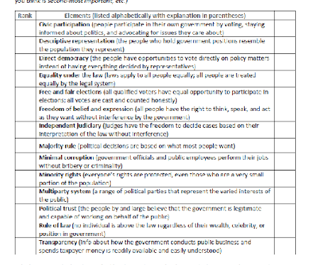
How is the US doing?
Go down the list of elements of democracy, and assign a score for every one (not just the 5 you ranked on Monday) as follows:
Based on your current knowledge and understanding of US politics & government, how well does the US exemplify this element of democracy?
  1 = The US doesn’t exemplify this element at all
  2
  3
  4
  5 = The US exemplifies this element extremely well
Notes:
Class session #2: I refer students to the far-right column on their “Identifying essential elements” handouts and ask them fill it out following the instructions on this slide. I encourage them not to overthink it and set a fairly short time limit (a couple of minutes).

Slide 7
How is the US doing?
Element | 1 | 2 | 3 | 4 | 5
Civic Participation
Descriptive Representation
Direct Democracy
Equality under the Law
Free & Fair Elections
Freedom of Belief & Expression
Independent Judiciary
Majority Rule
Minimal Corruption
Minority Rights
Multiparty System
Political Trust
Rule of Law
Transparency
Notes:
Class session #2: In the interest of time, I pick just a few of the elements (the ones students collectively ranked highly as being especially essential to democracy and/or ones I feel are especially timely); have students raise their hands to indicate how they ranked the US’s performance; and edit the table in this slide accordingly. Then we discuss: Why did students give the ratings they did? Why is there disagreement on some of the elements? How do they feel about an introductory American politics class vote as a method for measuring the quality of US democracy? This last question is meant to prompt critical thinking about methodology, objectivity, and expertise; it can be especially useful if planning to extend the module by looking at Democracy Index or Freedom Map scores.

