Slide 1


Journal Article Analysis Walkthrough
Josh Franco, Ph.D.
Summer 2022, Fall 2022, and Spring 2023
Cuyamaca College

Slide 2
About
Journal Article Analysis consists of reading journal articles and analyzing them.
You are responsible for identifying twelve parts of a journal article: title, main point, question, puzzle, debate, theory, hypotheses, research design, empirical analysis, policy implications, and contribution to the discipline, and future research.
Journal Articles vary in their organization and inclusion of these twelve parts.
Many articles explicitly describe all or most of these parts; however, other articles may not state a part, or may omit it entirely.

Slide 3
JAA Module
JAA #1 - 100 points, 4.5% overall grade
JAA #2 - 100 points, 4.5% overall grade
JAA #3 - 100 points, 4.5% overall grade
JAA Reflection – 100 points, 4.5% overall grade

Slide 4
How does the JAA fit in with the entire Course?

Slide 5
Visualization of Assessments by Category for 8-week Session Courses
Quizzes – 15%
Assignments – 14%
Chapter 1
Update Your Canvas Profile
Discussion – 12%
Simulation – 18%
Public Policy Project – 23%
Article #1
Article #2
Discussion
Data Analyst Roundtable
GIS Analyst Roundtable
Policy Analyst Roundtable
Communications Analyst Roundtable
Presentation
My Public Problem
01 - Introduce Yourself
Chapter 2
Chapter 3
Chapter 4
Chapter 5
Chapter 6
Chapter 7
Chapter 8
Chapter 9
Chapter 10
Chapter 11
Chapter 12
Chapter 13
Chapter 14
Chapter 15
Journal Article Analyses – 18%
iPoliSci Workshop during Week 1-2
02 – Varies
03 - Positive or Normative Perspective
04 - Varies
05 - Current Events
06 - Varies
Article #3
Levels / Comparative Method / California Political Geography
Status Quo / Country Government / California Political Actors
Political Actors / Country Geography / California State Budget
Network / Country Economy / California Legislative Process
Bridging / Country People and Society / California Regulatory Process
Share
SIM Reflection
JAA Reflection
Pair-Share-Think
PPP Reflection
iPoliSci Workshop during Week 3-4
iPoliSci Workshop during Week 5-6
iPoliSci Workshop during Week 7-8

Slide 6
8-Week Session Courses

Slide 7
16-Week (Semester) Session Courses

Slide 8
12 Parts of a Journal Article Analysis
1 - Title
2 - Main Point
3 - Question
4 - Puzzle
5 - Debate
6 - Theory
7 - Hypotheses
8 - Research Design
9 - Empirical Analysis
10 - Policy Implications
11 - Contribution to the Discipline
12 - Future Research

Slide 9
JAA #1
Varies by course, see JAA#1 assessment in Canvas for specific article

Slide 10
JAA #2
Varies by course, see JAA#2 assessment in Canvas for specific article

Slide 11
JAA #3
Varies by course, see JAA#3 assessment in Canvas for specific article

Slide 12
Handwritten Annotating
Download a PDF of article
Print article
Hand write your annotations on the printed article
Download CamScanner App for iOS or Android
Use CamScanner app “Batch” function to take picture of each page and save pages as a single PDF
Upload single PDF to Canvas Course

Slide 13
Electronic Annotating
Download a PDF of article
Download Adobe Acrobat Reader DC app for your PC, Mac, iOS, or Android device
Use Adobe Acrobat Reader DC app “Commenting” feature to electronically annotate the article
Save your electronically annotated PDF
Upload your PDF to Canvas Course

Slide 14
Getting Ahead
All 3 journal article analyses assignments are available the 1st day of the course
You are encouraged to keep pace, and even get ahead, by completing your JAAs before their due date

Slide 15
iPoliSci Workshops for JAA
iPoliSci Workshops for Ask Me Anything about JAA, SIM, or PPP
  Tuesdays from 7:00pm to 7:30pm
  Wednesdays from 7:00pm to 7:30pm
Feel free to schedule an appointment with me to discuss the JAA
  Appointment (ipolisci.com)

Slide 16
Abbreviated12 Parts
Title
Main Point
Question
Puzzle
Debate
Theory
Hypotheses
Research Design
Empirical Analysis
Policy Implications
Contribution to the Discipline
Future Research

Slide 17
1 – Identify Title
Typically on 1st page of article

Slide 18
2 – Identify Main Point
Read through abstract
Read through introductory paragraph or section
Read through conclusion paragraph or section
What strikes you as the “main point” of the article, denote that

Slide 19
3 – Identify Question
Check title
Check abstract
Check introductory paragraph or section
If you see a question mark (?) in the above areas, that is likely the question of the article

Slide 20
4 – Identify Puzzle
Read introductory paragraph or section
You are searching for terms that denote something that puzzling or missing, such as:
Puzzle or puzzling
Missing
Overlooked
Gap or hole
Perplex or perplexing
Ignored
Where you find one of these words, you are likely to find the paragraph that describes the Puzzle
Solving for

Slide 21
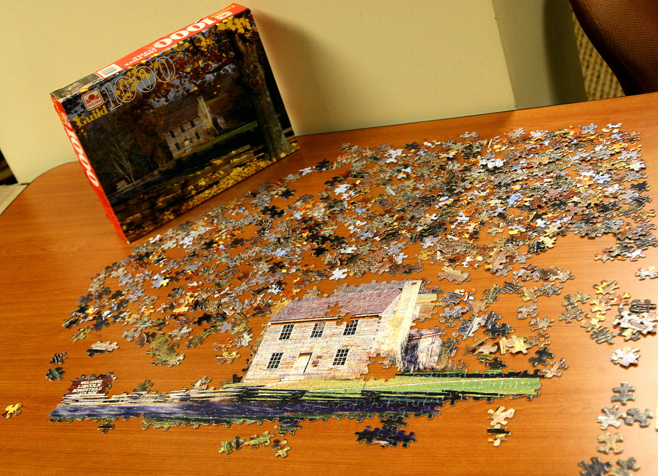
Journals are Pieces of the Puzzle
Imagine a never-ending puzzle
Each puzzle piece is a journal article
A new journal article attaches to (or builds on) existing pieces
Therefore journal articles should describe a puzzle, because they need to build on research already completed
Notes:
"PUZZLE" by Mononc' Paul is licensed under CC BY-NC-ND 2.0

Slide 22
5 – Identify Debate
Read introductory paragraph or section
Usually the in the upper half of the article, rarely will be placed in the lower half of the article
Terms to look for include:
Debate
One side, Other side
Proponents, Advocates
Argue, argument
Notes:
Read introductory paragraph or section
Usually the in the upper half of the article, rarely will be placed in the lower half of the article
Terms to look for include:
Debate
One side, Other side
Proponents, Advocates
Argue, argument

Slide 23
6 – Identify Theory
Theory is an explanation of how the world works
Theories in political science center on political actors, behaviors, institutions, and/or processes
Terms to search for include:
Theory
Model
Theoretical framework
Search for sections that include the word “Theory”

Slide 24
Theory in Detail
X = treatment, or independent variable
Y = outcome, or dependent variable
X -> Y

Slide 25
7 – Identify Hypotheses
Hypothesis is the expectation that one theoretical variable effects another theoretical variable
Both variables are likely to be stated and explained in the theory section of the article
Search for the term “hypothesis” or “hypotheses”
It is increasingly common for political scientists to clearly state their hypotheses using italics, indentations, bullet points, or tables

Slide 26
8 – Write Research Design
Unlike all the other parts, you need to Write out a Research Design for the article
The Research Design is how the author compares the effect of the explanatory variable (X) on the outcome variable (O) in a group (G) or set of groups.
Some political scientists use notation to denote research design. Below are 3 common examples:
Example 1: G O. This is a single group, observation only.
Example 2: G X O. This is a single group, treatment then observation.
Example 3: G O X O. This is a single group, observation before treatment, the treatment, then observation after treatment

Slide 27
8 – Write Research Design: 3 Additional Examples
Some political scientists use notation to denote research design. Below is 1 common example, and 2 complex examples:
  Example 4: G X O and G _ O. This is a two-group design. Group 1 receives them treatment, then is observed. Group 2 does not receive the treatment, then observed.
  Example 5: G O X O and G O _ O. This a two-group design. Group 1 and Group 2 are observed, then Group 1 receives the treatment while Group 2 does not receive the treatment. Finally, both Groups are observed again.
  Example 6: G O X O _ O and G O _ O X O. This is a two-group design, known as a switching replications design. Group 1 and Group 2 are observed, then Group 1 receives the treatment, while Group 2 does not receive the treatment. Then both Groups are observed. Next, Group 1 does not re-receive the treatment, and Group 2 receives the treatment for the first time. Then both groups are observed again.

Slide 28
Examples of Research DEsigns
G O1 X O2
G of students
O1=Before Treatment hue of hair color
  Light/Dark
X=Treatment SUNSHINE
O2=After Treatment hue of hair color
  Lighter/No Change/Darker?
G1 X O1a
G2 _ O2a
G=students
  G1=SIDasFem
  G2=SIDasMas
X=Treatment, Sunshine
O1a= hue of hair color
  Lighter/No Change/Darker?
O2a= hue of hair color
  Lighter/No Change/Darker?
_=Absence of the Treatment OR No Treatment

Slide 29
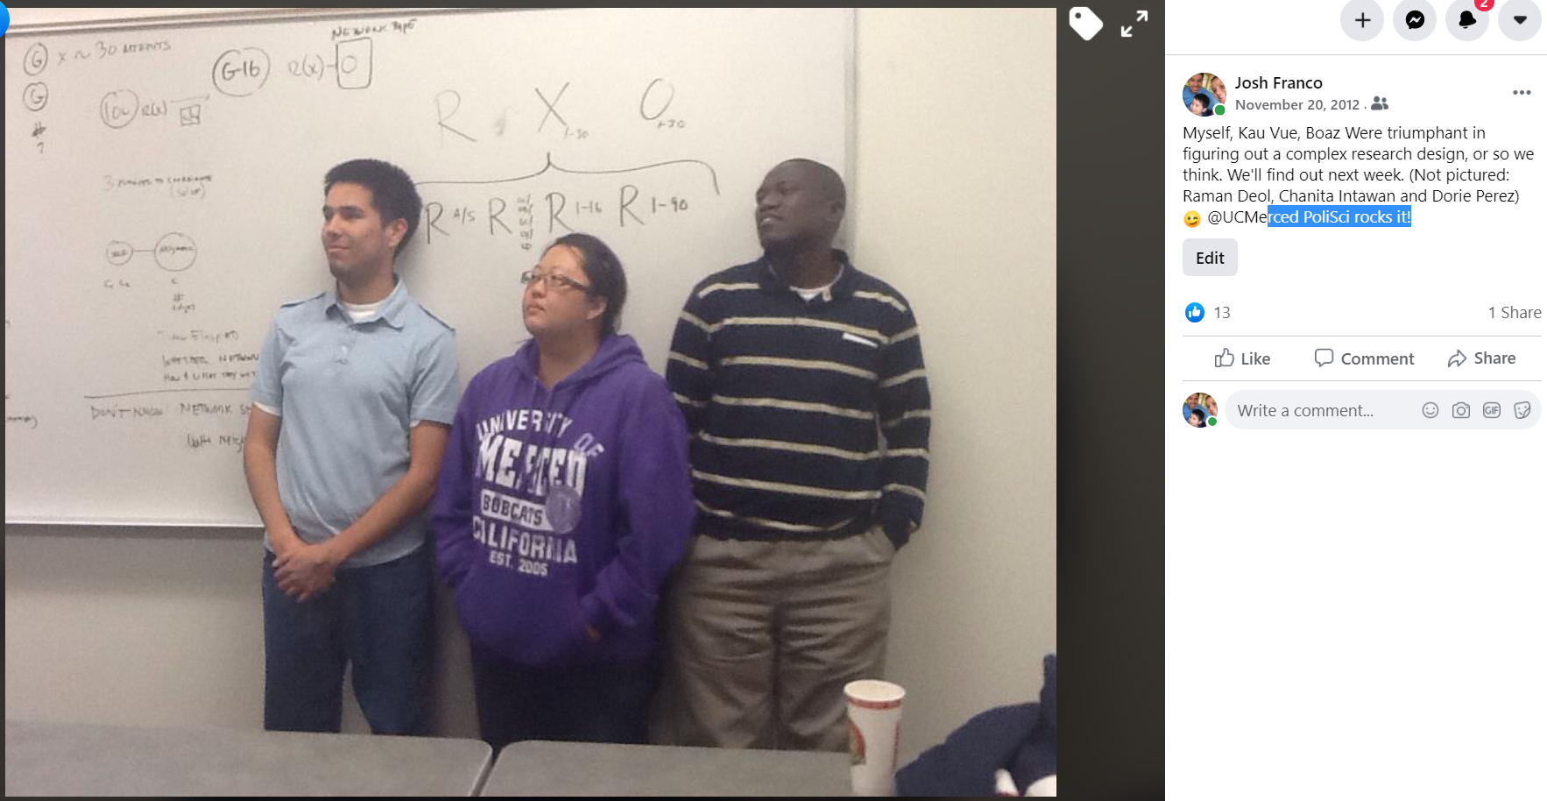
Josh Franco, Kau Vue, and Boaz Were conquered a Complex Research Design

Slide 30
9 – Identify Empirical Analysis
The Empirical Analysis is the use of quantitative or qualitative evidence to explore whether the hypothesized relationship between two variables does indeed occur in the world.
You should identify tables, charts, and graphs as Empirical Analysis
Additionally, you should note types of statistical analyses used, if available, by searching for the term “regression”
Regression analysis is one statistical technique political scientists use to analyze quantitative data

Slide 31
10 – Identify Policy Implications
The Policy Implications are how the findings of the article should influence the behavior of individuals, groups, organizations, or governments.
Sometimes policy implications are not clearly stated. So, in these cases, you need to ask and answer the following questions:
After reading the article, how should individual behavior change?
After reading the article, how should group behavior change?
After reading the article, how should organizational behavior change?
After reading the article, how should government behavior change?

Slide 32
11 – Identify Contribution to the Discipline
Political scientists strive to contribute new knowledge to the existing knowledge with their journal articles
Contribution to the Discipline is what the journal article contributes to the body of knowledge
Terms to search for include:
Contribution
Knowledge or know

Slide 33
12 – Identify Future Research
The journal article is another piece of a never ending puzzle of knowledge
As a new piece is added to a Puzzle, the knowledge creates new edges for new research to be considered, explored, and conducted
Terms to search for include:
Future research
Next step
Build our understanding

Slide 34
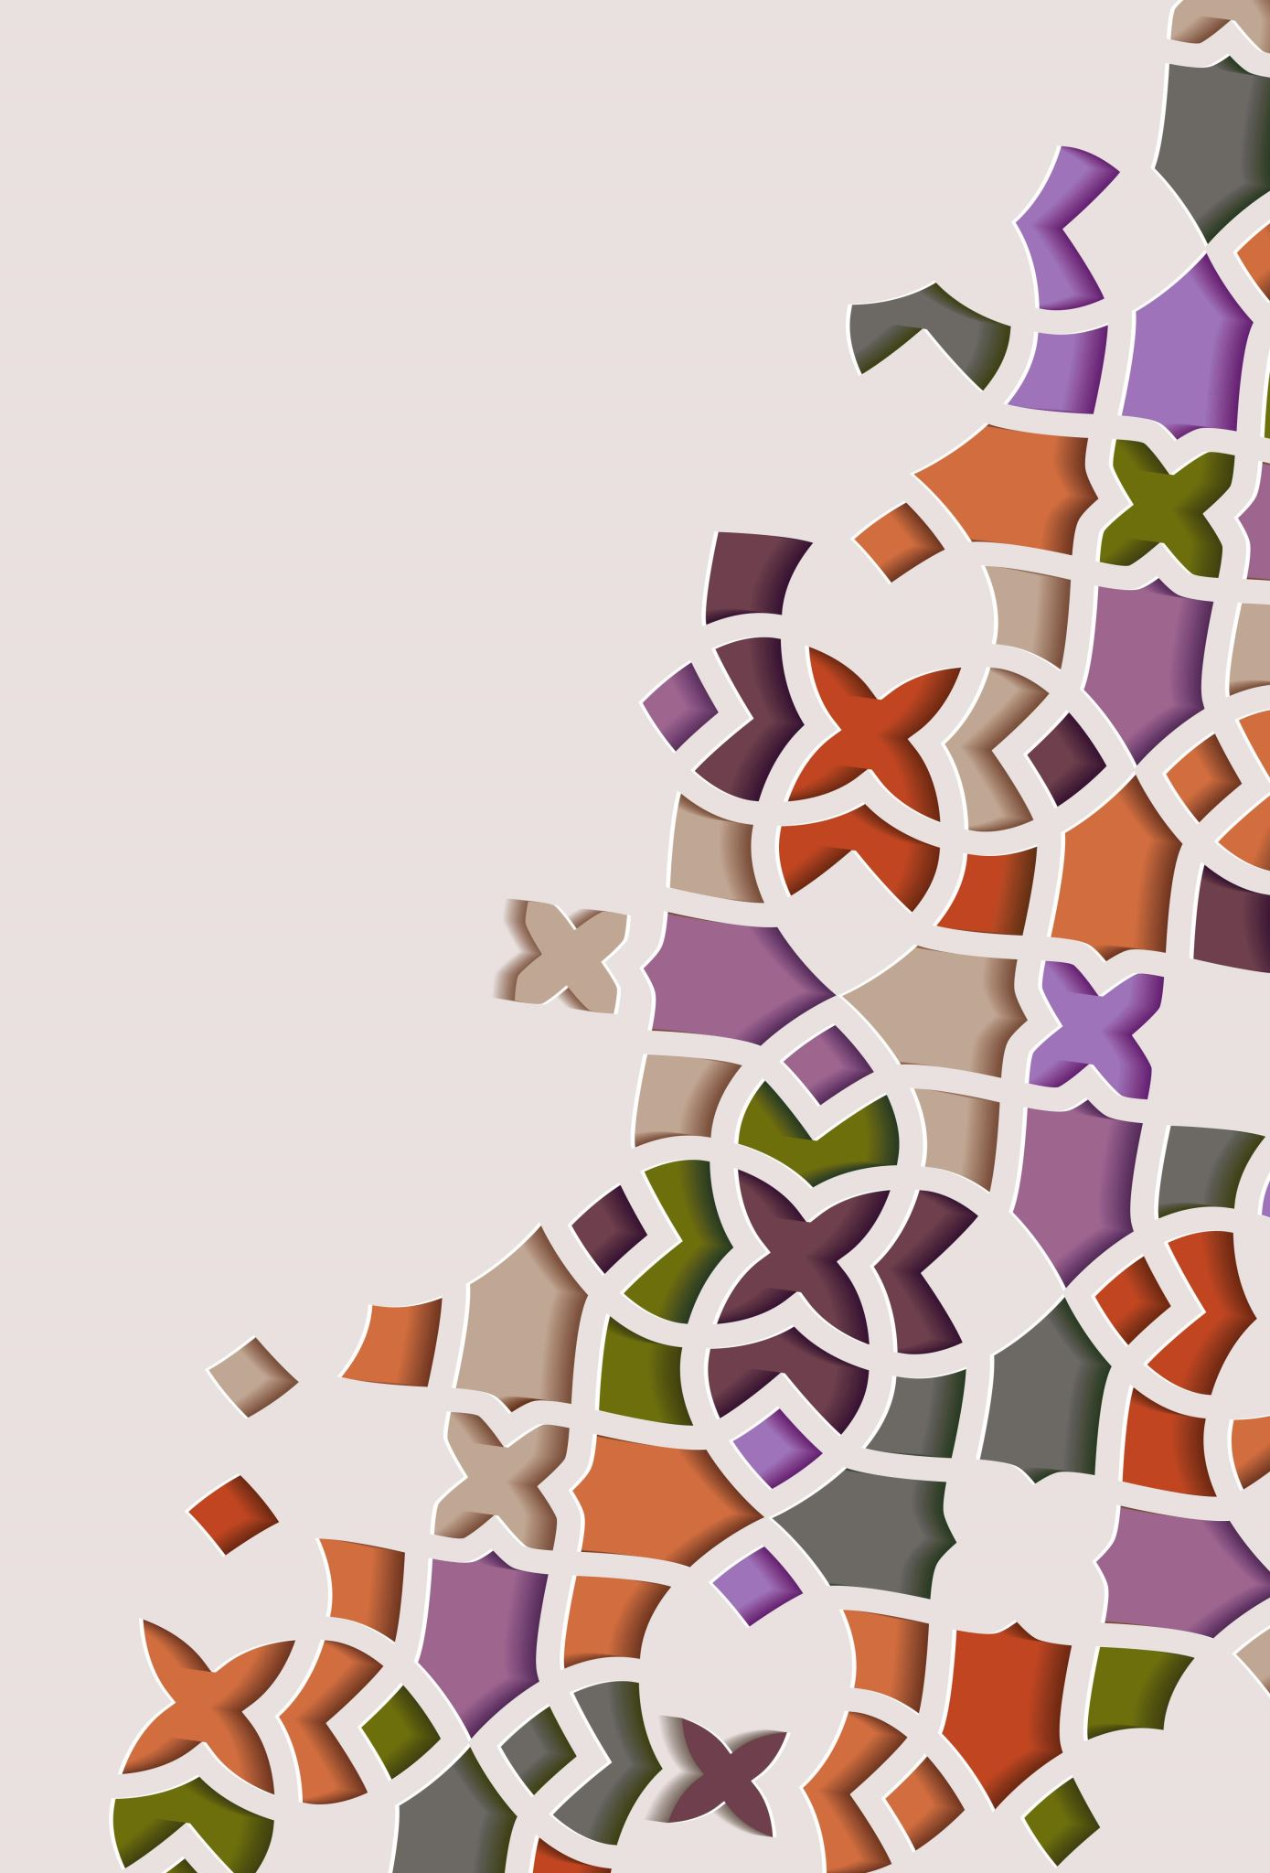
Strategies and Tips for Successfully completing the JAAs

Slide 35

Sticky Note Strategy
Obtain 12 sticky notes
Each sticky note should have 1 of the 12 parts
  For example: Sticky Note #4 has “Puzzle” written on it
As you read, place the sticky notes near the text that relates to the concept
  For example: if you find “puzzle” you should probably put a sticky note next to it
As you continue reading, you may move sticky notes, and that is OK
By the time you finish reading a Journal Article, you should have all 12 sticky notes somewhere on the article
Notes:
"Sticky Notes" by Rameshng is licensed under CC BY-SA 2.0

Slide 36
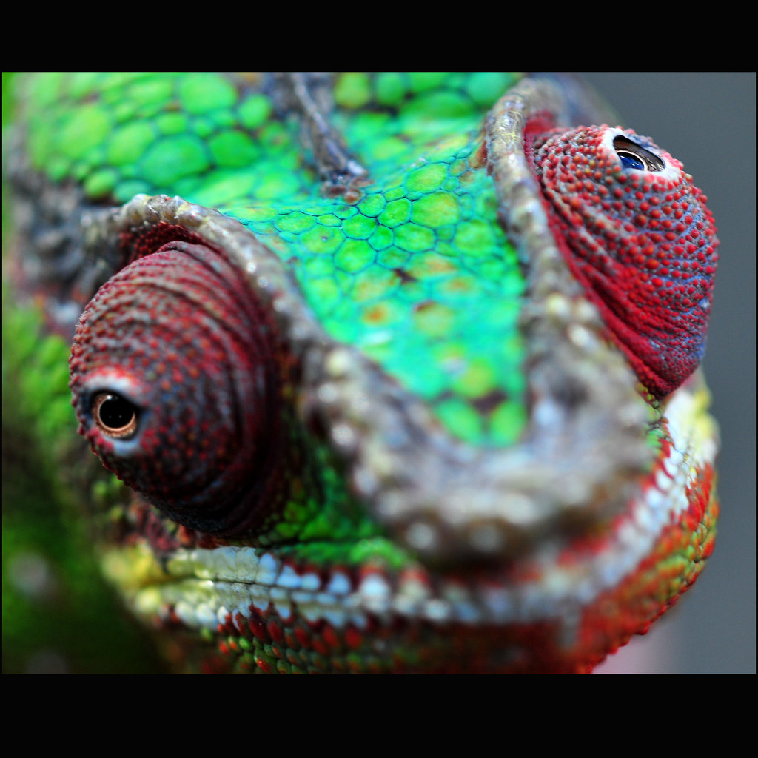
Accepting Ambiguity
Not every journal article is going to clearly state or identify all 12 parts
  This is especially the case for Research Design, since I ask you to write it out based on a narrow definition of the concept
The goal of the JAA is not to get the “right” answer
  That will come later, in your upper division classes at university and, Masters and Doctoral level courses
The goal of the JAA is to read through a journal article, use your judgement in identifying the parts, and understanding there is an ambiguity to political science research
Notes:
"'Due to the increasing popularity of apathy and ambiguity we find ourselves without advice for your problem.' Mother Nature..2010..." by Steve @ the alligator farm is licensed under CC BY-SA 2.0

Slide 37

Not Letting Perfect be the Enemy of the Good
For one reason or another, there is this desire to be “perfect”
However, there is no such thing as a “perfect” JAA
So, if you are waiting to “perfect” your JAA, you are letting perfect become the enemy of the good
A good JAA is a done JAA
Notes:
"Storm-Clouds-Over-Palm-Trees-in-North-Palm-Beach-Golf-Course" by Captain Kimo is licensed under CC BY-NC-ND 2.0

Slide 38

Submit your JAA, and Let’s Discuss
Submitting the JAA is not the end, but a beginning
After you submit, myself or the Teaching Assistant will review and provide feedback
Also, we can discuss the JAA during designated iPoliSci Workshops
Notes:
"Working Together Teamwork Puzzle Concept" by rama_miguel is licensed under CC BY-SA 2.0

