Slide 1
Public Policy Project

Slide 2

What is Public Policy?

Slide 3
Definition
Public policy is the constitutional, legal, judicial, regulatory, or policy documents that are produced by governmental institutions at the international, national, and subnational levels.

Slide 4
Examples of Public Policy
Public policies include:
amendments to a federal or state constitution;
federal, state or local laws passed by legislative bodies and approved by executives;
federal and state judicial rulings;
regulations promulgated by federal, state or local governments; and
policies adopted by federal, state, or local institutions, boards, commissions, or related entities

Slide 5
Level | Constitutional | Legal | Judicial | Regulatory | Policy
International |  | Charter of the United Nations | International Criminal Court | International Whaling Commission | Paris Climate Agreement
National | U.S. Constitution | U.S. Code | U.S. Supreme Court Cases | U.S. Code of Federal Regulations | U.S. Immigration and Citizenship
Subnational – U.S. State | California Constitution | California Code | California State Supreme Court Cases | California Code of Regulations | California State Water Resources Control Board – Antidegradation Policy
Subnational – Local government | El Cajon Municipal Code

Slide 6
What is the Public Policy Project?

Slide 7
Description
The Public Policy Project encourages you to identify a public problem to focus on.
After discussion with your peers, you are responsible for selecting the causes, effects, and solutions to the public problem you selected.
After that, you will explore four different analyst roles:
Data Analyst
Geographic Information Systems Analyst
Policy Analyst
Communications Analyst

Slide 8
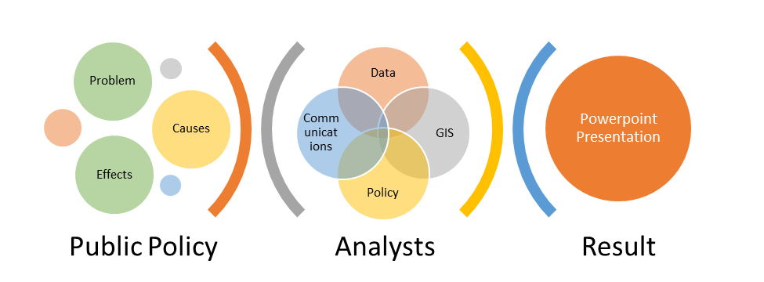
Visual Representation of the PPP

Slide 9
Overview of the PPP
Public Policy Project – 20%
Discussion
Data Analyst Roundtable
GIS Analyst Roundtable
Policy Analyst Roundtable
Communications Analyst Roundtable
Presentation
Pair-Share-Think
My Public Problem
The Public Policy Project consists of 8 components.
These components are sequential, meaning they build on each other.
For example, the “My Public Problem” submission is an iteration of the “Discussion” from the week prior.

Slide 10
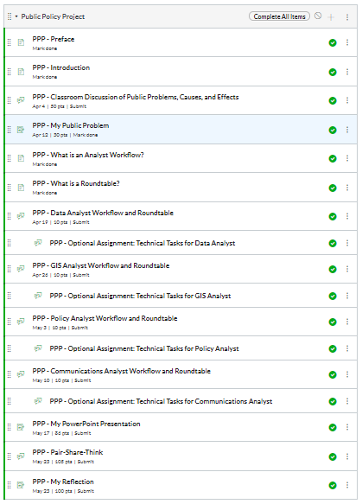
Public Policy Project Module in Canvas LMS
To the right is an image of the Public Policy Module as it appears in Canvas Learning Management System.
This module is typically located at the end of the Modules to offer students a holistic view of the project.
In many courses, specific components of the Public Policy Project are located in a “Weekly Module” to help students keep pace throughout a quarter, semester, intersession, or summer session course.

Slide 11
PPP Activity by Week by Term Type
 | PPP - Classroom Discussion | PPP - My Public Problem | PPP - Data Analyst Roundtable | PPP - GIS Analyst Roundtable | PPP - Policy Analyst Roundtable | PPP - Communications Analyst Roundtable | PPP - My PowerPoint Presentation | PPP - Pair-Share-Think about Presentation | PPP - My Reflection
Week # for Semester Length Course | 7 | 10 | 11 | 12 | 14 | 15 | 17 | 18 | 19
Week # for 8-week Session Course | 1 | 2 | 3 | 4 | 5 | 6 | 7 | 8 | 8

Slide 12
What is the “Classroom Discussion”?

Slide 13
Classroom Discussion
Discussion Post
Time Frame
Semester: Week 7
8-week Session: Week 1
Reply to 2 Peers
State a public problem
Share why you think it is an important public problem to focus on
Explain what at least cause of the public problem is
Explain what at least effect of the public problem is
Validate your peer’s justification for focusing on the public problem
Add one additional cause of the public problem
Add one additional effect of the public problem

Slide 14
Example of a “Discussion” Post
Declare your public problem is
Cause 1
Effect 1

Slide 15
What is the “My Public Problem”?

Slide 16
My Public Problem
Individual Submission
Using Discussion, update your PP
@ least 2 causes
Time Frame
Semester: Week 10
8-week Session: Week 2
@ least 2 effects
Student-Professor
Direct communication between you and me

Slide 17
Example of a “My Public Problem” Submission
Declare your public problem is
Cause 1
Cause 2
Effect 1
Effect 2

Slide 18
Analyst Workflows and Roundtables

Slide 19
What are Analyst Workflows?
Analyst has a set of tasks (what are called “Workflows”) to complete to adequately explore the public problem’s causes, effects, and solutions.
Completion of these tasks result in you obtaining valuable knowledge, skills, and abilities related to the public problem, their role and role of other analysts.

Slide 20
What are Analyst Roundtables?
As you progress through your Public Policy Project and the Analyst Workflows, please check in with me and your peers at our virtual roundtable.
Post any questions, comments, concerns, or suggestions that you'd like to share with me and your classmates.
If you don't have any questions, comments, concerns or suggestions, then feel free to post that as well.

Slide 21
Analyst Roles

Slide 22
What is the Data Analyst Workflow?

Slide 23
the Data Analyst Workflow
About
Data Analysis “is the process of systematically applying statistical and/or logical techniques to describe and illustrate, condense and recap, and evaluate data.”[1] Data analysts work with spreadsheets, collections of spreadsheets (also called databases), and data analysis software. We typically use software by “pointing and clicking”. However, software can be “programmed” as well.
Estimated Time
An estimated 180 minutes is needed to complete this activity.
Learning Objectives
By the completion of this learning unit, you will be able to:
Remember what data analysis is
Understand the utility of causal models
Apply causal models to your public problem
Analyze data for patterns related to your public problem’s causes or effects
Evaluate the utility of data analysis in explaining a public problem
Create a “Data Analyst Highlight” slide

Slide 24
Data Analyst Roundtable
Time Frame
Semester: Week 11
8-week Session: Week 3

Slide 25
What is the GIS Analyst Workflow?

Slide 26
the GIS Analyst Workflow
About
Geographic Information Systems “is a framework for gathering, managing, and analyzing data. Rooted in the science of geography, GIS integrates many types of data. It analyzes spatial location and organizes layers of information into visualizations using maps and 3D scenes. ​With this unique capability, GIS reveals deeper insights into data, such as patterns, relationships, and situations—helping users make smarter decisions.”[1] GIS analysts work with spreadsheets and GIS software.
Estimated Time
An estimated 180 minutes is needed to complete this activity.
Learning Objectives
By the completion of this learning unit, you will be able to:
Remember what GIS analysis is
Understand the utility of GIS maps
Apply GIS maps to your public problem
Analyze GIS maps for patterns related to your public problem’s causes or effects
Evaluate the utility of GIS analysis in explaining a public problem
Create a “GIS Analyst Highlight” slide

Slide 27
GIS Analyst Roundtable
Time Frame
Semester: Week 12
8-week Session: Week 4

Slide 28
What is the Policy Analyst Workflow?

Slide 29
the Policy Analyst Workflow
About
Policy Analysis “is the process of identifying potential policy options that could address your problem and then comparing those options to choose the most effective, efficient, and feasible one. Conducting a policy analysis ensures you have gone through a systematic process to choose the policy option that may be best for your situation.”[1] Policy analysts work with existing and proposed laws and regulations, decision-making processes at the individual, local, state, national, and/or international level, and elected and appointed decision-makers.
Estimated Time
An estimated 180 minutes is needed to complete this activity.
Learning Objectives
By the completion of this learning unit, you will be able to:
Remember what policy analysis is
Understand the utility of policy process model
Apply policy-making models to your public problem
Analyze policies related to your public problem’s causes or effects
Evaluate the utility of policy analysis in explaining a public problem
Create a “Policy Analyst Highlight” slide

Slide 30
Policy Analyst Roundtable
Time Frame
Semester: Week 14
8-week Session: Week 5

Slide 31
What is the Communications Analyst Workflow?

Slide 32
Communication Analyst Workflow
About
Communication Analysis is the design, creation, and promotion of text, audio, and visual information produced from data, GIS, and policy analysis. Communications analysts work with spreadsheet, GIS, policy, graphic design, and infographic creation software.
Estimated Time
An estimated 180 minutes is needed to complete this activity.
Learning Objectives
By the completion of this learning unit, you will be able to:
Remember what communication analysis is
Understand the utility of infographic design
Apply infographic design to your public problem
Analyze data, GIS, and policy analysis of public problem’s causes or effects
Evaluate the utility of communication analysis in explaining a public problem
Create a “Communications Analyst Highlight” slide

Slide 33
Communications Analyst Roundtable
Time Frame
Semester: Week 15
8-week Session: Week 6

Slide 34
What is “My PowerPoint Presentation”?

Slide 35
PowerPoint Presentation
About
A PowerPoint presentation of your Public Policy Project is one media to communicate your work.
Estimated Time
An estimated 120 minutes is needed to complete this activity.
Instructions
A Google Slides Presentation template is available to assist you in preparing your presentation, and hopefully you viewed, copied, and have been updating the template as you've progressed.
The PowerPoint Presentation gives you an opportunity to communicate your findings. Your PowerPoint Presentation should consist of the following slides:
Title Slide
Public Problem
Causes of Problem
Effects of Problem
Data Analyst Highlight
GIS Analyst Highlight
Policy Analyst Highlight
Communications Analyst Highlight
Solutions to Problem
Three-Bullet Point Reflection
Works Cited

Slide 36
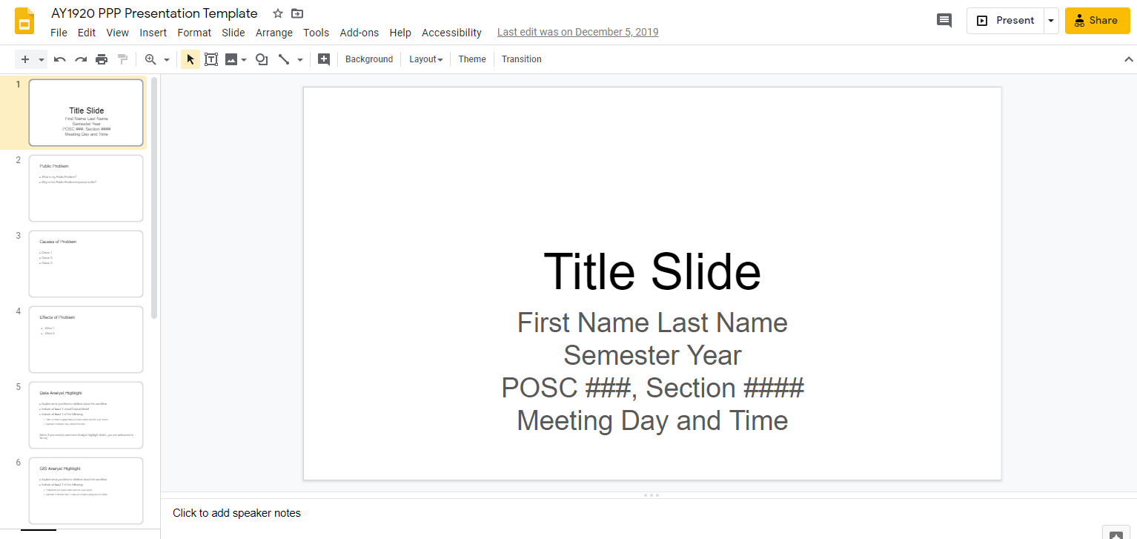
PowerPoint Template
Go to Google Slides Template
Option 1: Copy to Your Google Drive
Click File
Select “Make A Copy” of Entire Presentation
Copy document to your Google Drive
Option 2: Download Microsoft PowerPoint
Click File
Select “Download” as Microsoft PowerPoint
Save to your hard drive

Slide 37
Presentation
Time Frame
Semester: Week 17
8-week Session: Week 7

Slide 38
What is “Pair-Share-Think”?

Slide 39
Pair-Share-Think
About
There is a concept in teaching called “Think-Pair-Share”. Educators encourage their students to think about an object (idea, concept, theory, piece of art, theater production, song, etc.). Then, the educator will pair students together. Once paired, students will share their thoughts about the objects with their peer.
While you worked individually (unless you collaborated with your peers, which was entirely permissible and encouraged), it’s time to Pair-Share-Think.
Estimated Time
An estimated 120 minutes is needed to complete this activity.
Instructions
Post
Upload your Presentation
Write a 5-sentence summary of your presentation
Canvas Help: How do I attach a file to a discussion reply as a student? (Links to an external site.)
Reply to a Peer’s Post
Respond to the following questions:
What did you find most similar about your group member’s presentation to your own presentation?
What did you find least similar about your group member’s presentation to your own presentation?
What about your group member’s presentation did you find most interesting?
Where do you think your group member’s presentation can improve?

Slide 40
Pair-Share-Think
Time Frame
Semester: Week 18
8-week Session: Week 8

Slide 41
What is “My Reflection”?

Slide 42
My Reflection
About
Reflections are an opportunity for you share with me, your professor, your thoughts about the Public Policy Project. No other student will read your reflection.
Estimated Time
An estimated 60 minutes is needed to complete this activity.
Instructions
Please write at least 6 sentences reflecting on the Public Policy Project.
Sentence #1: Your 1st Sentence should be a question. Examples of questions include:
What did you find most interesting about the Public Policy Project? Why did you find this the most interesting?
What did you find most relevant to your daily life about the Public Policy Project? Why did you find this the most relevant?
You are welcome to ask and answer your own question.
Sentence #2-6: Sentences 2 through 6 should be your response to the question you posed in sentence #1.

Slide 43
PPP – My Reflection
Time Frame
Semester: Week 19
8-week Session: Week 8

Slide 44
Questions, Comments, or Concerns?

