Slide 1
Explaining the War in Ukraine: A Quick Primer
John Ishiyama
Professor of Political Science
University of North Texas.

Slide 2
Explaining the war in Ukraine
  Longer term historical factors
  Recent developments in Ukraine since 2014
  Russian security priorities
  Putin’s motivations?

Slide 3
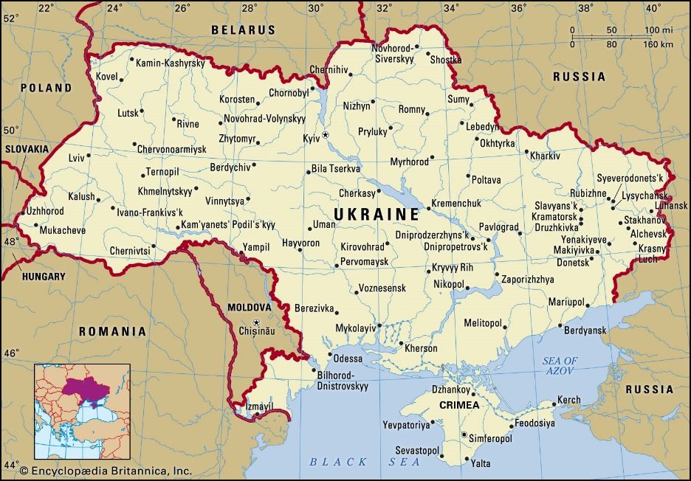
Background
There are longstanding historical and cultural ties between Russia and Ukraine
Establishment of a Russian state in 9th century
In about 862 CE Rurik the Varangian established a settlement around where Moscow is today and declared himself prince. His son Oleg moved the capital south to Kyiv (now in Ukraine)- Kievan Rus’ state

Slide 4
Prince Vladimir (980-1015) of Kiev established relations with the Byzantine Empire and adopted Orthodox Christianity State religion
Connections with gave rise to written language based on Greek (brought by the Greek monks Cyril and Methodius)

Slide 5
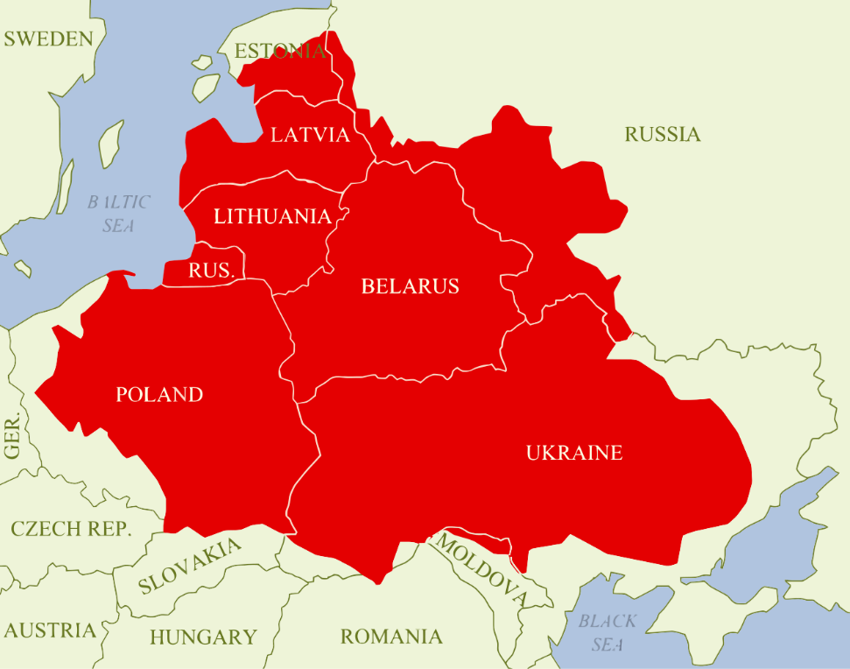
Polish Lithuanian State in the 17th century
Orthodox Christianity came to the Kyiv Rus’ state in the 10th century, spread from there
Ukraine historically at various time divided among great powers. The Mongols, the Swedes, the Poles, the Austrians and the Russians

Slide 6
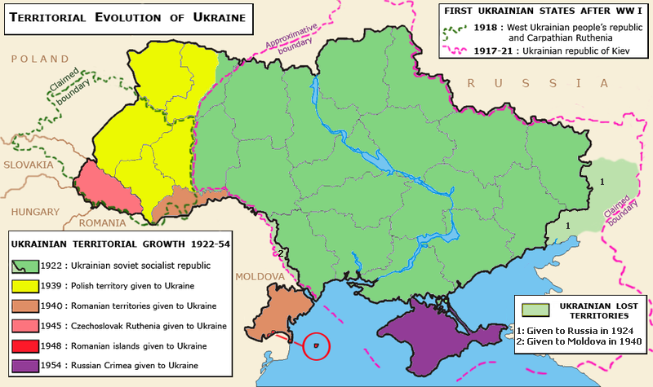
This has left a lasting division between the left and right banks of the Dniepr river, with the western half more oriented historically and culturally with the “West” and the Eastern half oriented towards Russia.
This division continues to dominate domestic Ukrainian politics into the 21st century.

Slide 7
Soviet and Post Soviet Politics
Ukraine was part of the USSR (Soviet Union) from 1922-1991
  Suffered during the Stalinist period (Holodomor-mass famine) in the 1930s and during WW2
  Some collaboration between Ukrainians and Nazi occupation during WW 2 (Ukrainian Insurgent Army-UPA- founded by Stepan Bandera).
  Stepan Bandera, notorious far right-wing Anti Semitic Ukrainian politician, at first collaborated with Nazis after the invasion of the Soviet Union in 1941, but then was arrested by them after declaring Ukrainian independence.
    The UPA remained active and fought against Polish and Soviet Partisans in collaboration with the Nazi occupation,
    continued its insurgency against the Communist authorities in Poland until 1947 and against Soviet authorities in Ukraine until 1949.
    After the war Bandera conducted Anti-Soviet activities until his assassination by the KGB in 1959
    Was awarded in 2010 Hero of Ukraine by outgoing President Yuschenko – objected to by the European Parliament, Russia, Poland and many Jewish organizations

Slide 8
WW 2 had terrible consequences for the Soviet Union and especially Ukraine
Some of the largest battles of the war were fought on Ukrainian territory (Kyiv, Odessa, Kharkiv)
Ukraine was entirely occupied by the Nazis
Although some Ukrainians joined the UPA, thousands more joined the Soviets during the German occupation
Ukrainians made up a large portion of the Soviet military
  Between 1941-45 about 4,500,000 Ukrainians served with the Soviets, and 1,400,000 were killed in action
Overall, the Soviet lost around 27 million people during the war, including 8.7 million KIA and 19 million civilians (US lost 405,000 KIA in comparison)

Slide 9
During the Soviet period, Ukraine was always considered the most important Union Republic only second to Russia, particularly in the post WW2 period.
Soviet Union collapsed in 1991
15 independent states emerged (including Ukraine)– region considered the “Near Abroad” (ближнее зарубежье-a Russian term to describe the countries of the Former Soviet Union, i.e FSU)
About 15 million ethnic Russians were left behind in the “Near Abroad”
included Ukraine (about 8 million)

Slide 10
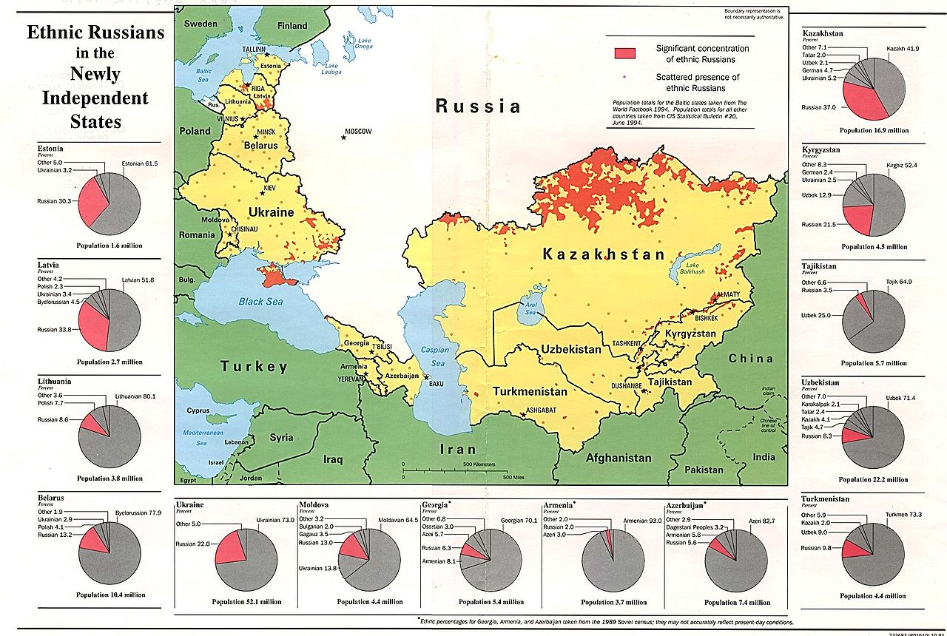

Slide 11
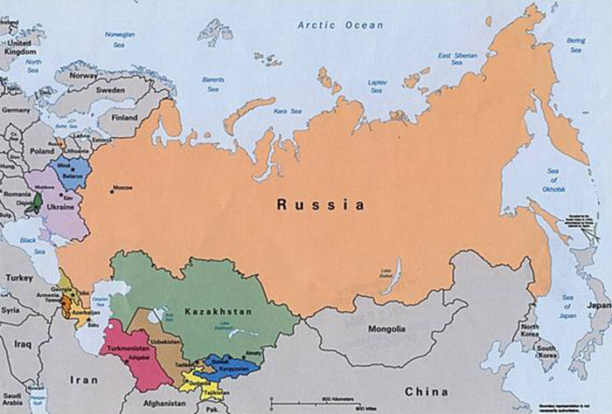
Russia and the FSU region
Russia under Putin (since 2000) has focused its security idea on protecting Russia’s influence in the “Near Abroad” - including Ukraine.
Has used military deployments to influence Georgia, Moldova, Tajikistan, Kazakhstan
Has military bases and a collective security treaty with many countries in the FSU region.
The FSU region is critical to Russian security according the Russian leaders (even before Putin)

Slide 12
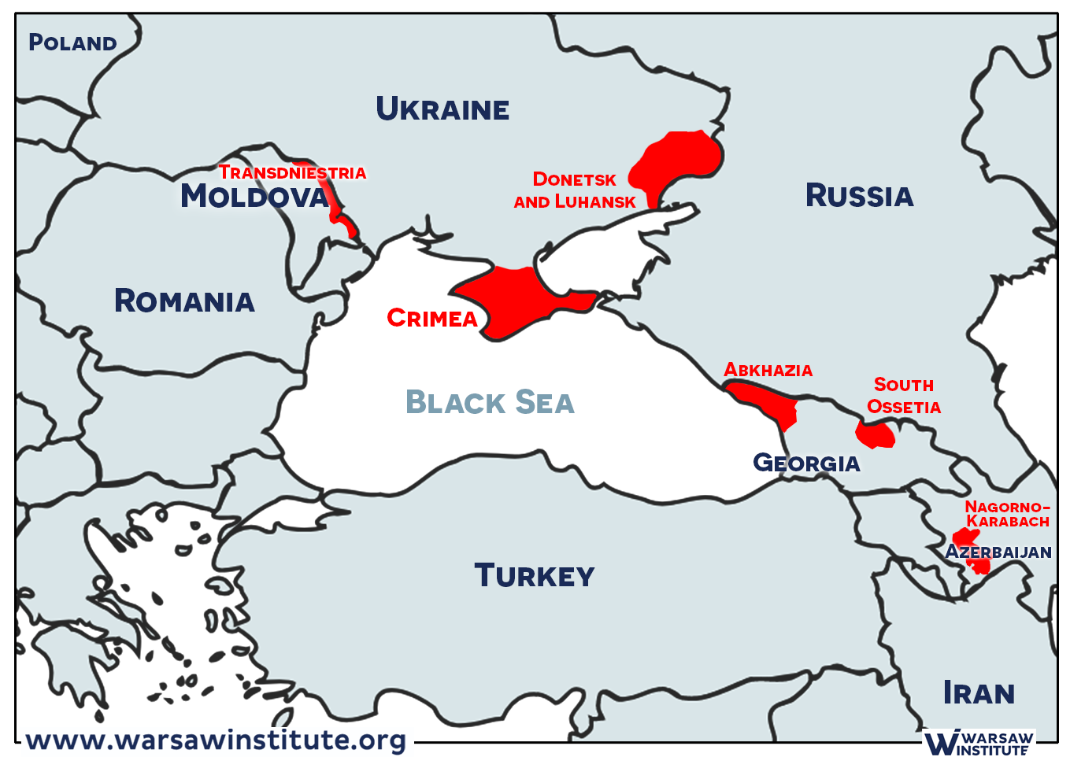
Russia has sponsored several separatist “de facto” states in the countries of the FSU, largely used to weaken and influence these states
Transnistria (Moldova) Abkhazia and South Ossetia (Georgia) and now Donetsk PR and Luhansk PR (Ukraine)

Slide 13
Unrecognized states supported by Russia
Have supported a number of internationally unrecognized states since 1991 as leverage against these states
  Abkhazia and South Ossetia (Georgia-war was fought in 2008 between Georgia and Russia)
  Transnistria (seceded from Moldova in 1992)
  Nagorno-Karabakh (seceded from Azerbaijan 1994– but is on verge of collapse after Azerbaijan’s victory over Armenia last year.)
Many citizens of these regions enjoy the same rights as Russian citizens, carry Russian passports, and use the Ruble as the currency.
This appeared to be the plan for the Donbas (short for Don River Basin)

Slide 14
Russia has proclaimed “responsibility to protect” to protect these “persecuted” minorities
UN doctrine adopted after Rwanda. Russia uses this to justify protection of ethnic Russians in near abroad

Slide 15
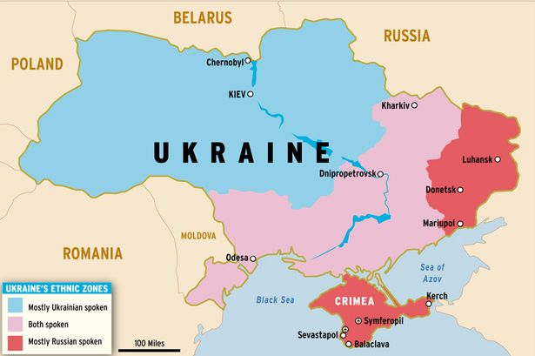
Ukraine since independence
The country is Ethnolinguistically divided
77.5% Ethnic Ukrainian
17.2 % Ethnic Russian
67% Ukrainian first language
30% Russian first language

Slide 16
Denuclearization: Budapest Memorandum
After the collapse of the Soviet Union, a diplomatic memorandum of understanding (called the Budapest Memorandum, 1994)
Signed by Russia, Ukraine, the United States, Great Britain, and later France and China.
The memorandum stated that in exchange for surrendering the nuclear weapons that Ukraine had inherited to Russia, that all parties would guarantee the borders and territorial integrity of Ukraine.

Slide 17
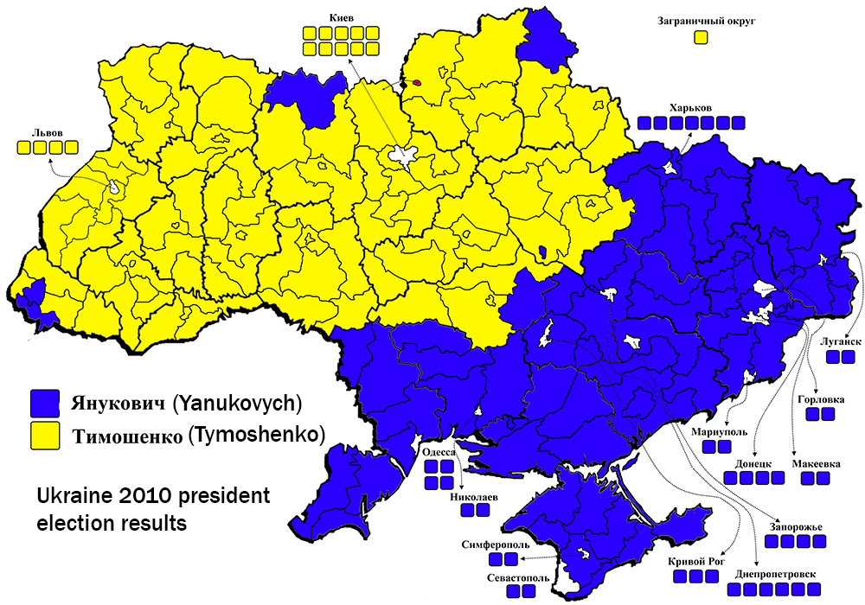
Post soviet Ukrainian electoral politics
Ukraine has always been politically divided between the East and the West over whether it should follow a pro-European or pro-Russian path.
Elections after the 2004 ‘Orange Revolution” (overthrew authoritarian President Leonid Kuchma) produced governments that alternately pursued pro-Western and Pro-Russian foreign policies.
Map is from last “normal” presidential election in 2010.

Slide 18
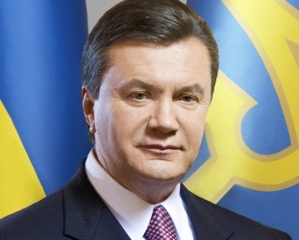
2014: EuroMaidan/Revolution of Dignity
It was under a pro-Western president that the idea of Ukraine joining NATO was first introduced.
In 2014 the pro- Russian sitting president, Viktor Yanukovich (elected in 2010), faced massive demonstrations in Kyiv around Maidan Square after his refusal to sign a political association and free trade agreement with the European Union
After many violent confrontations, the Ukrainian parliament voted to remove Yanukovich from his office, and he fled to Moscow.

Slide 19
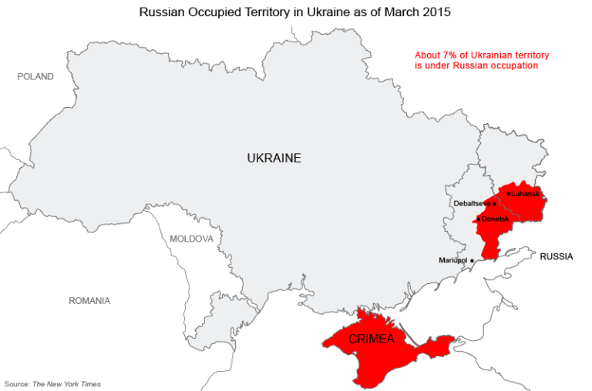
From the Russian point of view
  Yanukovich was removed illegally and they saw the Maidan uprising as a “coup” engineered by the West.
  They viewed this turn of events as extremely alarming, in as much they saw the removal of a pro-Russian leader in Ukraine. This was a direct affront to the Putin government
Pro Russian Militias seize Crimea, declare independence, and then request annexation from Russia
Russia annexes Crimea in March 2014
Moscow began to arm separatists in most Eastern region of the Ukraine, the Donbas (short of Don River Basin).
  This was done as to gain leverage against the Pro Western government in Kyiv and to prevent Ukraine from joining the European Union (and perhaps NATO).
  Minsk Protocols signed in 2014-15 (by Russia, Ukraine, and OSCE)
  War remained a stand off with cease fire up until now.

Slide 20
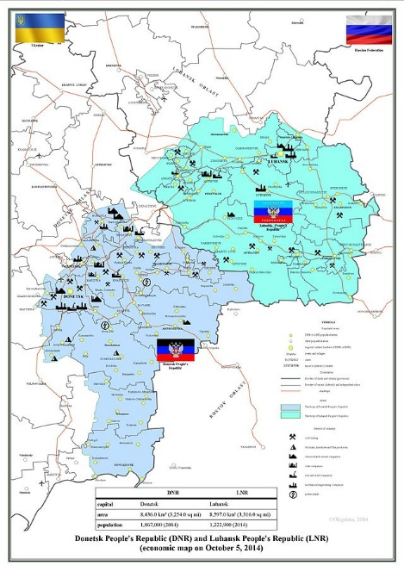
In 2014-15, the Organization for Security and Cooperation in Europe (OSCE), Russia, and Ukraine signed the Minsk Protocols (1&2) which called for an immediate cease fire (1) and a discussion of decentralizing authority in Ukraine to provide some autonomy for the secessionist Eastern regions of the country, Donetsk and Luhansk (2).
The talks, however, stalled, although the cease fire largely held (until now).

Slide 21
In 2008 at the Bucharest meeting of NATO, an open door policy was adopted for potential entrance into NATO for Georgia and Ukraine
In 2017, Ukraine entered the European Union as an associate member, further demonstrating the Pro-Western bent of the Post-Maidan government in Kyiv.

Slide 22
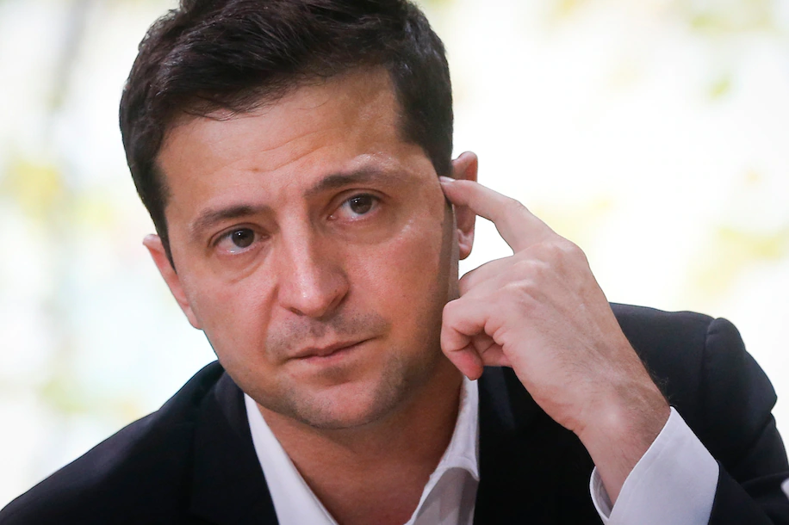
2019 election
In 2019, Volodymyr Zelensky (actor turned presidential candidate) was elected President of Ukraine on an anti-corruption platform and a pledge to end the civil war.
In many ways the Putin regime in Moscow saw this as a possible opening to negotiate an end to the civil war and implementation of the 2014-15 Minsk Protocols.
But after moving closer to the West, condemning Nordstream 2 (gas pipeline project from Russia to Germany), pledges to pursue NATO membership, and visits to Washington DC, Moscow became disillusioned with Zelensky

Slide 23
In February there was legislation introduced in the State Duma (the Russian legislature) to call for the recognition of the independence of the DPR and LPR, setting up a Crimea scenario where these “independent states” would request annexation.
Passed unanimously
Putin then issued a presidential decree recognizing the independence of the DPR and LPR

Slide 24
However, although it appears there was widespread support (even in the Russian population) for recognition, and somewhat less for annexation. There was little support for invasion and war.

Slide 25
Why did this invasion happen? Putin’s motivations
First, Putin promised to restore Russia to international prominence. Further Putin sees the “near abroad” as a crucial part of Russia’s sphere of influence, and critical to its national security position.
  The Ukraine is the biggest part of that strategy and keeping Ukraine at least neutral is critical to Russian influence in the Near Abroad.
Second, the use of military power has proven to be a reliable means to attain political goals for Putin-in Georgia, in Syria, in Africa. Great temptation to use it
  Fuel resources are and unreliable means to exert political pressure—the threat of military force is a proven lever for the Russians.
Third, general frustration with Zelensky and lack of progress on implementing the Minsk Agreements in 2014-15 which called for autonomy for the Donbas
Fourth, wants to build on his legacy in the latter part of his life (he will be 70 this year) and that legacy has to be making Russia great again. A pro-Western Ukraine cannot be part of that legacy.

Slide 26
Why does Putin portray a goal of the war as “denazification” when President Zelensky is Jewish?
Many journalists (as well as expert commentators) have pointed to the irony of this argument
  President Volodymr Zelensky is himself Jewish, and that Russian forces have damaged the memorial site for the Jewish victims of Nazi oppression during their occupation of the country, Baba Yar.
  How can this be “Denazification” if some of the most prominent targets of the Russian invasion are Jewish?
Based on assumption that “fascism” and “Nazism” and the legacy of the second World War mean the same things to the West and to Russia.
For the West, Nazism is associated with the Holocaust, and especially the 6 million Jews who were killed by Hitler’s regime.
For Russians Nazism is associated with Hitler’s brutal invasion of the Soviet Union in June 1941.
Nazism is associated with a mortal enemy, the enemy that caused the Soviet Union to lose lost around 27 million people during the war, including 8.7 million military casualties and 19 million civilians.
For Putin, then, denazification means the removal of enemies that represent an existential threat to the Russian nation.
The use of “denazification” (as well as references to the “heirs of Bandera” to describe the current Ukrainian government) are not meant for western media consumption, but to rally Russian nationalism

Slide 27
What will be the effects of the war on politics in Russia and how may that contribute to an “endgame”?
Been thinking about this but I’ll stop here– save it for Q&A.

