Slide 1
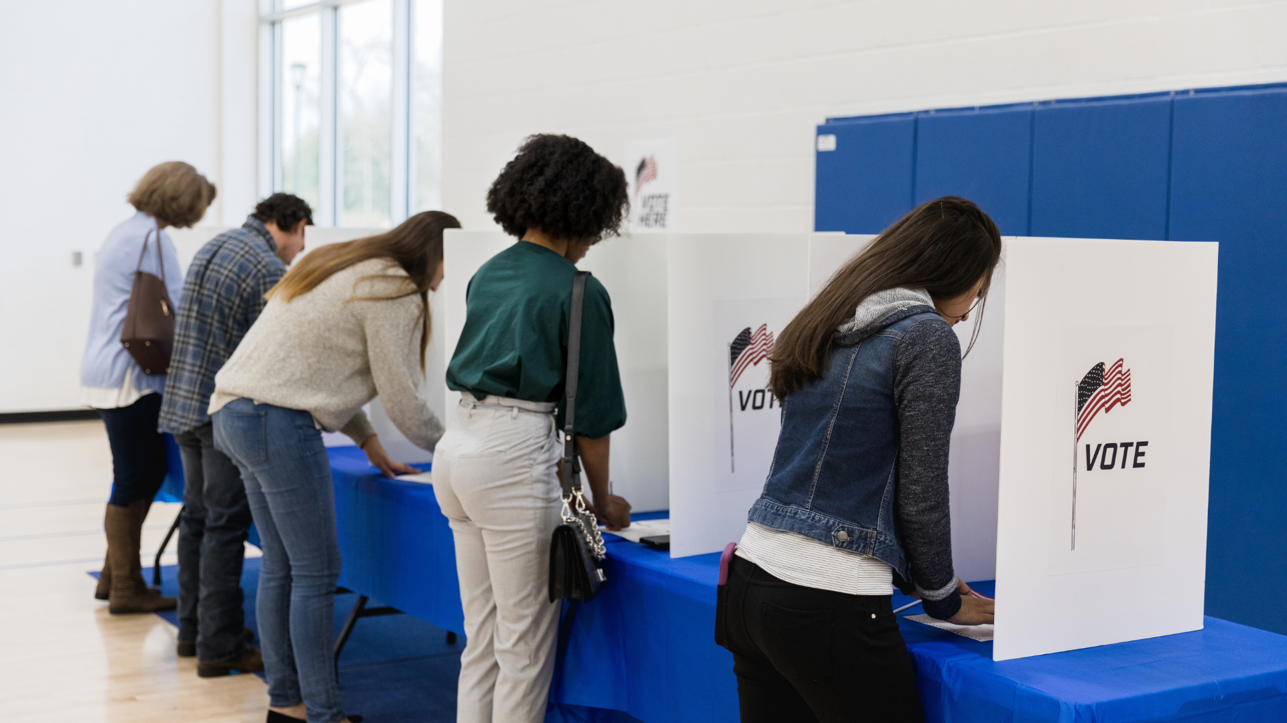
Political IdentiTree
Carah Ong Whaley, PhD, University of Virginia, February 2024

Slide 2
Agenda
Introductions
Get to Know Each Other
Political IdentiTree Activity
Political IdentiTree Questions
Political IdentiTree Discussion
Conversation
Notes:
When adding pictures, be sure to add alt-tags to all presentation images.
Please note: Agenda items have been broken out into individual items in accordance with ADA digital accessibility best practices.

Slide 3
Introductions
1-2 Minutes
Ask participants to share their name, and earliest or most prominent political memory.

Slide 4
Get to Know Each Other
3-5 Minutes
Ask participants to share (1-2 minutes): What are your hopes and concerns for your community and/or the country?

Slide 5
Political IdentiTree Set-up
2 Minutes
Some identities are linked to more social power than others.
If we have many dominant identities, we move through life differently than if we have few such identities.
Our social identities also relate to the construction of our political identities.

Slide 6
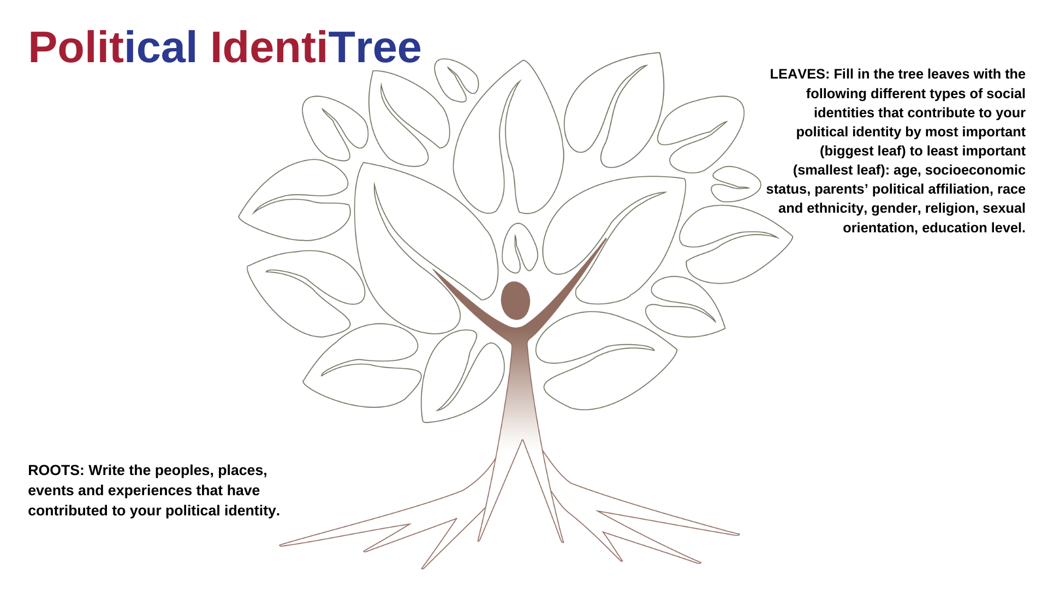

Slide 7
Political IdentiTree Activity & Questions
10 Minutes
What are different types of identities that contribute to your political identity?
e.g. age, socioeconomic status, parents’ political affiliation, race and ethnicity, gender, religion, sexual orientation, education level
Which of your identities matters most for why you are a voter? Why?
Which of your identities matters least for why you are a voter? Why?
How do your identities factor into why you are a voter? Does an identity factor into why you are a voter because it gives you a sense of belonging to a group?
Are there certain identities you have never thought of before as influencing why you are a voter?

Slide 8
Conversation
20-30 Minutes
How do particular portrayals of identities show up in our community and impact our ability to interact with others?
How do our social identities provide a lens to understand who we are and how our political actions - including voting, protesting, petitions, attending local and board commission meetings, contacting elected officials, writing public comments - impact others?
How do our own social identities impact how we perceive the political identities of others with different social identities?
How do you feel when candidates or political groups talk positively about the identities that matter most to you? How does it influence your sense of belonging? Would you share an example from the election?
How do you feel when candidates or political groups talk negatively about the identities that matter most to you? How does it influence your sense of belonging? Would you share an example from the election?

Slide 9
Conversation
20-30 Minutes
How do you feel when you see or hear a positive portrayal of the identities that matter most to you in the media or on social media? How does it influence your sense of belonging? Would you share an example from the election?
How do you feel when you see or hear a negative portrayal of the identities that matter most to you in the media or on social media? How does it influence your sense of belonging? Would you share an example from the election?
How do your identities affect how you experience and perceive election results (that is, the aftermath of all the voting)?
How does your perceptions of the identities of others affect how you experience and perceive election results (that is, the aftermath of all the voting)?

