Slide 1

Democracy’s Crises and
Democracy’s Rebirth

Slide 2
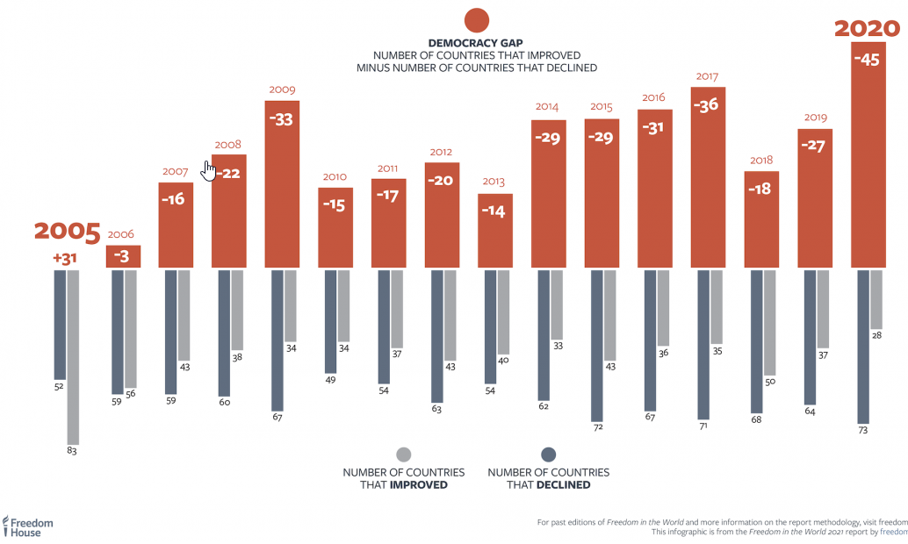

Slide 3
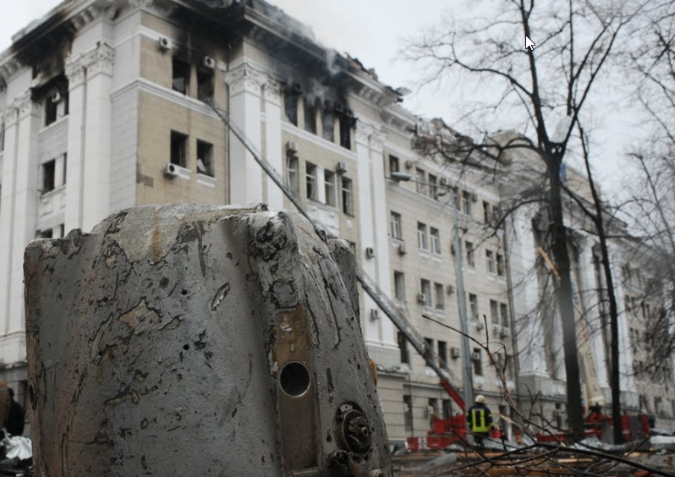
Autocracy’s March in the War in Ukraine

Slide 4
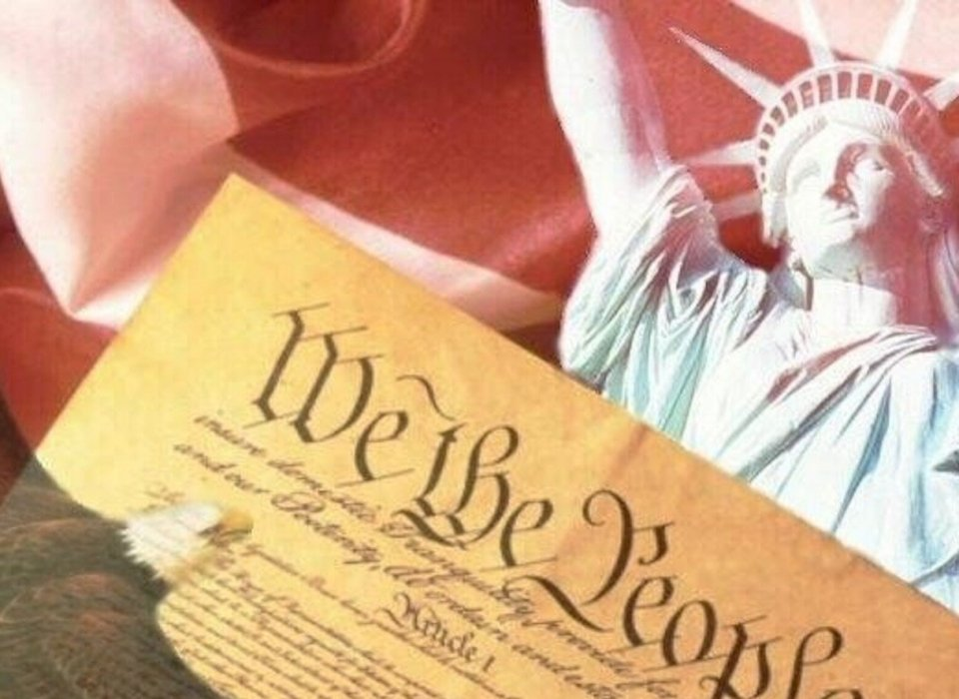

Slide 5
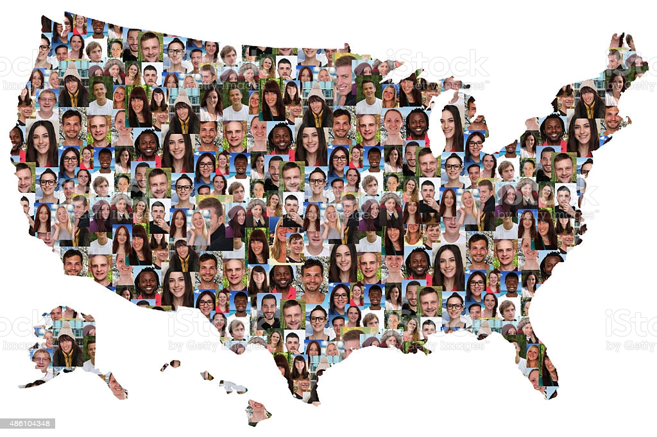
Our goal is building a multi-racial, multicultural democracy

Slide 6



A Consensus of Ideas and Solutions

Slide 7
Today we face Eight Key Challenges
Racial and income inequality
Systemic racism
Money in politics
Low level of citizen and voter participation
Polarization and the politics of resentment
Political corruption
Structural problems like the Electoral College and the Senate Filibuster
Current Crises such as the pandemic, overcoming economic recession, inflation, and crime

