Slide 1
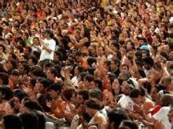
Democracy’s Rebirth: Creating a more Participatory and Deliberative Democracy

Slide 2
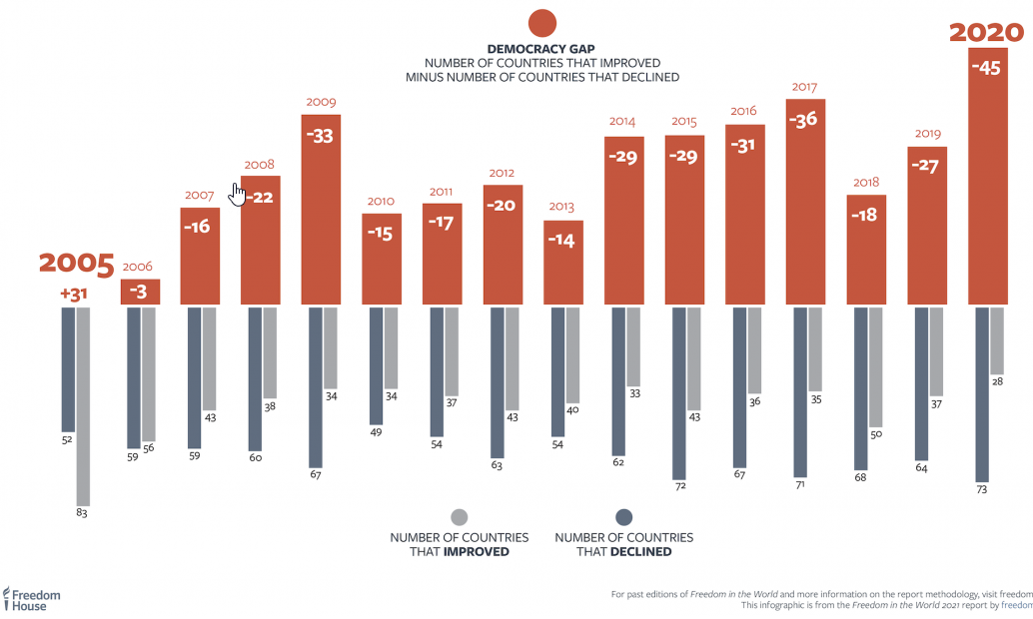

Slide 3
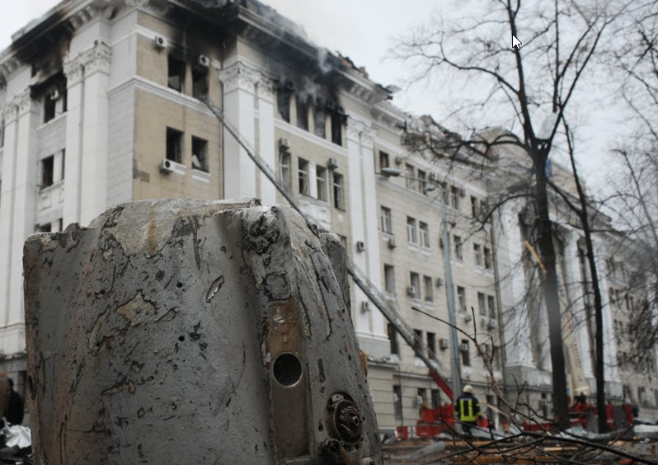
Autocracy’s March in the War in Ukraine

Slide 4
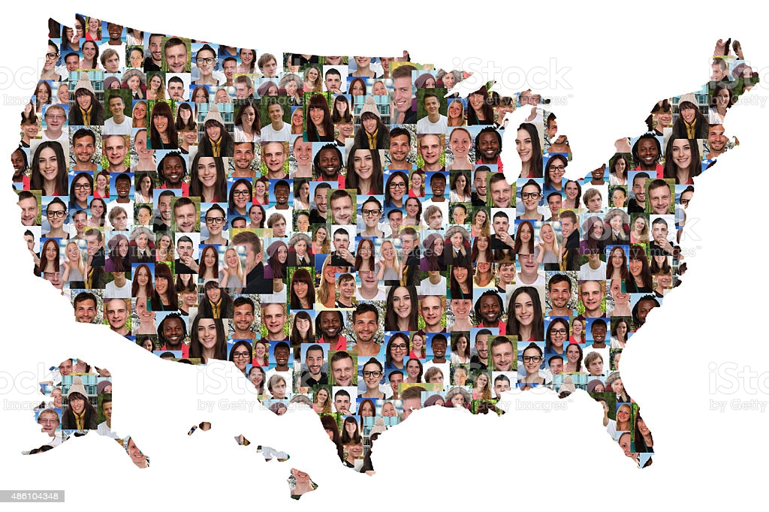
Our goal is building a multi-racial, multicultural democracy

Slide 5
Today we face Eight Key Challenges
Racial and income inequality
Systemic racism
Money in politics
Low level of citizen and voter participation
Polarization and the politics of resentment
Political corruption
Structural problems like the Electoral College and the Senate Filibuster
Current Crises such as the pandemic, overcoming economic recession, inflation, and crime

Slide 6
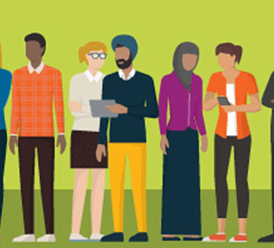

We are Divided by Income, race, and Ideology

Slide 7
Reforms to deal with income inequality
Create a fairer tax system so that the wealthy and corporations pay significantly higher taxes.
Better regulate transnational corporations.
Institute a shorter work week, better education, and job training pro­grams for citizens.
● Enact fairer immigration rules and citizenship for the twelve million immigrants
already in the United States without legal status.

Slide 8
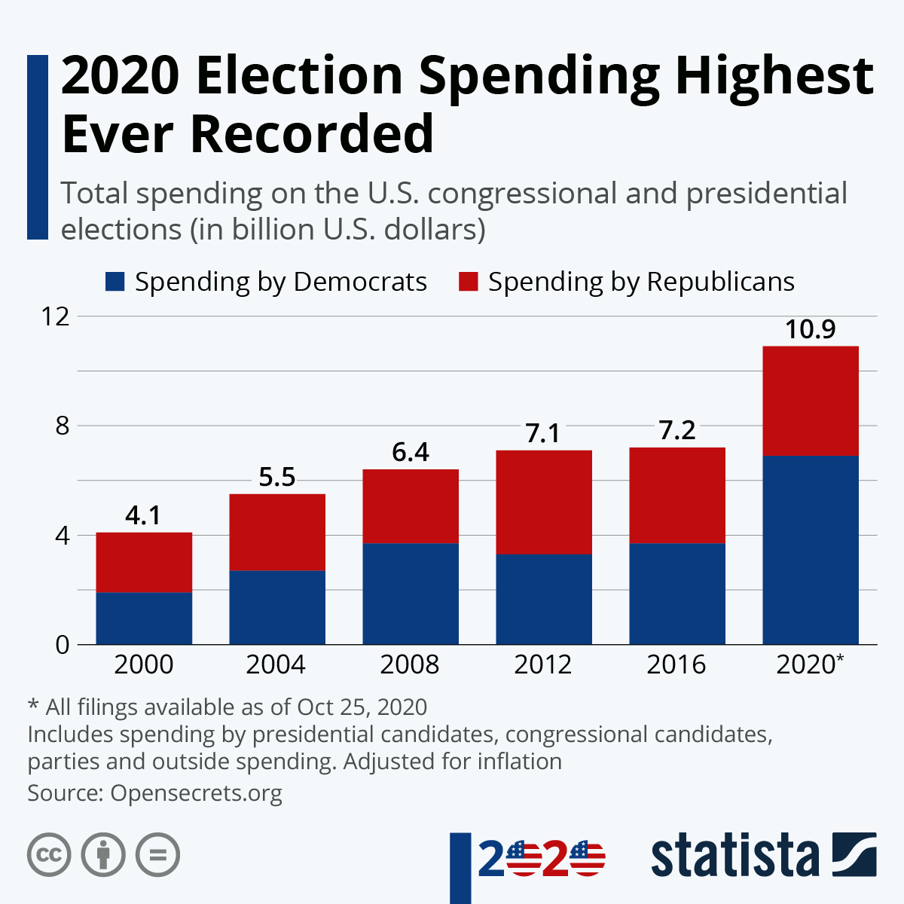

Slide 9
Campaign Reforms
Reinstitute the Voting Rights Act of 1965 or pass the broader HR 1 For the People Act to prevent voter suppression laws and make voting easier.
• Publicly finance political campaigns and restrict private campaign contributions.
• Repeal Citizens United by a constitutional amend­ment to clarify that corporations are not citizens, that campaign contributions can be regulated, and that corruption can be broadly defined and prohibited.
• Implement automatic voter registration.
• Institute ranked-choice voting to end uncompetitive districts and single-party dominance.

Slide 10

Corruption is often stealing or Bribery

Slide 11
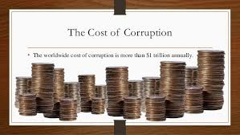

Slide 12
Transparency and Anti-Corruption Reforms
Ensure greater transparency in government so citizens can better hold officials accountable.
• Require civic education and civic engagement courses in schools and enact the Civics Secures Democracy Act to make civic engagement a priority in K–12 education.
• Establish nonpartisan redistricting commissions to end partisan gerrymandering after 2021.
• Prohibit outside employment of public officials that conflicts with their public duties.
• Strengthen the role of inspectors general in all units of government.
• Destroy machine politics by eliminating patronage, favoritism, and crooked contacts.

Slide 13
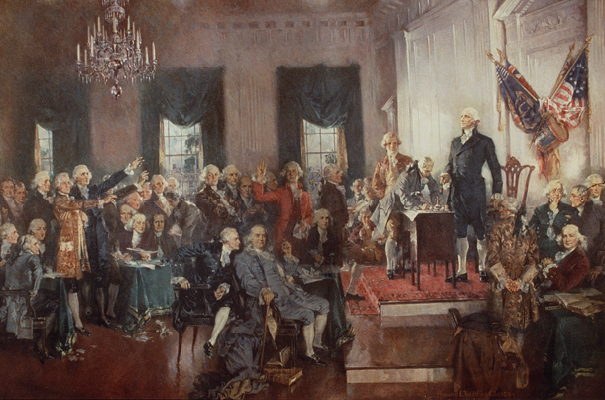
Constitutional Convention of 1787

Slide 14
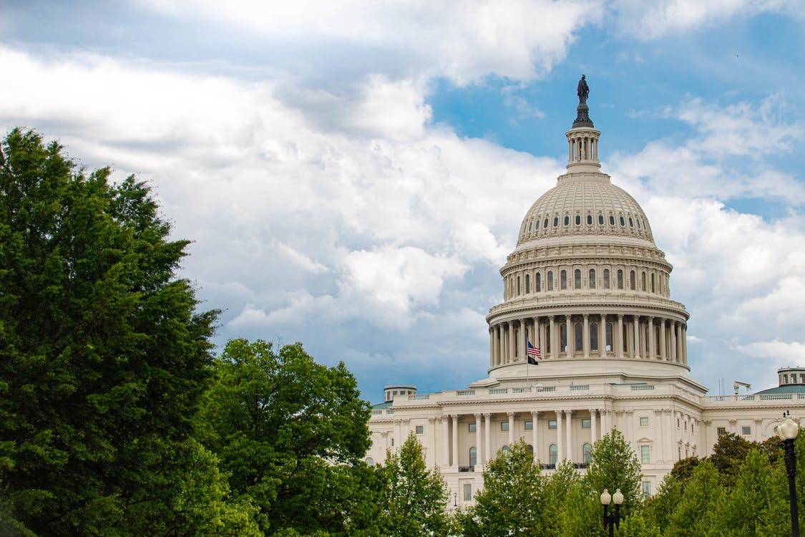
Making Congress More Deliberative

Slide 15
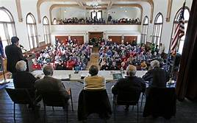
New England Town Hall Meeting

Slide 16
Deliberative Democracy Reforms
Create more participatory neighborhood government in our cities and towns.
• Create deliberative democratic institutions at the state and national levels.
• Work to eliminate the culture of corruption and institutional corrup­tion.
• Reform the Electoral College so that the results reflect the national popular vote for president and vice president.
• Enact term limits for all elected offices.
• Create longer early voting periods, easier vote-by-mail systems, and, when safeguards are in place, institute electronic voting.
• Institute merit selection and term limits for judges.

Slide 17
Questions:
Which reform is most important to you?
Which ones do you think are impossible?

