Slide 1
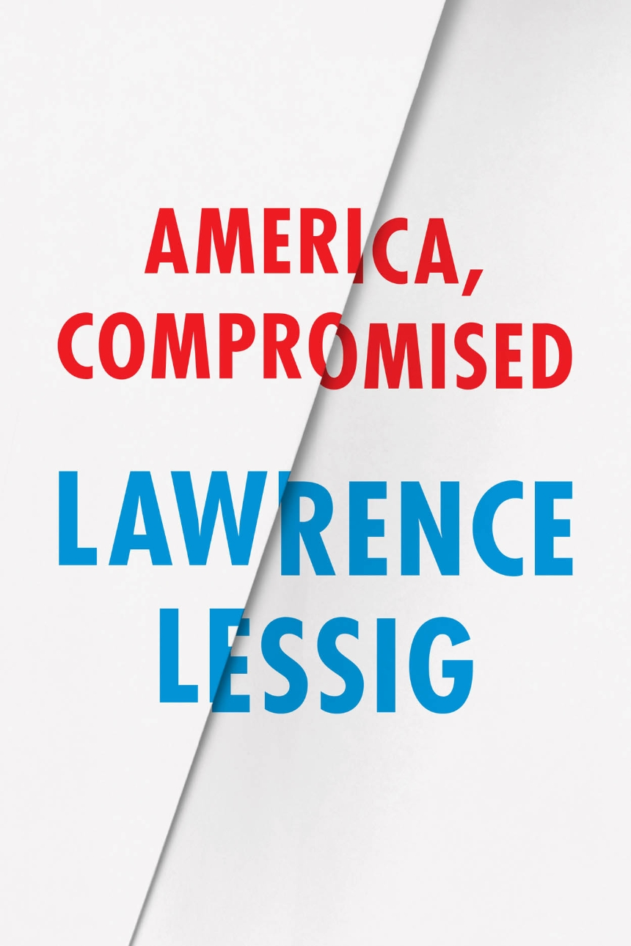
Political, Institutional and Moral Corruption

Slide 2
Political Corruption
Political corruption is the use of political or governmental office for the private benefit for oneself or one’s family and friends.

Slide 3

Corruption is often stealing or Bribery

Slide 4
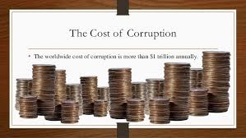

Slide 5
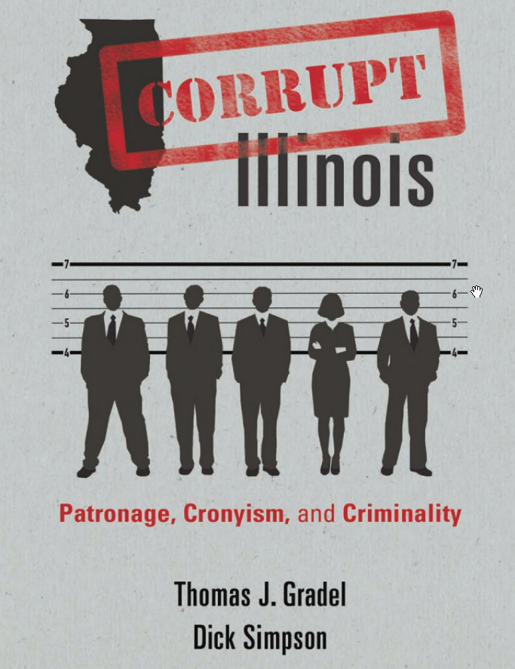
Corrupt Illinois: One example of the
Continuing Problem

Slide 6
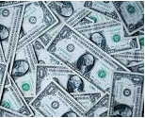
The cost of corruption in Illinois is at least $500 million a year
The Illinois Debt is more than $140 billion. The continuing cost of
corruption is a part of the problem.

Slide 7
Corruption in major cities in the U.S.

Slide 8
Institutional Corruption

Slide 9

Emoluments = Gifts from Foreign Powers

Slide 10
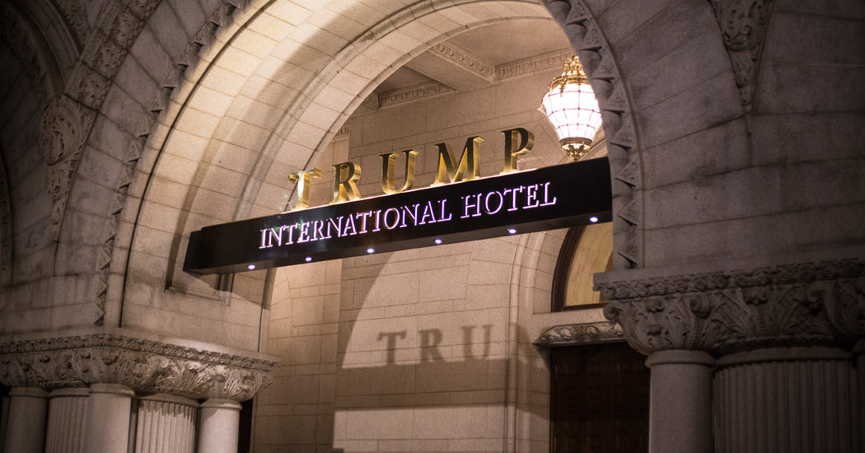

Slide 11

Ivanka Trump was able to sell beauty products

Slide 12
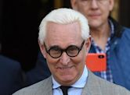
Roger Stone

Slide 13
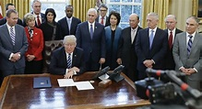
The Trump Cabinet

Slide 14
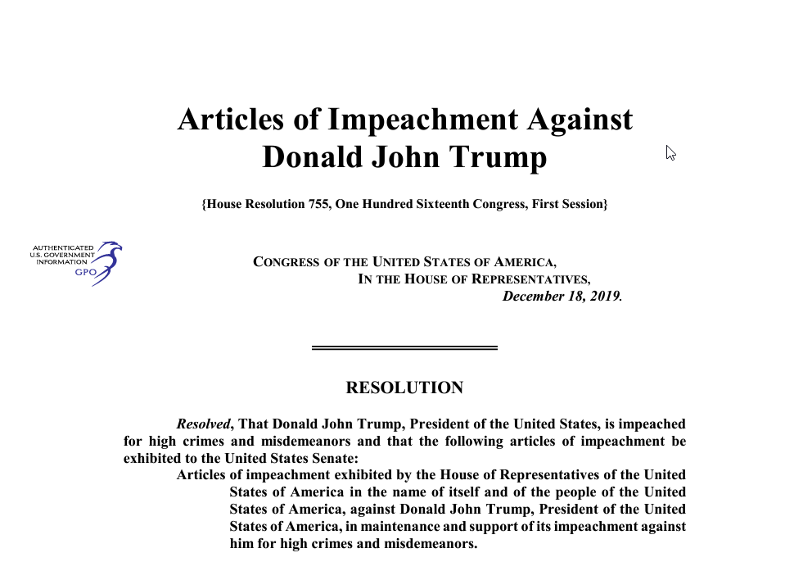

Slide 15
Institutional Corruption
We have allowed core institutions of America’s economic, social and political life to become corrupted.

Slide 16

The Greenback or Money Primary

Slide 17

The Public can take action to end corruption

Slide 18
Ending Corruption
Demand more transparency and accountability of government and public officials.
Hire more inspectors general, including in the suburbs and local governments.
Provide civic engagement programs in our schools by passing the Civics Secures Democracy Act.
Encourage more citizen participation in government and politics by changing the dates of elections, creating Automatic Voter Registration, and new rules for considering legislation in the state legislature.
Adopt public financing for political campaigns as New York City, Maine, and Minnesota have done.
Elect better public officials who will not just promise but will carry out reforms.
Change how we remap legislative districts and adopt term limits for public officials.
End political machines and permanently changing the culture of corruption.

