Slide 1

Money in Politics

Slide 2
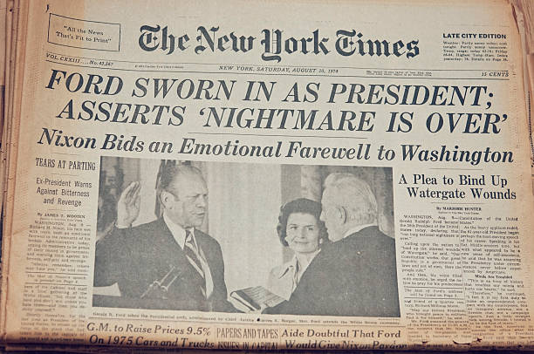
Watergate Scandal brings campaign
Finance Reforms

Slide 3

Citizens United changed the rules governing money in politics

Slide 4
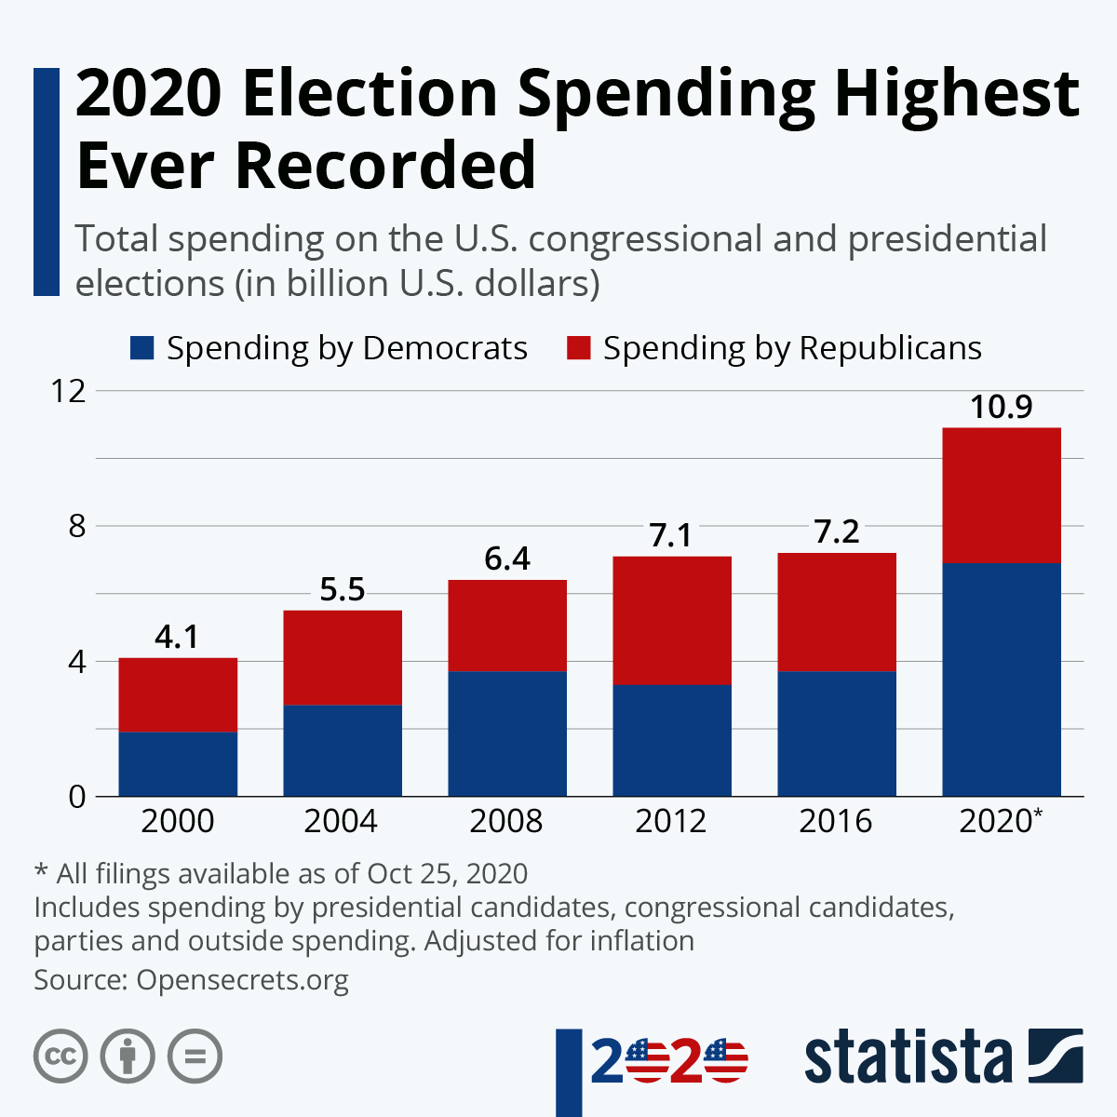

Slide 5


Slide 6
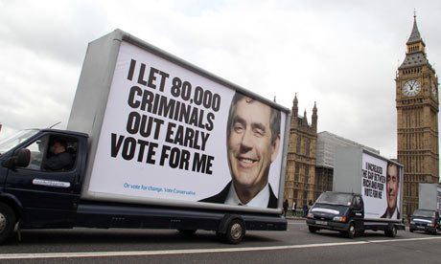

Slide 7

The Working Class make UP only:
10 percent of the average city council
3 percent of the average state legislature
Congresspeople spent less than 2 percent of his or her adult life doing the kinds of jobs most Americans go to every day.

Slide 8
Official bias
Members of Congress who are wealthier are more likely to oppose the estate tax.
Mayors from business backgrounds shift city resources away from social safety net programs and toward business-friendly infrastructure projects.
Legislators with more education and income are less likely to support policies that would reduce economic income inequality.
Lawmakers with more money in the stock market are more likely to raise the debt ceiling and thereby protect the stock market.

Slide 9

Lobbyists can control government outcomes

Slide 10

Money manipulates public opinion

Slide 11
Solutions
Candidates and Citizen Lobbyists have sufficient funds
representatives actually represent a majority of their constituent
government to match small private donations to candidates
vouchers for a set amount are provided to each reg­istered voter
free television coverage of candidate debates and free mailing
prevent public officials from lobbying other units of government
prevent public officials from lobbying government for several years after they leave the government.
“People’s lobbyists” or to public subsidies to public interest organizations

