Slide 1
Racial and Income Inequality

Slide 2


We are Divided by Income, race, and Ideology

Slide 3
Income Inequality By Race And Gender In The U.S.
Rank | Ethnicity And Gender | Weekly Wages
1 | Asian Males | $1,080/week
2 | White Males | $897/week
3 | Asian Females | $841/week
4 | White Females | $734/week
5 | Black Males | $680/week
6 | Native Hawaiian & Pacific Islander Males | $632/week
7 | Native American & Alaskan Males | $623/week
8 | Hispanic Males | $616/week
9 | Black Females | $611/week
10 | Native Hawaiian & Pacific Islander Females | $556/week
11 | Hispanic Females | $548/week
12 | Native American & Alaskan Females | $529/week

Slide 4
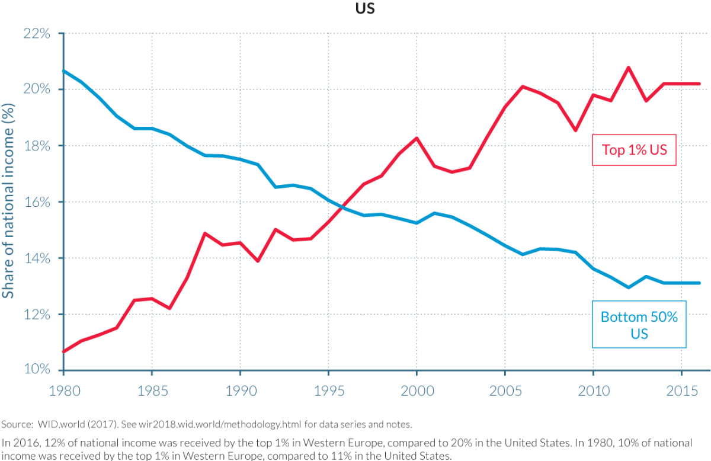
The rich get Richer and the poor get poorer

Slide 5
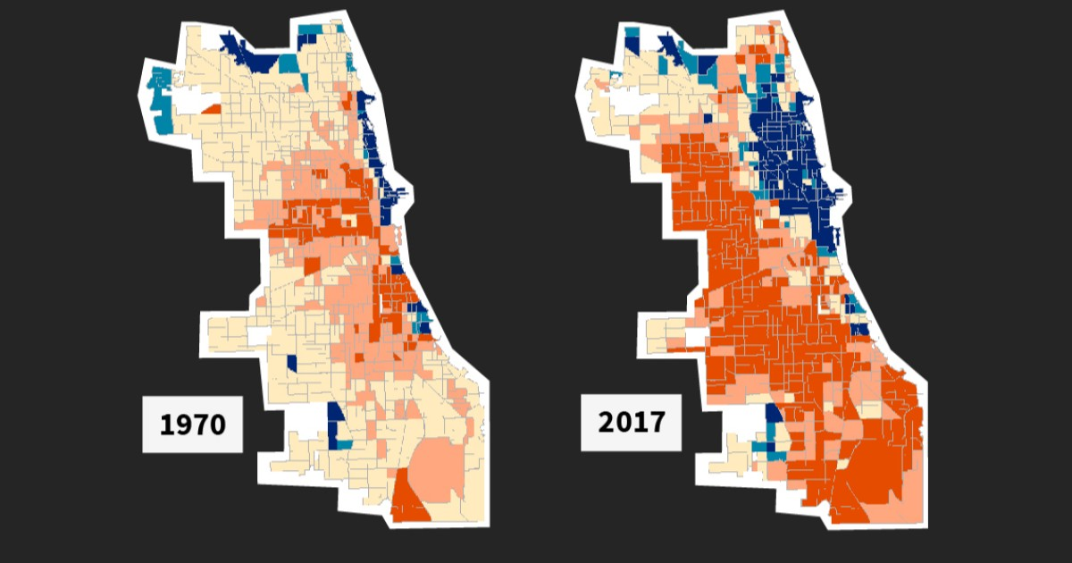
Middle Class Census Tracks in Chicago

Slide 6
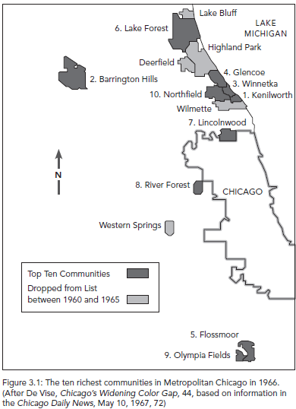

Slide 7
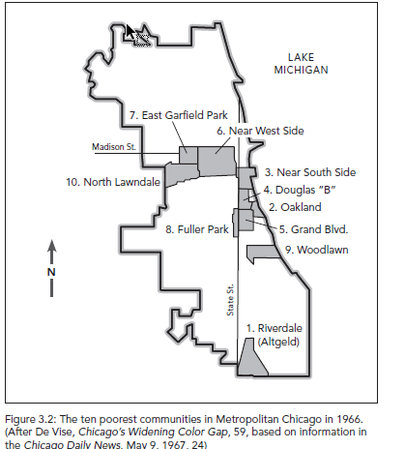

Slide 8


Slide 9

Solutions are not as simple or easy as slogans like this one nor are they easy to enact in practice.

