Slide 1

PSC102
De Tocqueville, Equality, & Education

Slide 2

Wednesday
05 October
Please, be sure cell phones are off
Assignments –
  Reading
    ReRead – Packer’s ‘Four Americas’ –Smart America section
    Reading Module for Smart America – selected works - all
  Writing - L/A 3 due Friday night, 14 Oct 2021, by midnight ET [dropbox will close] – outline/grading criteria posted on BlackBoard
Engagement Opportunities
  See B/B announcements

Slide 3

Last Class:
Substance
Renaissance and
rise of Modernity

Slide 4

Recent Thoughts on
College Degree in US
Those without a college degree can find their upward mobility in the job market limited by a lack of educational credentials
The public as a whole – including a substantial share of college graduates – expresses reservations about the extent to which various higher education institutions prepare students for the workforce more generally
The purpose of college: Americans view workforce-relevant skills and knowledge as more important than personal and intellectual growth
Americans have mixed views about the extent to which college prepares students for a well-paying job in today’s economy
Pew Research - 2016

Slide 5
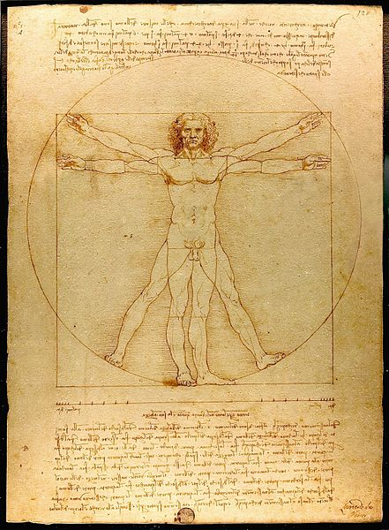
Renaissance Thinking
& the U.S. ‘experiment’
Man is the measure of all things
Protagoras
New Perspective emerging
From Europe in 1400s
Prof. McGovern’s quick history of everything

Slide 6


Smart America:
Rise of the Administrative
State
Prior to Civil War – These United States; Post – The United States
Prior to Civil War – role of college in US history
Post Civil War – need for bureaucracy/administra-tion – the rise of Political Science and Gov’t studies

Slide 7
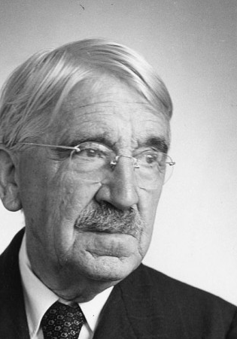
The Father of Smart
America – John Dewey
John Dewey (1859-1952) was an American philosopher, associated with pragmatism. His immense philosophical and other written output encompasses most areas of philosophy as well as a host of other educational, social and political concerns. Although much of Dewey’s political writing is prompted by specific issues, his overall orientation is deeply shaped by his pragmatism or (as he preferred) “experimentalism”. At the core of his political thinking are the beliefs that science and democracy are mutually supportive and interdependent enterprises, that they are egalitarian, progressive and rest on habits of open social communication

Slide 8
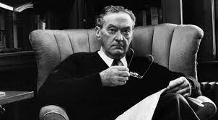
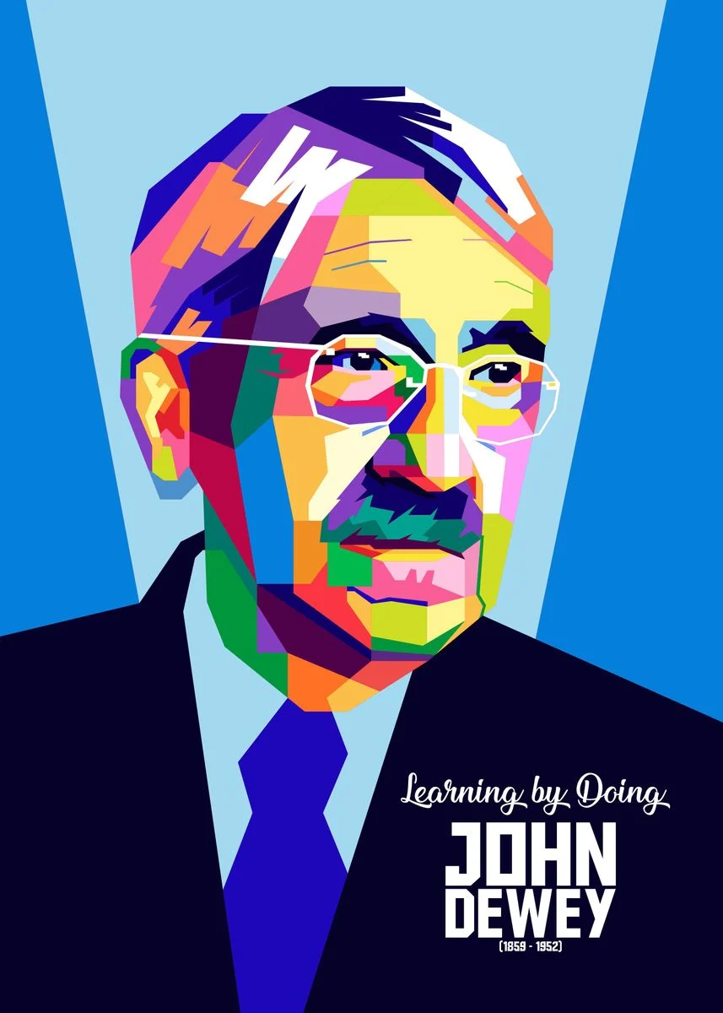
Dewey on
Democracy
The period between the wars saw an imposing series of books articulating and developing his philosophical beliefs. This includes Reconstruction in Philosophy (1920), Human Nature and Conduct (1922), Experience and Nature (1925), The Quest for Certainty (1929), Art as Experience (1934), A Common Faith (1934), Logic: The Theory of Inquiry (1938), and Theory of Valuation (1939).
The Public and Its Problems (1927) contained a defense of participatory democratic ideals against sceptics such as Walter Lippmann, who argued that there was only space for a minimally democratic politics in complex modern societies. Dewey was a critic of laissez-faire liberalism and its accompanying individualistic view of society from his early writings.

Slide 9
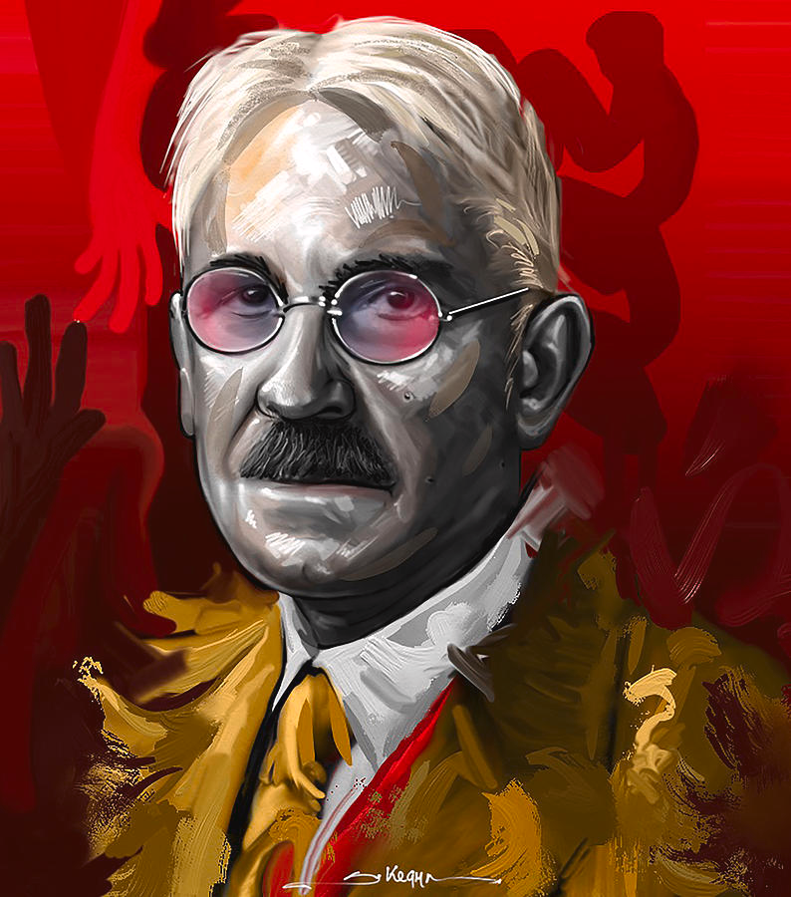
As Public
Intellectual
As a public intellectual, Dewey was a supporter of such causes as women’s suffrage and the Settlement House movement (he was a frequent visitor to the philosopher Jane Addams’s and Ellen Gates Starr’s famous Hull House in Chicago). He lectured to international audiences and his educational writing in particular was influential in a wide range of settings. His immense range of public and political activities included presidency of the teachers’ union, sponsorship of the American Civil Liberties Union and NAACP, support for the Outlawry of War movement in the interwar years, chairing the People’s Lobby. After his move to New York, and particularly after the onset of the First World War, a substantial part of his published output consisted of commentary on current domestic and international politics, and public statements on behalf of many causes, both domestic and international. He was a prominent critic from the left of Roosevelt’s New Deal while at the same time opposing Soviet communism and its western apologists.

Slide 10
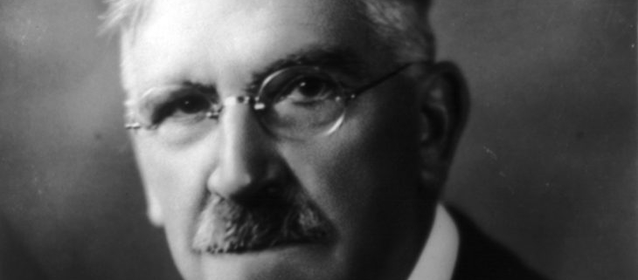
Defense of Positive Democracy
In texts such as “The Ethics of Democracy” and “Christianity and Democracy,”, Dewey elaborates a version of the Idealist criticisms of classical liberal individualism. For this line of criticism, classical liberalism envisages the individual as an independent entity in competition with other individuals, and takes social and political life as a sphere in which this competitive pursuit of self-interest is coordinated.
By contrast, the Idealists rejected this view of social and political life as the aggregation of inherently conflicting private interests.
Instead, they sought to view individuals relationally: individuality could be sustained only where social life was understood as an organism in which the well-being of each part was tied to the well-being of the whole.
Freedom in a positive sense consisted not merely in the absence of external constraints but the positive fact of participation in such an ethically desirable social order.

Slide 11
Defense of
Positive Democracy
On this foundation, Dewey rebuts the bleak assessment that democracy is the rule of the ignorant majority. While it is important that voters can reject their rulers and so control them to some extent, democracy is not simply a form of government defined by the distribution of the franchise or majority rule. Rather what matters, as Dewey puts it, is the way that the majority is formed.
Dewey’s view: that “men are not isolated non-social atoms, but are men only when in intrinsic relations” to one another, and the state in turn only represents them “so far as they have become organically related to one another, or are possessed of unity of purpose and interest” (“The Ethics of Democracy”, EW1, 231-2).
Democracy is a form of moral and spiritual association that recognizes the contribution that each member can make in his or her particular way to this ethical community. And each of us can contribute to this community since we each only become the individuals we are through our engagement in the institutions and practices of our society.
Other important themes also appear in these early statements. Democracy is not “simply and solely a form of government”, but a social and personal ideal; in other words, it is not only a property of political institutions but of a wide range of social relationships. This ideal is common to a range of social spheres, and should take “industrial, as well as civil and political” forms (“The Ethics of Democracy”, EW1, 246).
Through democracy in this expansive and ideal sense,
  the incarnation of God in man … becomes a living, present thing … The truth is brought down to life, its segregation removed; it is made a common trust enacted in all departments of action, not in one isolated sphere called religious. (“Christianity and Democracy”, EW4, 9)
While the Christian conception of democracy recedes (but does not entirely disappear) in Dewey’s later work, the idea that democracy should be viewed as a form of relationship that encompasses and unifies different spheres of social life remains important.
Dewey’s later work is more questioning of the traditional ethical standards and ideals that he appeals to in an essay like “The Ethics of Democracy:”
  individuals are not presocial atoms, and democracy is more than a method of majority rule through voting; it is also a social and ethical ideal.

Slide 12
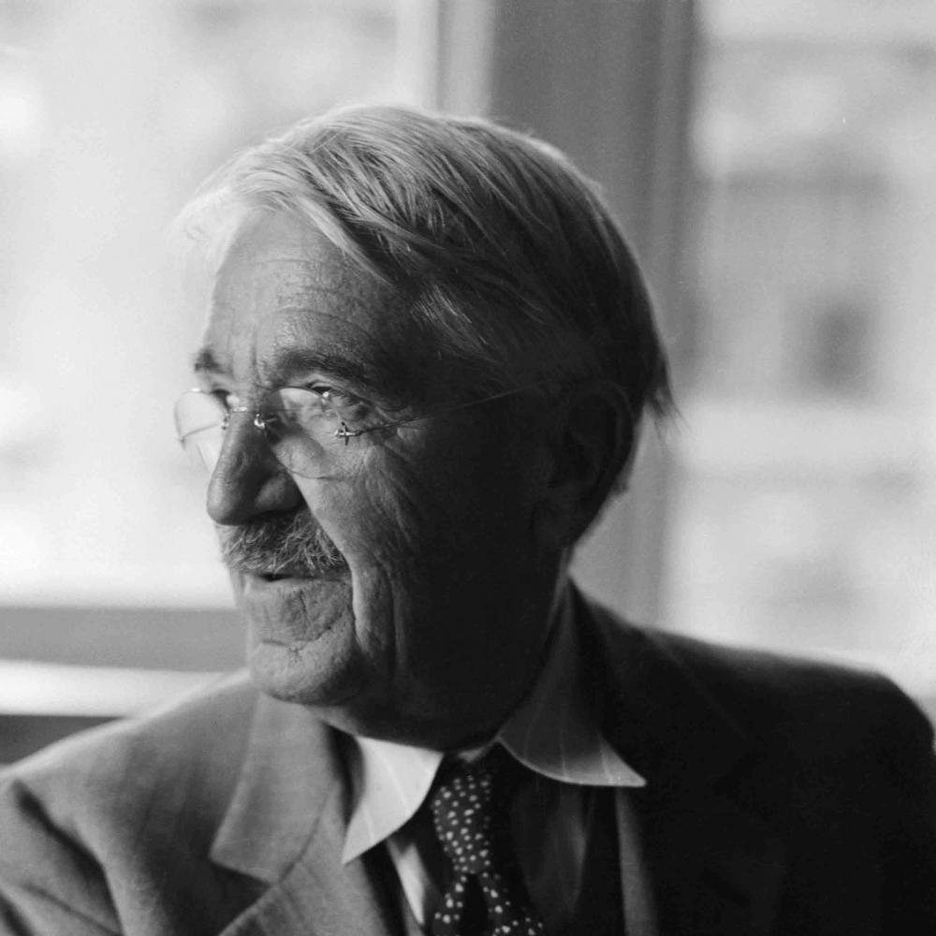
Contra “Free
America”?
Dewey criticizes classical liberalism for conceiving of the individual as “something given, something already there”, prior to society and for viewing social institutions merely as instruments for coordinating the interests of pre-social individuals. Instead, he argues, social institutions are “means for creating individuals.”
When classical liberalism treats the individual as “something given,” he argues, a genuine:
  liberalism knows that an individual is nothing fixed, given ready-made. It is something achieved, and achieved not in isolation but with the aid and support of conditions, cultural and physical: — including in ‘cultural’, economic, legal and political institutions as well as science and art. (“The Future of Liberalism”, LW11: 291)

Slide 13
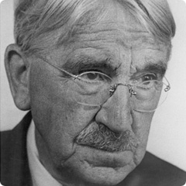
On
Liberalism
Three features of Dewey’s view of individuality are most prominent:
Individuality is reflective: freedom is held to consist in the capacity and willingness on the part of a person to reflect on her or his own goals, aims and projects, and to revise them as a result of this reflection. Individuality consists in the personal capacity for choice
It is social: it is thought to involve participation in shaping the social conditions that bear on individuality. As Dewey puts it in The Public and Its Problems, liberty “is that secure release and fulfilment of personal potentialities which take place only in rich and manifold association with others: the power to be an individualized self making a distinctive contribution and enjoying in its own way the fruits of association”
And it must be exercised in order to be enjoyed. For Dewey’s, it is a necessary condition of an agent’s being free that he or she should actually pursue those ends outlined by that theory as constitutive of the good – that is, he or she should exercise the opportunity: I am in possession of my liberty in this valuable sense for Dewey only if I actually act in these ways.

Slide 14

Smart America:
Packer
Key Elements
At home in modernity
College educated – dominate top 10% of Am. incomes
Individual still – not class/group oriented
Meritocracy
“Created a new hereditary class structure. Educated professionals pass on their money, connections, ambitions, and work ethic to their children, while less educated families fall further behind, with less and less chance of seeing their children move up”
Uneasy with patriotism – “If your goal is to slow climate change, or reverse inequality, or stop racism, or rebuild democracy, you will need the national solidarity that comes from patriotism”

Slide 15
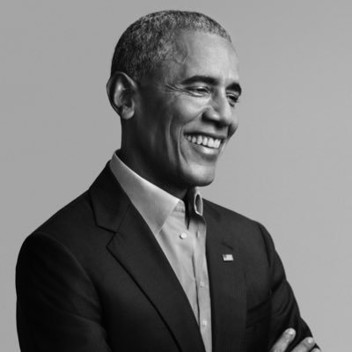
Obama
Banneker School
Speech
We live in a global economy. And when you graduate, you’re no longer going to be competing just with somebody here in D.C. for a great job. You’re competing with somebody on the other side of the world, in China or in India, because jobs can go wherever they want because of the Internet and because of technology. And the best jobs are going to go to the people who are the best educated -- whether in India or China, or anywhere in the world.
“a high school education these days is not enough. By 2020, two out of three job openings require some form of higher education.”
And so Amari, she was talking about the support everybody here gave her, and she said, “I believed in myself because my teachers believed in me.” And that’s the kind of community that we want in every school -- where you’re looking out for each other and you’re taking care of one another. And so now Amari plans to be a doctor so she can help kids who had illnesses like hers. And that’s what’s possible -- (applause) -- that's what's possible when we’re all committed to each other’s success; when we understand that no matter what you look like, where you come from, what faith you are, whether you’re a boy or a girl -- that you should have great opportunities to succeed. And that requires you to put effort into it.

Slide 16
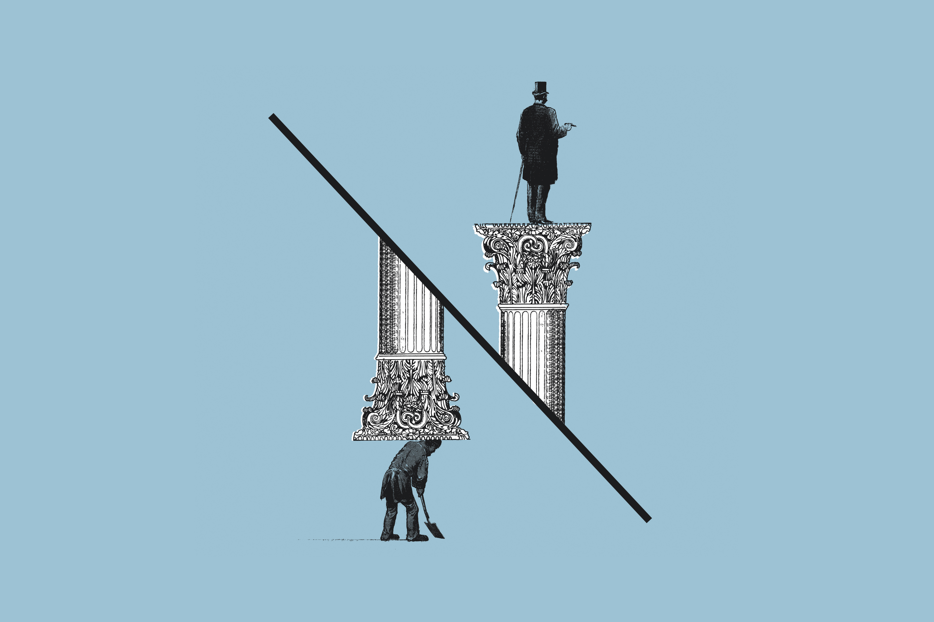
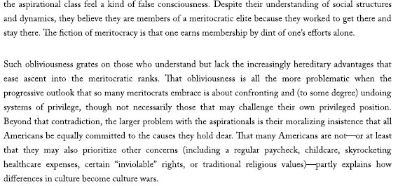
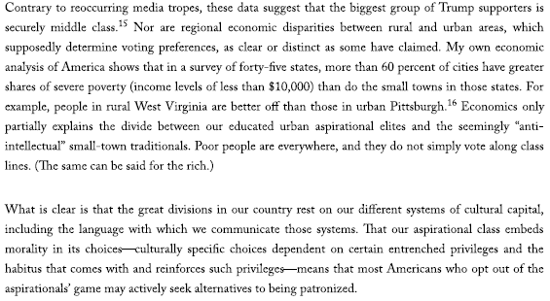
The Endless Pursuit of Better

Slide 17
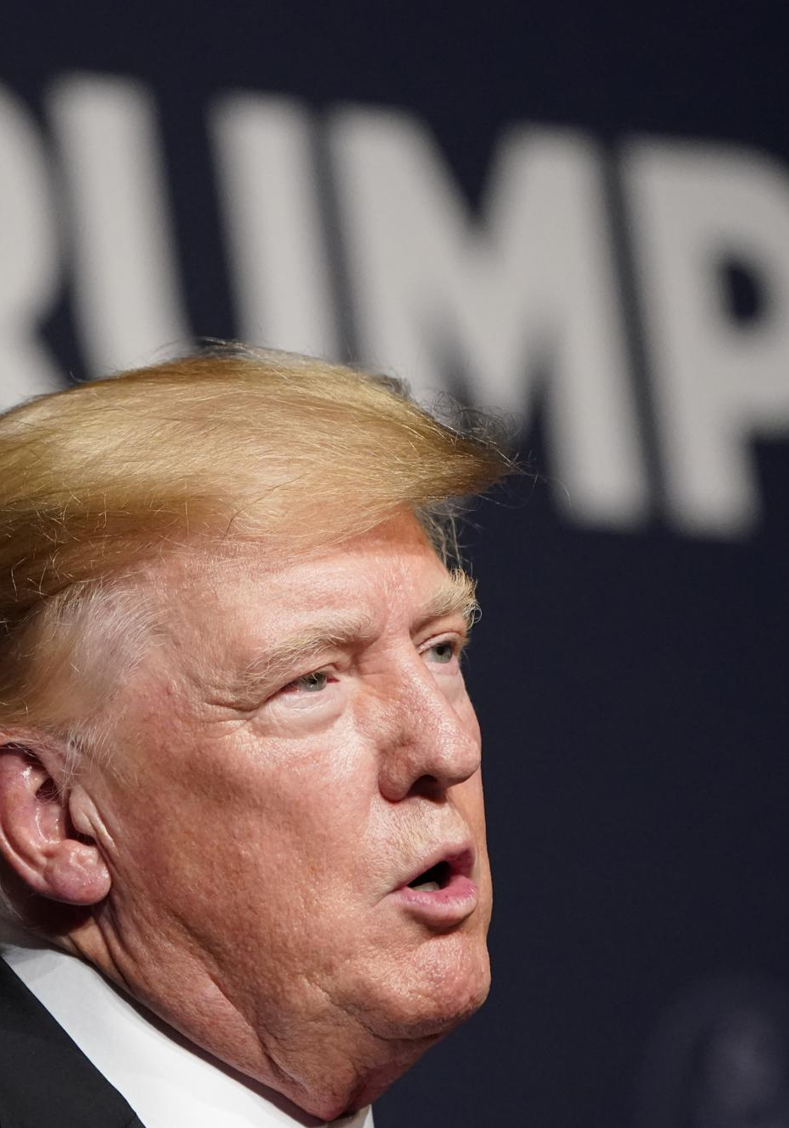
Trump
Subpoena
Federalism
Madison
Washington
Roosevelt
Nixon

