Slide 1

PSC102
Real America

Slide 2

Wednesday
19 Oct 2022
Please, be sure cell phones are off
Assignments –
  Reading
    ReRead – Packer’s ‘Four Americas’ – Real America section
    Reading Module for Real America – selected works - all
  Writing - L/A 4 due Friday, 28 Oct, by midnight ET [dropbox will close] – outline/grading criteria posted on BlackBoard
  Working on L/A-3 grades
C/E – Due Friday 21 Oct by midnight ET
  See NYU webinar posted on BlackBoard

Slide 3

Last Class:
Substance
Insulation of ‘Smart America’
Failure of Smart America to engage patriotism

Slide 4
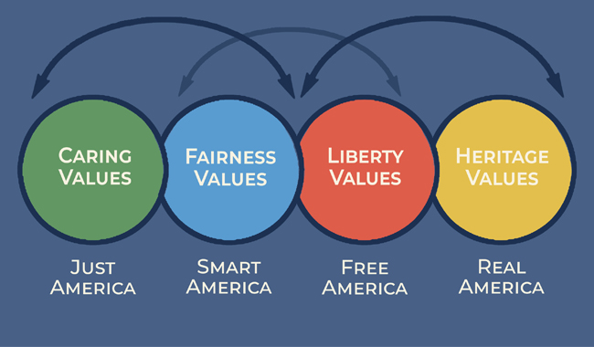
US Political Thought:
Key Themes/
Foundations
Liberalism
Republicanism
Protestantism
Nationalism
Discursive politics

Slide 5
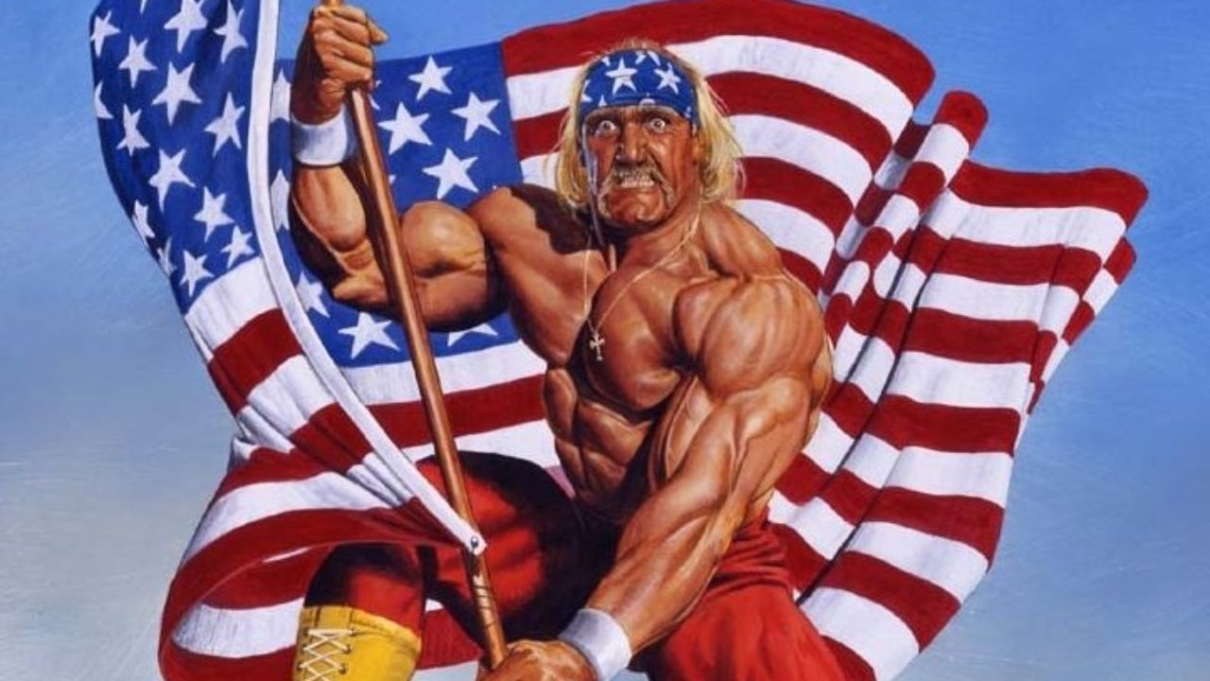
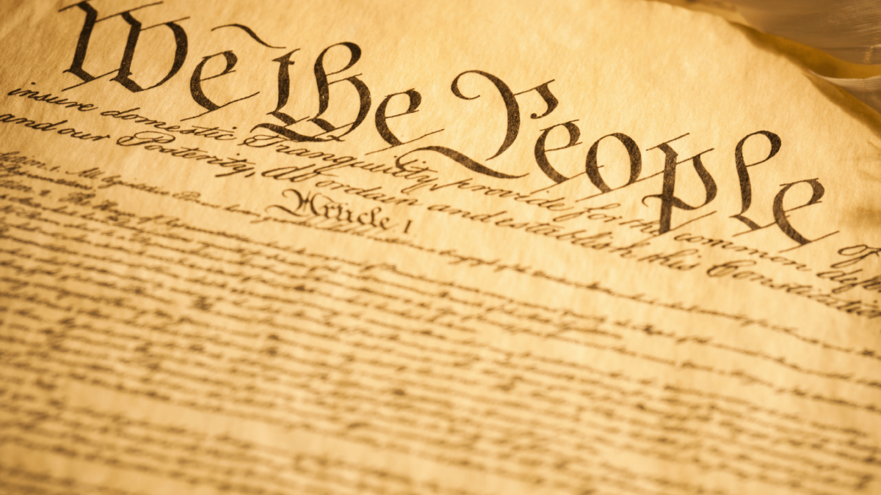
Real America
Introduction
“We believe that the best of America is in these small towns that we get to visit,” she said, “and in these wonderful little pockets of what I call the real America, being here with all of you hardworking, very patriotic, very pro-America areas of this great nation. Those who are running our factories and teaching our kids and growing our food and are fighting our wars for us.” -Sarah Palin

Slide 6
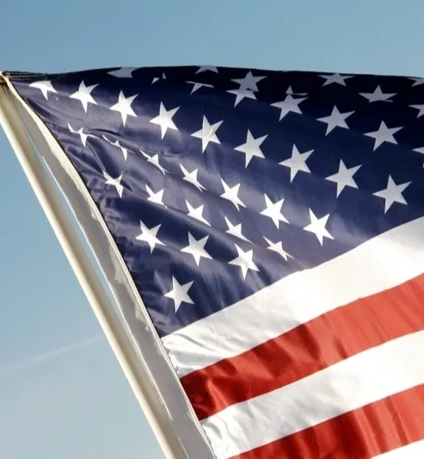
Real America
Motivations
Its motivation fueled by Americans of ‘suspect origins,’ radical foreign political positions, and redistributionist views.
The worst offense is a new galling mix of class and race. Non-white professionals who go to the best schools, who appear to know more, and who appear too weak or too cerebral to get in the mud pit of politics with them.

Slide 7
Real America
Packer 1
Real America is a very old place. The idea that the authentic heart of democracy beats hardest in common people who work with their hands goes back to the 18th century.
It was embryonic in the founding creed of equality. “State a moral case to a ploughman and a professor,” Thomas Jefferson wrote in 1787. “The former will decide it as well, and often better than the latter, because he has not been led astray by artificial rules.”
Moral equality was the basis for political equality. As the new republic became a more egalitarian society in the first decades of the 19th century, the democratic creed turned openly populist.
Andrew Jackson came to power and governed as champion of “the humble members of society—the farmers, mechanics, and laborers,” the Real Americans of that age.
The Democratic Party dominated elections by pinning the charge of aristocratic elitism on the Federalists, and then the Whigs, who learned that they had to campaign on log cabins and hard cider to compete.

Slide 8
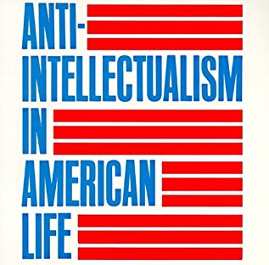
Real America
Packer 2
The triumph of popular democracy brought an anti-intellectual bias to American politics that never entirely disappeared.
Self-government didn’t require any special learning, just the native wisdom of the people.
“Even in its earliest days,” Richard Hofstadter wrote, “the egalitarian impulse in America was linked with a distrust for what in its germinal form may be called political specialization and in its later forms expertise.”
Hostility to aristocracy widened into a general suspicion of educated sophisticates. The more learned citizens were actually less fit to lead; the best politicians came from the ordinary people and stayed true to them.
Making money didn’t violate the spirit of equality, but an air of superior knowledge did, especially when it cloaked special privileges.

Slide 9
Real America
Packer 3
Religious
Nationalistic
From its beginnings, Real America has also been religious, and in a particular way: evangelical and fundamentalist, hostile to modern ideas and intellectual authority. The truth will enter every simple heart, and it doesn’t come in shades of gray. “If we have to give up either religion or education, we should give up education,” said Bryan, in whom populist democracy and fundamentalist Christianity were joined until they broke him apart at the Scopes “monkey trial” in 1925.
Real America has a strong nationalist character. Its attitude toward the rest of the world is isolationist, hostile to humanitarianism and international engagement, but ready to respond aggressively to any incursion against national interests. The purity and strength of Americanism are always threatened by contamination from outside and betrayal from within. The narrative of Real America is white Christian nationalism.

Slide 10
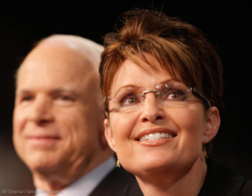
Real America
Packer 4
The overwhelmingly white crowds that lined up to hear Palin speak were nothing new.
Real America has always been a country of white people. Jackson himself was a slaver and an Indian-killer, and his “farmers, mechanics, and laborers” were the all-white forebears of William Jennings Bryan’s “producing masses,” Huey Long’s “little man,” George Wallace’s “rednecks,” Patrick Buchanan’s “pitchfork brigade,” and Palin’s “hardworking patriots.” The political positions of these groups changed, but their Real American identity—their belief in themselves as the bedrock of self-government—stayed firm.
From time to time the common people’s politics has been interracial—the Populist Party at its founding in the early 1890s, the industrial-labor movement of the 1930s—but that never lasted. The unity soon disintegrated under the pressure of white supremacy.
Real America has always needed to feel that both a shiftless underclass and a parasitic elite depend on its labor. In this way, it renders the Black working class invisible.

Slide 11
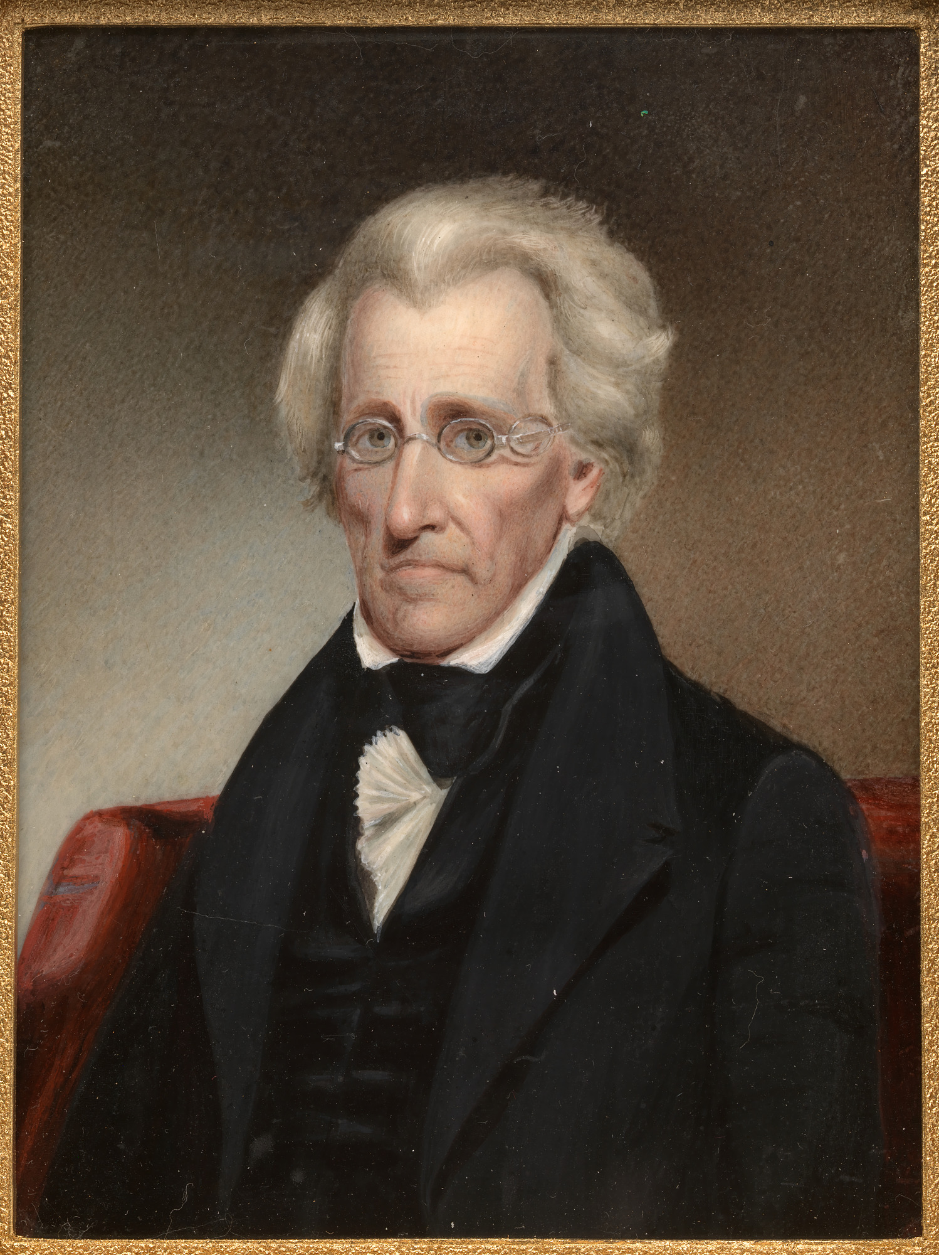
Andrew Jackson
& Populism in Early US
Founders’ fear of democracy
In 1828, Jackson’s broad appeal as a military hero won him the presidency. He was “Old Hickory,” the “Hero of New Orleans,” a leader of plain frontier folk. His wartime accomplishments appealed to many voters’ pride. Over the next eight years, he would claim to represent the interests of ordinary white Americans, especially from the South and West, against the country’s wealthy and powerful elite. This attitude would lead him and his allies into a series of bitter political struggles.

Slide 12
Jackson v.
Banking ‘Elite’
Nearly every American had an opinion about President Jackson. To some, he epitomized democratic government and popular rule. To others, he represented the worst in a powerful and unaccountable executive, acting as president with the same arrogance he had shown as a general in Florida.
The charter of the controversial national bank that Congress established under Alexander Hamilton’s financial plan had expired in 1811. But five years later, Congress had given a new charter to the Second Bank of the United States. Headquartered in Philadelphia, the bank was designed to stabilize the growing American economy. By requiring other banks to pay their debts promptly in gold, it was supposed to prevent them from issuing too many paper banknotes that could drop suddenly in value. Of course, the Bank of the United States was also supposed to reap a healthy profit for its private stockholders
The bank’s charter was not due for renewal for several years, but in 1832, while Jackson was running for reelection, Congress held an early vote to reauthorize the Bank of the United States. The president vetoed the bill.
Jackson’s bank veto set off fierce controversy. Opponents in Philadelphia held a meeting and declared that the president’s ideas were dangerous to private property. Jackson, they said, intended to “place the honest earnings of the industrious citizen at the disposal of the idle”—in other words, redistribute wealth to lazy people—and become a “dictator.” A newspaper editor said that Jackson was trying to set “the poor against the rich,” perhaps in order to take over as a military tyrant. But Jackson’s supporters praised him. Pro-Jackson newspaper editors wrote that he had kept a “monied aristocracy” from conquering the people.

Slide 13
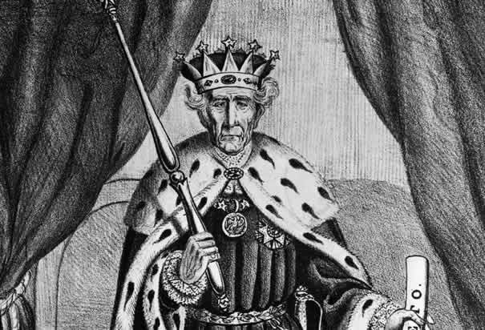
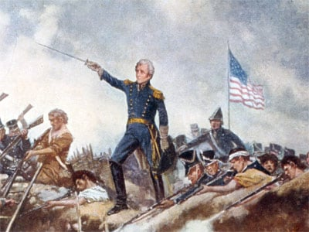
Jackson v.
Banking ‘Elite’ [2]
By giving President Jackson a vivid way to defy the rich and powerful, or at least appear to do so, the Bank War gave his supporters a specific “democratic” idea to rally around. More than any other issue, opposition to the national bank came to define their beliefs. And by leading Jackson to exert executive power so dramatically against Congress, the Bank War also helped his political enemies organize.
Increasingly, supporters of Andrew Jackson referred to themselves as Democrats. Under the strategic leadership of Martin Van Buren, they built a highly organized national political party, the first modern party in the United States. Much more than earlier political parties, this Democratic Party had a centralized leadership structure and a consistent ideological program for all levels of government. Meanwhile, Jackson’s enemies, mocking him as “King Andrew the First,” named themselves after the patriots of the American Revolution, the Whigs.

