Slide 1

PSC102
Just America

Slide 2
Monday
31 Oct 2022
Assignments –
  Writing
    L/A-5 due Friday,4 Nov, by midnight ET [dropbox will close] – outline/grading criteria posted on BlackBoard
    L/A4 Grades posted on BlackBoard
    Research paper question will be posted– paper due Wed, 16 Nov by midnight ET
C/E – Due Friday 5 Nov by midnight ET
NYU Brandemas Center Webinar:
"Presidential Records Act: From Nixon to Trump, How the PRA Preserves History," Thursday, 03 November, 2022 7 PM EDT - Register Here: https://nyu.zoom.us/webinar/register/WN_EqTey2-ZQ5G2LrTpu2yrLA

Slide 3

Last Class:
Substance
Populism: Typology – types at work in Palin’s VP run
C/A4 preview

Slide 4
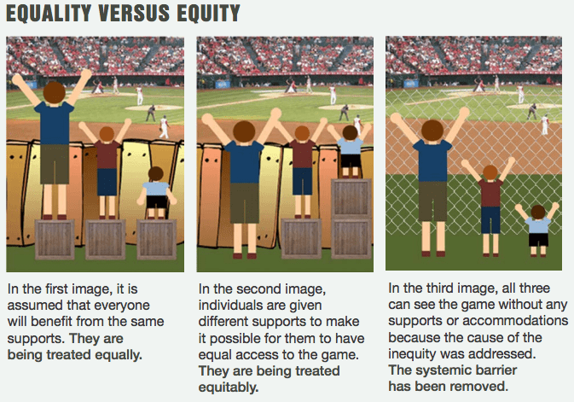
Justice
Distributive (determining who gets what)
Procedural (determining how fairly people are treated),
Retributive (based on punishment for wrong-doing)
and Restorative (which tries to restore relationships to "rightness.")

Slide 5
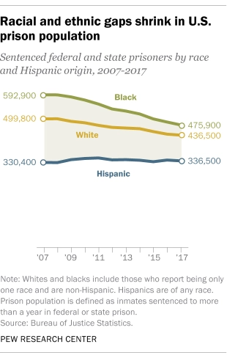
Black Lives
As of 2020, black families have a median household income of just over $41,000, whereas white families have a median household income of more than $70,000.
Blacks largest racial minority – 14.1% of population
2019 – 55% of murder victims black

Slide 6
Critical Race Theory
CRT does not define racism in the traditional manner as solely the consequence of discrete irrational bad acts perpetrated by individuals but is usually the unintended (but often foreseeable) consequence of choices. It exposes the ways that racism is often cloaked in terminology regarding “mainstream,” “normal,” or “traditional” values or “neutral” policies, principles, or practices. And, as scholar Tara Yosso asserts, CRT can be an approach used to theorize, examine, and challenge the ways which race and racism implicitly and explicitly impact social structures, practices, and discourses. CRT observes that scholarship that ignores race is not demonstrating “neutrality” but adherence to the existing racial hierarchy.
The originators of CRT include Derrick Bell, Kimberlé Crenshaw, Cheryl Harris, Richard Delgado, Patricia Williams, Gloria Ladson-Billings, Tara Yosso, among others. CRT transcends a Black/white racial binary and recognizes that racism has impacted the experiences of various people of color, including Latinx, Native Americans, and Asian Americans. As a result, different branches, including LatCrit, TribalCrit, and AsianCRT have emerged from CRT. These different branches seek to examine specific experiences of oppression. CRT challenges white privilege and exposes deficit-informed research that ignores, and often omits, the scholarship of people of color. CRT began in the legal academy in the 1970s and grew in the 1980s and 1990s.

Slide 7
Packer’s
Critique
Call this narrative “Just America.” It’s another rebellion from below. As Real America breaks down the ossified libertarianism of Free America, Just America assails the complacent meritocracy of Smart America. It does the hard, essential thing that the other three narratives avoid, that white Americans have avoided throughout history. It forces us to see the straight line that runs from slavery and segregation to the second-class life so many Black Americans live today—the betrayal of equality that has always been the country’s great moral shame, the heart of its social problems.
But Just America has a dissonant sound, for in its narrative, justice and America never rhyme. A more accurate name would be Unjust America, in a spirit of attack rather than aspiration. For Just Americans, the country is less a project of self-government to be improved than a site of continuous wrong to be battled. In some versions of the narrative, the country has no positive value at all—it can never be made better.
Again, he doesn’t approve of any one of these ‘Americas’
What’s the failing of
Just America?

Slide 8
Packer’s
Critique
II
Critical theory upends the universal values of the Enlightenment: objectivity, rationality, science, equality, freedom of the individual. These liberal values are an ideology by which one dominant group subjugates another.
All relations are power relations, everything is political, and claims of reason and truth are social constructs that maintain those in power. Unlike orthodox Marxism, critical theory is concerned with language and identity more than with material conditions.
In place of objective reality, critical theorists place subjectivity at the center of analysis to show how supposedly universal terms exclude oppressed groups and help the powerful rule over them.
Critical theorists argue that the Enlightenment, including the American founding, carried the seeds of modern racism and imperialism.
Elements of Free America’s privileging individual over community
Embrace Smart America’s meritocracy
Embrace Real America’s fear of them/system

Slide 9
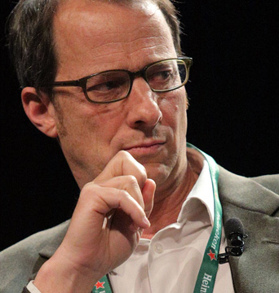
Unpacking
Packer
The self is not a rational being that can persuade and be persuaded by other selves, because reason is another form of power.
The historical demand of the oppressed is inclusion as equal citizens in all the institutions of American life. With identity politics, the demand became different—not just to enlarge the institutions, but to change them profoundly. When Martin Luther King Jr., at the March on Washington, called on America to “rise up and live out the true meaning of its creed: ‘We hold these truths to be self-evident, that all men are created equal,’ ” he was demanding equal rights within the framework of the Enlightenment. (In later years, his view of the American creed grew more complicated.)
But in identity politics, equality refers to groups, not individuals, and demands action to redress disparate outcomes among groups—in other words, equity, which often amounts to new forms of discrimination. In practice, identity politics inverts the old hierarchy of power into a new one: bottom rail on top. The fixed lens of power makes true equality, based on common humanity, impossible.

Slide 10
Packer’s
Target – Elite/Academics
By the turn of the millennium, these ideas were nearly ubiquitous in humanities and social-science departments. Embracing them had become an important credential for admittance into sectors of the professorate.
The ideas gave scholars an irresistible power, intellectual and moral, to criticize institutions in which they were comfortably embedded. In turn, these scholars formed the worldview of young Americans educated by elite universities to thrive in the meritocracy, students trained from early childhood to do what it takes to succeed professionally and socially. “It is a curious thing, but the ideas of one generation become the instincts of the next,” D. H. Lawrence wrote.
The ideas of critical theorists became the instincts of Millennials. It wasn’t necessary to have read Foucault or studied under Judith Butler to become adept with terms like centered, marginalized, privilege, and harm; to believe that words can be a form of violence; to close down a general argument with a personal truth (“You wouldn’t understand,” or just “I’m offended”); to keep your mouth shut when identity disqualified you from speaking. Millions of young Americans were steeped in the assumptions of critical theory and identity politics without knowing the concepts. Everyone sensed their power. Not everyone resisted the temptation to abuse it.

Slide 11
PoMo: Get it Straight
Postmodernity
Postmodernism
Descriptive – historical condition
Foucault/Lyotard: deny that they are part of a PoMo ‘movement’
Postmodernity describes the socio-politico-cultural-economic condition, values, or mood of society that is argued to exist after, or at least in reaction to Modernity, beginning roughly at the end of World War II. Where Modernity seeks to exude an attitude of optimism, prediction, control and progress, terms that it seeks to have understood as universally held and sought not just in the West but globally, the condition of Postmodernity is one of conflict, scepticism, fragmentation, and distrust of universal narratives and systems of authority
Normative endorsement; critique of Enlightenment
Baudrillard/Butler
Postmodernism represents an active critique of Modernity and its values and attitudes. Those that promote a position of Postmodernism generally argue that Modernity’s endorsement of humans using reason to remake nature in such a way as to support the pursuits of the individual free from oppressive societal and governmental control has either been rendered obsolete or has led to Modernity’s science and reason being employed to carry out genocide, near global environmental catastrophe, and the gutting of individual autonomy and replacing it with shallow individualism based upon instant consumptive gratification (Baudrillard; Butler). In this then, those endorsing Postmodernism welcome the collapse of Modernity’s overall narrative or mantra as a necessary corrective to Modernity’s excesses and pathologies

Slide 12
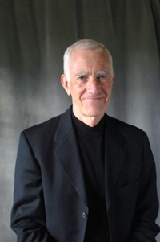
Borgmann
Postmodernity v. Postmodernism
Naked Public Square
Sullenness
Hyperactivity

Slide 13
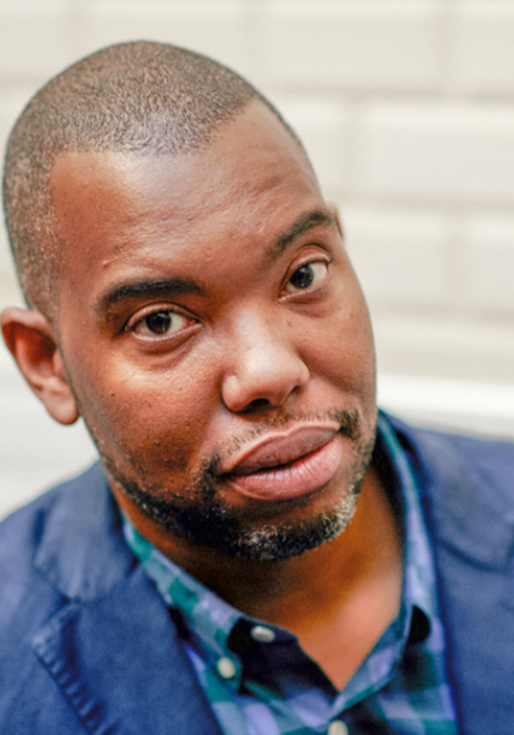
Coates
“White President”
Packer’s Critique
Essentializing – lack of discourse
For both Black and White
“When you construct an entire teleology on one cause—even a cause as powerful and abiding as white racism—you face the temptation to leave out anything that complicates the thesis.”

