Slide 1
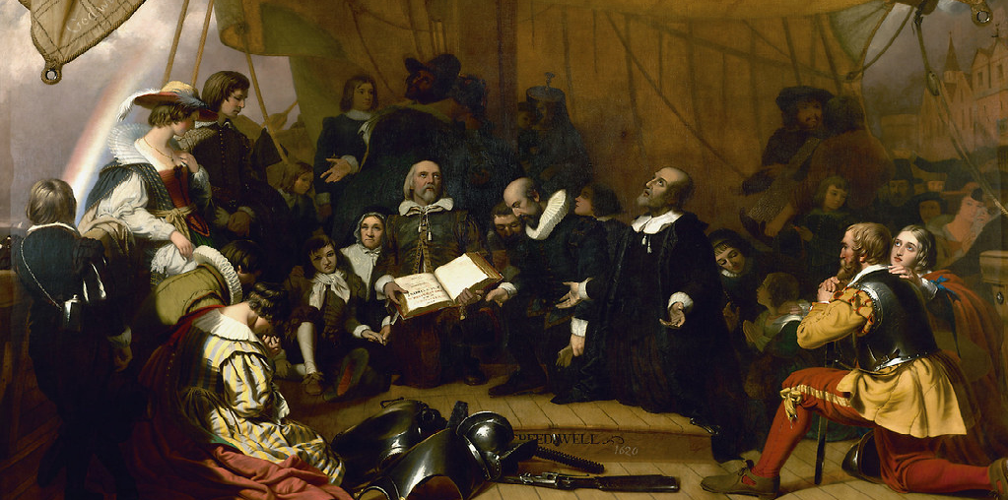
PSC102
Intro US Gov’t and Pol –
Free America

Slide 2

Monday
26 Sept 2022
Please, be sure cell phones are off
Assignments –
  Reading
    ReRead – Packer’s ‘Four Americas’ – Free America section
    Reading Module for Free America – selected works - all
  Writing L/A 2 due Friday, 30 Sept 2022, by midnight ET [dropbox will close] –outline/grading criteria posted on BlackBoard
Engagement Opportunity
  CFR – ZOOM Wed 1-2 pm – MidTerm Elections discussion - sign up by emailing cfracademic@cfr.org with their name, title, and academic affiliation

Slide 3

Last Class:
Substance
Statism & Modernity
Discursive America & Packer’s CQ in Four Americas

Slide 4
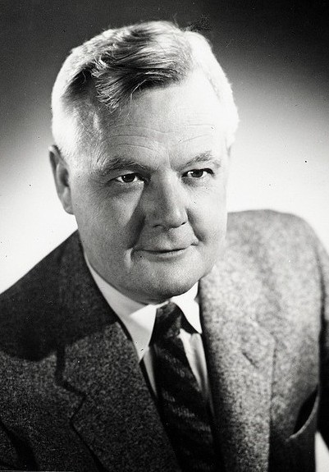
Great Man Theory?
Perry Miller and Shiny Cities
Perry Miller, a midcentury Harvard scholar of history and literature. From 1931 to 1963, as the scholar Michael Clark has summarized, Miller “presided over most literary and historical research into the early forms of American culture.” He helped establish the study of what he called “American Civilization,” contributing to the rise of a new discipline, American Studies.
Miller’s most lasting influence, however, came not from his overall study of the Puritans but from his assertions about one particular text. In deciding that “the uniqueness of the American experience” was fundamentally Puritan, Miller turned to the precise origin of America—the founding of Boston in 1630 with the arrival of John Winthrop he turned to the moment marked as an origin in a mostly forgotten text.

Slide 5
Perry Miller and
John Winthrop
That 1630 sermon by John Winthrop is now famous mainly for its proclamation that “we shall be as a city upon a hill.”
  Beginning in the 1970s, Ronald Reagan placed that line, from that sermon, at the center of his political career.
  Tracing the story of America from John Winthrop forward, Reagan built a powerful articulation of American exceptionalism—the idea, as he explained, “that there was some divine plan that placed this great continent between two oceans to be sought out by those who were possessed of an abiding love of freedom and a special kind of courage.” In 2012, American exceptionalism—as summarized by the phrase “city on a hill”—became an official plank in the platform of the Republican party.
Before Miller began his career, no politician referenced “A Model of Christian Charity” as the origin of America or sought national office by quoting, citing, or invoking it. Hardly anyone knew this sermon existed, and no one described the nation as a “city on a hill.”
  It wasn’t just Reagan who picked it up, either. After Miller, Winthrop’s text has been quoted by almost every president to hold office:
  John F. Kennedy, Lyndon Johnson, Richard Nixon, Jimmy Carter, Ronald Reagan, George H. W. Bush, Bill Clinton, and Barack Obama.

Slide 6
Why?
In the many years that history textbooks hit the market before Miller’s career, none made the coming of Winthrop’s ship a special beginning to American history, and none called the United States a “city on a hill.”
After Miller died, Winthrop’s sermon began spreading across textbooks at every level of schooling, so that by 2010 a new U.S. history textbook appeared taking “City upon a Hill” as its title.
According to Miller, the commitment to a higher cause and the dedication to God had made the Puritan community unusually successful, and the success of their venture—the wealth it generated—had eventually undermined the venture itself. When Puritans started making money, their purposes collapsed. “A hundred years after the landings, they were forced to look upon themselves with amazement, hardly capable of understanding how they had come to be what they were,” he wrote. They had lost sight of their cause and plan, their purpose and devotion. For Miller, the point of this failure was clear: The demise of the Puritans did not arise from external opposition; rather, it came about from within. It was caused by the Puritans’ own success.
Post WWII need for meaning

Slide 7

John Winthrop
https://www.americanyawp.com/reader/colliding-cultures/john-winthrop-dreams-of-a-city-on-a-hill-1630/
‘How to Approach Pol Theory’
  Central Question for Winthrop
  Human nature?
  Key Ideas
  How does this fit in with Free America
How does it fit in with your view?
How does it fit in with foundational elements discussed last week?
Future reading – how well does original fit with R. Reagan’s speech

Slide 8
Compare/Contrast
Liberalism
City on a Hill
Anti-elite & anti-traditional
Rational & self-interested
Individual prior to society
Negative freedom
Institutional arrangements to limit government intrusion into private sphere
Equality among all individuals
Trad ordering of rich and poor
  God’s plan
  Not a call for reordering
Use of reason to back faith
”the only way to avoid this shipwreck, and to provide for our posterity, is to … do justly, to love mercy, to walk humbly with our God. For this end, we must be knit together, in this work, as one man.”

