Slide 1
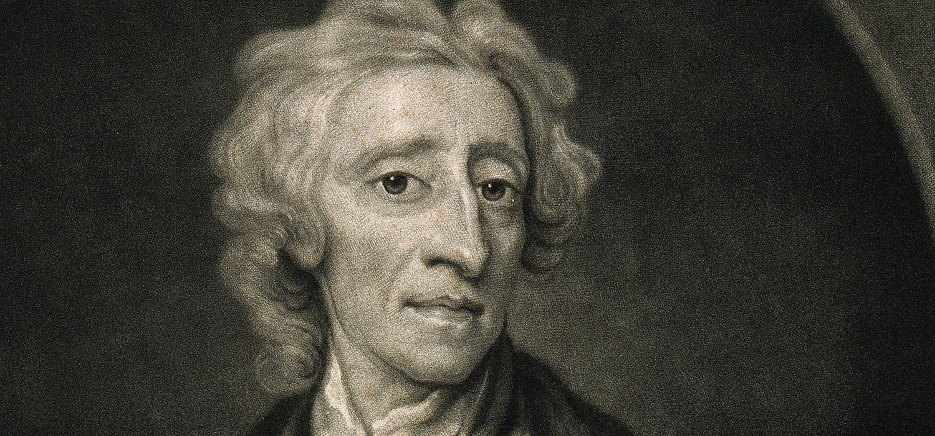
PSC102
Intro US Gov’t and Pol –
Free America B

Slide 2

Wednesday
28 Sept 2022
Please, be sure cell phones are off
Assignments –
  Reading
    ReRead – Packer’s ‘Four Americas’ – Free America section
    Reading Module for Free America – selected works – all
    Warning – “Corn Mutiny” in Locke .pdf – eek!
  Writing L/A 2 due Friday, 30 Sept 2022, by midnight ET [dropbox will close] –outline/grading criteria posted on BlackBoard
Engagement Opportunity
  CFR – ZOOM Wed 1-2 pm – MidTerm Elections discussion - sign up by emailing cfracademic@cfr.org with their name, title, and academic affiliation

Slide 3

Last Class:
Substance
Perry Miller and City on a Hill
WWII and need for ‘origin story’
Compare with
Classical li- beralism
Critical Thinking – how do we get from Winthrop to R/R with same language?

Slide 4
Compare/Contrast
Liberalism
City on a Hill
Anti-elite & anti-traditional
Rational & self-interested
Individual prior to society
Negative freedom
Institutional arrangements to limit government intrusion into private sphere
Equality among all individuals
Trad ordering of rich and poor
  God’s plan
  Not a call for reordering
Use of reason to back faith
”the only way to avoid this shipwreck, and to provide for our posterity, is to … do justly, to love mercy, to walk humbly with our God. For this end, we must be knit together, in this work, as one man.”

Slide 5
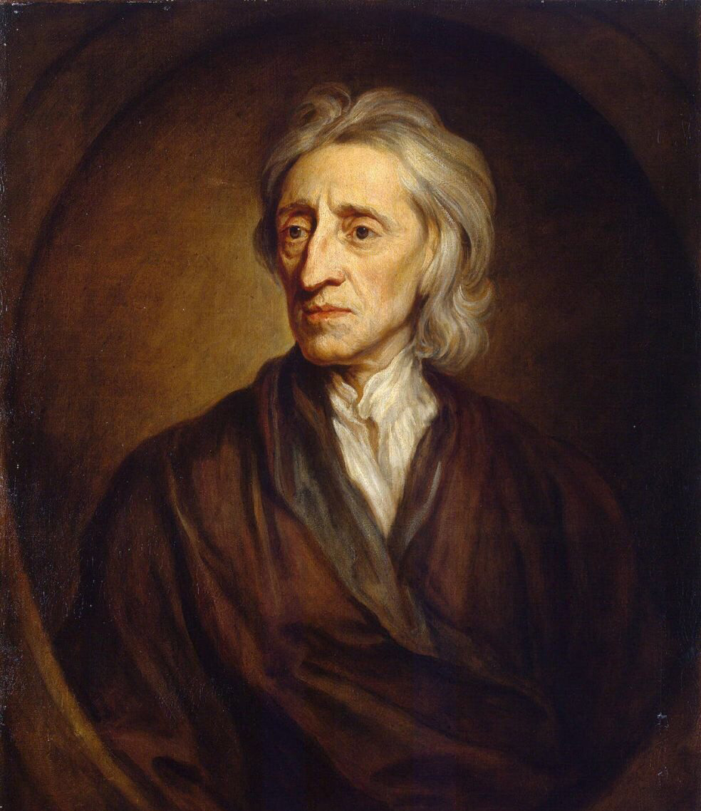
Locke:
Enlightenment
& Modernity
Thomas Jefferson: mankind has have “certain unalienable Rights, that among these are Life, Liberty and the pursuit of Happiness. — That to secure these rights, Governments are instituted among Men, deriving their just powers from the consent of the governed.”
The distinctive social and political philosophy of the Enlightenment enshrined liberty, so the system of thought that men developed to support and defend it became known as classical liberalism.
Importantly, however, this political philosophy did not originate with Jefferson or his contemporaries. As Jefferson wrote, “the object of the Declaration” was “not to find out new principles, or new arguments, never before thought of,” but rather “to be an expression of the American mind.” “[A]ll its authority,” he conceded, “rests then on the harmonizing sentiments of the day.”
And as he readily pointed out, one of the primary shapers of the American mind was John Locke. Locke (1632–1704) was at the forefront of Enlightenment thinkers who advanced an experimental, this-worldly approach to knowledge, science, and philosophy. Although he was not the first to advance a theory of natural rights, his defense of rights was the most systematic, clear, and comprehensive—and, consequently, the most influential.

Slide 6
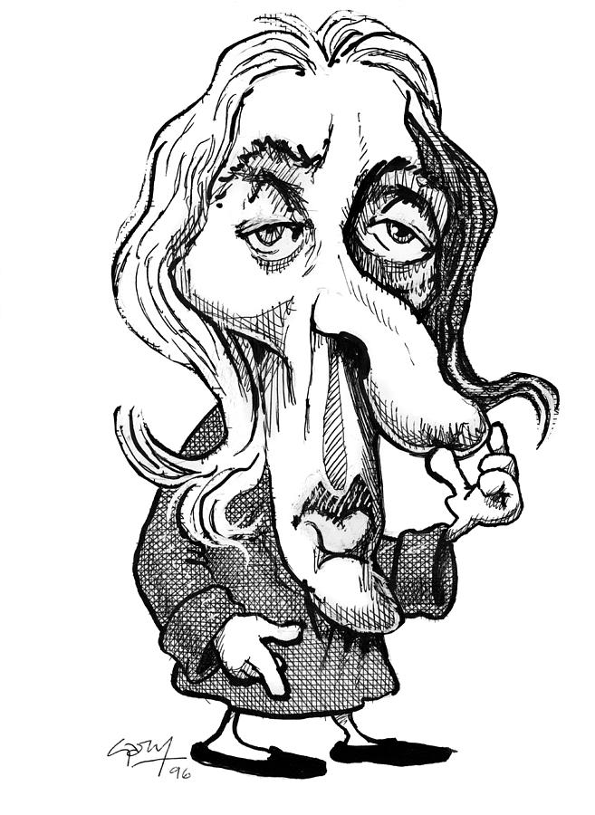
Locke
On Government
“The great and chief end, therefore, of men uniting into commonwealths, and putting themselves under government, is the preservation of their property; to which in the state of Nature there are many things wanting”

Slide 7
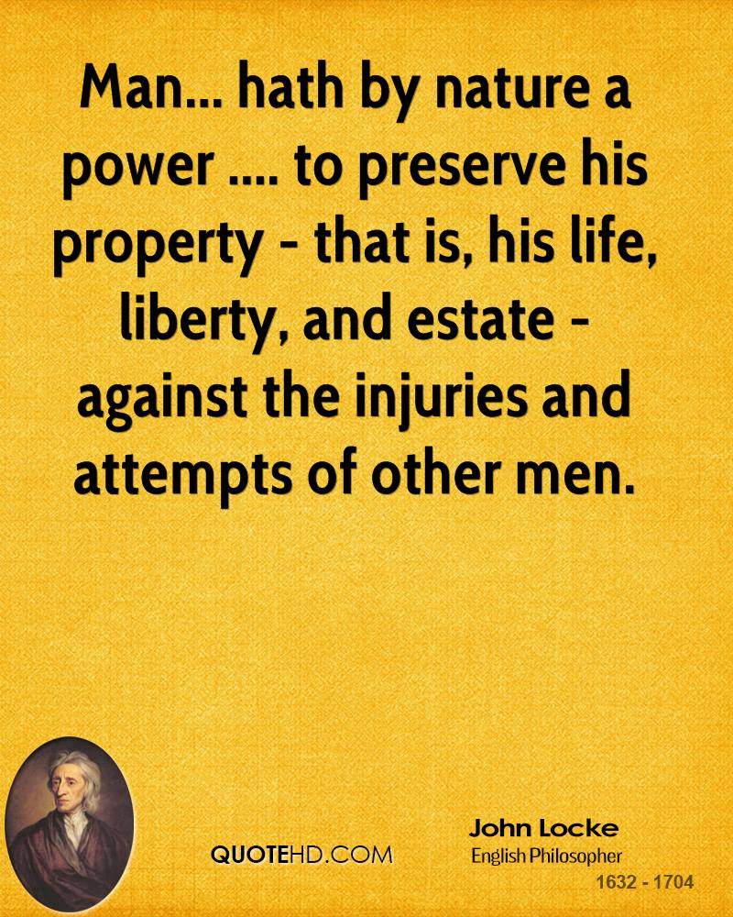
Locke
Natural Rights
Doesn’t want government enforcing huge natural moral code – limited to the following
  Life
  Liberty
  Estate
Night Watchman Gov’t
  Laissez-faire

Slide 8
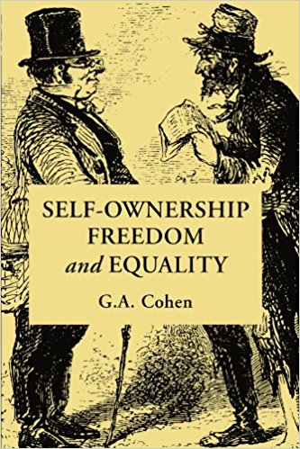
Property/Money/Labor
You have right to possess yourself: we own ourselves (central liberal argument): no one has right to tell me how to think or behave
Life and liberty self evident in natural law argument: property not as self evident
Needs to establish self-ownership and that which I acquire through my labor is indeed mine (Chapter 5) – my labor creates ownership

Slide 9
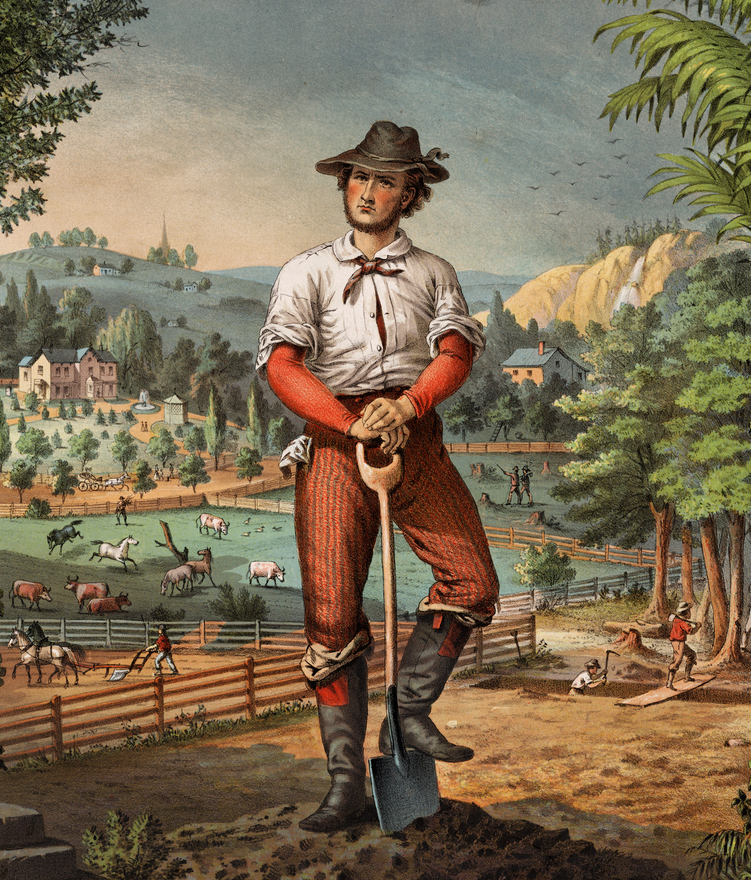
Property/Money/Labor
Locke impressed with the bounty that labor provides for mankind
Where 10 acres of uncultivated land provides me with enough nourishment, 1 acre cultivated provides enough nourishment for many
Humans realize that settled agriculture makes more sense and people start enclosing property

Slide 10



Property/Money/Labor
Crucial precondition for Locke for this to work
Holding of unequal property will be accepted
Benefit of private property and money: doesn’t help just me – helps others and avoids spoilage
Problem presented by spoilage

Slide 11

Disadvantages to life in the state of nature
All may have reason, but
  The law governing the state of nature (reason) is necessarily simple and may therefore be open to dispute
  People make poor judges in their own cases

Slide 12

Locke on Government
Point of government then is to remedy these disadvantages: legitimate government consents to do the following
  Government should then provide effective enforcement: executive branch
  Government ought to provide comprehensible legislation: legislative branch
  Government ought to provide impartial adjudication: judicial branch

Slide 13
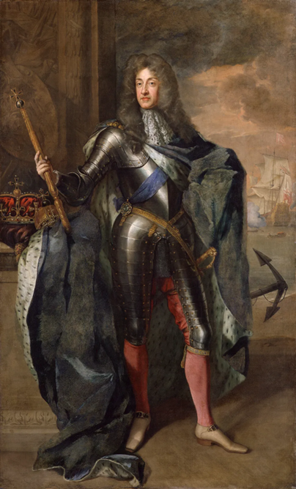
Consent and Government
Absolute ruler (English monarchy) not legitimate according to Locke because he acts in own self-interest (i.e. monarchy is corrupt)
Need for:
Consent
Minimal state

Slide 14
Locke
Limited Gov’t
But though men when they enter into society give up the equality, liberty, and executive power they had in the state of Nature into the hands of the society, to be so far disposed of by the legislative as the good of the society shall require, yet it being only with an intention in every one the better to preserve himself, his liberty and property (for no rational creature can be supposed to change his condition with an intention to be worse), the power of the society or legislative constituted by them can never be supposed to extend farther than the common against those three defects above mentioned that made the state of Nature so unsafe and uneasy.
And so, whoever has the legislative or supreme power of any commonwealth, is bound to govern by established standing laws, promulgated and known to the people, and not by extemporary decrees, by indifferent and upright judges, who are to decide controversies by those laws; and to employ the force of the community at home only in the execution of such laws, or abroad to prevent or redress foreign injuries and secure the community from inroads and invasion. And all this to be directed to no other end but the peace, safety, and public good of the people...

